Slide 1
Workplace Stress & Burnout:
Mindfulness, an Amazing Antidote
Karin E. Baughman, DNP, APRN, PMHNP-BC
Notes:
I used to think workplace stress and burnout were an inevitable part of working-kind of like driving in traffic- something that had to result in a level of fatigue and smoldering rage, then I found an amazing elixer, Mindfulness, a truly amanzing antidote to the stressors we each face daily in our workplaces. I am hopeful and confident what I come to share today can make a difference for you as it has and is for me.

Slide 2
Objectives
Brainstorm sources of stress in your workplace
Identify symptoms of workplace stress
Define burnout related to workplace stress
List symptoms experienced by those suffering from burnout
Describe three components of mindfulness
Explore outcomes associated with mindfulness
Participate in mindfulness exercises
Notes:
Here’s what we will be covering in our brief time together: Let’s get started so we have time to practice before we conclude.

Slide 3

Close your eyes and picture yesterday at your workplace…
Notes:
Warning: The following exercise could be traumatizing for some…
For those of you WFH (working from home), has it/was it, any better in your sweats?

Slide 4
What are sources of workplace stress?
Notes:
2-min think, pair, share- for the next couple of minutes think privately for the first minute, then pair up and share about the current sources of workplace stress you experience on a regular basis-

Slide 5
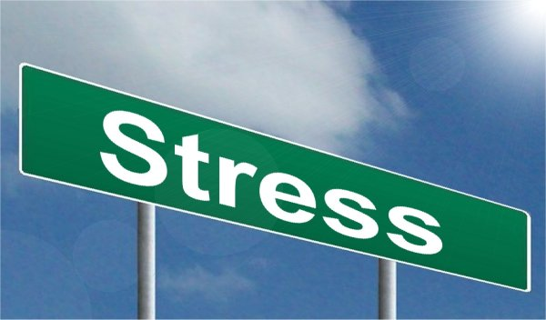
How did you identify its presence?
Notes:
We don’t need a sign to point it out, the evidence is everywhere: what are the indicators where you work?

Slide 6
Research supports what you know
69% say work is a stressor (APA, 2011)
Turnover and staffing issues (Hayes, 2012)
Quality and safety issues (Aiken et al., 2012)
Higher rates of illness/workplace injury (Ayes et al., 2003)
Compassion fatigue and burnout (Sabo, 2011)
Notes:
These are cascading effects of unaddressed workplace stress as shown in research. You have identified many of these. Which are currently a priority in your workplaces? How are they affecting internal/external customer service, quality of care, budgetary issues?

Slide 7

How is burnout different?
“To be burned out means you were once on fire.” Jesse Wilson, RN, MSN
Emotional exhaustion
Depersonalization
Reduced feelings of accomplishment
Result of chronic exposure to environmental stressors
Person/job mismatch
Common in “people work”
Notes:
The “emotional labor” of work is high in helping professions and difficult to measure

Slide 8
What happens when we quit caring?
Notes:
Do you see it in your workplace? What is the end result? I heard about a nurse throwing PA’s (prior authorizations in the trash) instead of taking action of them, thus delaying client’s needed access to life-saving medications. Other delays in therapeutic responses to phone calls, “phoning it in” w/o a high level of engagement – the lack of engagement takes its toll on our interactions w/ clients in all types of settings as well as w/ our coworkers and is highly contagious in an organization

Slide 9
Compassion Fatigue …
Suggests a therapeutic relationship exists
Secondary trauma
Stress results
Emotional labor
Burnout is suggested to be a precursor
Amenable to treatment
Notes:
An extension of burnout often associated with helping professions. The pandemic has stretched many of our helpers to a dangerous point of emotional and physical fatigue. The things they have witnessed and heard have caused trauma, secondary stressors and the emotional labor of trying to care for families who are hurting, grieving, and in many cases unable to be with their loved ones, has caused another level of pain/draining their reserves, leading to burnout and compassion fatigue as their storehouses are utilized daily w/o replenishment. The good news, this ailment is fixable.

Slide 10
Mindfulness as an Antidote
Notes:
There is good news, among several cures widely available, at a minimal or no cost to absolutely anyone, mindfulness is one possible antidote!

Slide 11
What is Mindfulness?
The awareness that rises when we pay attention, on purpose, in the present moment non-judgmentally (with kindness and curiosity) - Dr. Jon Kabat-Zinn – he is the founder of Mindfulness-based Stress Reduction (MBSR). (1990)
A mental state achieved by focusing one's awareness on the present moment, while calmly acknowledging and accepting one's feelings, thoughts, and bodily sensations, used as a therapeutic technique.
Notes:
These definitions are provided by one of the west’s leading experts on the subject. Let’s watch this you tube video as Jon Kabat-Zinn, himself, captures the bare essence of mindfulness. Watch with me:

Slide 12

Presence of Heart
(Kabat-Zinn. (2010).

Slide 13

Three Components Of Mindfulness
On Purpose
In the Present Moment
Non-judgmentally
https://unsplash.com/
Notes:
Within the Kabat-Zinn’s definition are contained 3 components:

Slide 14
On Purpose
Conscious and deliberate direct attention
Mindfully “awake” and aware of our current set up and surroundings
Living more consciously helps us become more aware of ourselves/others
Our attention is immersed in the present
Notes:
Intentionality helps to summarize this aspect of mindfulness.

Slide 15
In the Present Moment
Our mind habitually wanders, rarely present in the moment
Mindful awareness is experienced when we let go of distractions
Our attention is held when we stop and accept what is here and now
Notes:
“Someone once said, the past is history, tomorrow is a mystery, today is the present, that’s why it’s called ‘a gift.’” Learning to be fully available and in to the present moment is challenging work but with great return for our efforts. We feel more fully and experience a greater richness of all life’s big and little moments.

Slide 16
Non-Judgmentally
Increase awareness of mind chatter
Attend to experiences without judging or labelling them as +/-
Become a watcher of perceptions, thoughts and emotions without getting caught up in them
Watching in this way offers choice and freedom
Notes:
A small example of this, I have tried (and not yet succeeded) in practicing – is with the weather. My tendency is to say, “It’s sunny, that’s good, it’s rainy, that’s bad.” I am working to just “attend” to the weather without judging it… a growing edge for sure. Another for many of us, is our impatience- for example- our gardens. Can we just sit in our gardens, w/o trying to rush the next stage or “work” the garden, w/ emphasis placed upon productivity and work w/i the garden? Most, I feel sure are like me, most of the time, deadheading, watering, weeding, not just “soaking up, enjoying, smiling” at the beauty of the wonderful eyecandy created by earlier work, but instead of judging this present state of impatience, notice, w/o judgement and grow toward a new place of enjoyment/rest

Slide 17
7 Attitudes of Mindfulness
Non-Judging
Patience
Beginner’s Mind
Trust
Non-Striving
Acceptance
Letting Go (Kabat-Zinn, 1990)
Notes:
Finally, Kabat-Zinn summarizes these 7 attitudes of mindfulness, helpful when attempting to wrap one’s head/heart around the practice.

Slide 18
Benefits of Practicing Mindfulness
Reduced stress, anxiety and other destructive emotions (Wongtongkam, et. al, 2017)
Reduced depression and insomnia (Goyal, et. al, 2014)
Improved focus and memory (Moore, Gruber, Derose, & Malinowski, 2012)
Increased compassion and emotional resilience (Marsh, 2014)
Creates clearer thinking, decreased emotionally reactive responses (Goleman & Davidson, 2017)
Notes:
I have added some additional resources since sending these slides in, one is : Altered Traits by Daniel Goleman & Richard J. Davidson (2017). The use of fMRI’s to study the brains of those who meditate compared with those who don’t has helped capture exciting data. Dad Siegel, who has studied brain imaging, meditation, and neural plasticity, states, “The brain is using the mind to create itself.” In other words, “The way we pay attention affects neural plasticity” according to Goleman & Davidson (2018)

Slide 19
Benefits of Practicing Mindfulness
Increased connection with others (Marsh,2013)
Reduced loneliness and increased social contact (Lindsay, et al, 2019)
Decreased pro-inflammatory cytokines, increased telomerase (Goleman & Davidson, 2017)
Increased neural plasticity, decreased brain atrophy (Siegel, 2007)
Notes:
I have added some additional resources since sending these slides in, one is : Altered Traits by Daniel Goleman & Richard J. Davidson (2017). The use of fMRI’s to study the brains of those who meditate compared with those who don’t has helped capture exciting data. Dad Siegel, who has studied brain imaging, meditation, and neural plasticity, states, “The brain is using the mind to create itself.” In other words, “The way we pay attention affects neural plasticity” according to Goleman & Davidson (2018)

Slide 20
What does research show?
Pro’s
Con’s
Mindfulness Research Methodology Improving (Goldberg et al., 2017)
MBCT improved depression, anxiety, emotional regulation in those with BPD (Bojic & Becerra, 2017)
MBSR helpful in treating BED (Kristeller, Sheets, & Wolever, 2013)
Caregiver’s helped by MBSR (see ref. list)
Help for those with Diabetes and CAD (Keyworth, Knopp, & Roughley, 2014)
Possible reporting bias in RCTs using MBSR (Coronado-Montoya et al., 2016)
Drop out rates (Grossman et al., 2003)
Homework required for full benefits (Pipe, et al., 2009)
“Practice makes perfect”
Modifications of MBSR make it hard to quantify (Grossman, 2004)-
Glossary-MBCT-mindfulness-based cognitive therapy, BPD –bipolar disorder, MBSR-Mindfulness-Based Stress Reduction, BED-binge eating disorder, CAD-coronary artery disease, RCT-randomly controlled trials
Notes:
There have been many issues with the quality of research conducted with mindfulness, limiting the usefulness/broader scientific application of the currently known findings. On this slide some of those limitations are noted. There are improvements in this area emerging.

Slide 21
Practicing Mindfulness at Work
Stop and take at least 3 deep breaths when you feel stressed.
Try to take uninterrupted breaks to refocus and or stretch.
Practice a walking meditation, simply slow down your pace & notice the ground against your feet.
Participate in mindfulness offerings such as yoga, stress reduction or meditation classes.
Utilize resources such as Mindfulness Based Stress Reduction program developed by John Kabat-Zinn PhD.
Utilize meditation apps such as: The Mindfulness App, Get Some Headspace, Breathe2Relax, Calm, or MINDBODY Connect.
Notes:
Stretching-my favorite-YWTA every body say, and stretch and breathe- to Y W T A –you want to feel amazing
Breathing-3 breaths-1-notice what’s happening in your body, 2-notice what you are feeling, 3rd breath ask what’s the most important thing right now? One body, One heart,One Mind (Marc Lesser-7 Practices of a Mindful Leader, 2019)

Slide 22
Let’s Practice

Slide 23

Breathing Changes Brain Chemistry
Progressive Muscle Relaxation
Four Square Breathing
Inhale,2,3,4
Hold,2,3,4
Hold,2,3,4
Exhale,2,34
Repeat,2,3,4
Notes:
Just last week and nearly every week, I have an opportunity to teach these simple exercises to clients who come to my outpatient mental health setting. They are often anxious at the time, we just simply start and do it together experientially so they can feel a difference , in the moment and have the guided practice with me to follow along on a hand out I provide before leaving my office. Let’s do these together now.

Slide 24
Grounding Exercises
5-see
4-touch
3-hear
2-smell
1-taste
Notes:
This is one of my all time favorites: So helpful to use when someone is “in their head” and needs to get out for a moment: Using one’s senses allows them to get a bit more grounded in order to allow breathing, CBT, or other coping to become more effective.

Slide 25
Increase Awareness: Remember
S: STOP
T: Take 3 breaths
O: Observe Sensations, Emotions, Thoughts
P: Proceed in a more modulated, less reactive, more responsive way
(National Wellness Institute, 2015)
Notes:
This is another favorite. I encourage placing small red stop signs around their homes and using natural stop signs to provide visual cues when driving to do the same.

Slide 26
Mindful Meditation
Sit or lie comfortably.
Close your eyes…If you feel safe doing so
Make no effort to control the breath; simply breathe naturally.
Focus your attention on the breath and on how the body moves with inhalation and exhalation.
Try Freeman 21 day meditation challenge https://www.freemanhealth.com/mind-your-wellbeing
Use CALM – 1 minute breather

Slide 27


1-minute Take a breather
Count your breath
  Inhale 1-2-3
  Pause
  Exhale longer 1-2-3-4-5
Aware of this moment
  What do you notice from all 5 senses?
  What do you notice in your body? Tension? Holding a certain posture? Something else?
  Where are your thoughts? Past events? Future tasks?
  What are your emotions right now?
  Name what you notice. E.g. “This is fear.” “This is sound.”
Let it be, let it go
  Simply observe whatever you notice, without trying to change it.
  Send yourself some kind and non-judgmental self compassion if this moment is a difficult one.
    See if you can make space for whatever you are feeling to be there without making yourself wrong.
    Remember that we all face difficulties in life sometimes; you are not alone. What would you say to a friend in the same situation?
  Think of something you are grateful for right now.
Move mindfully
  Take a moment to stretch your body or stand up from your desk.
  Move mindfully into your next task, being truly present.
Notes:
The CALM pneumonic above is a copyrighted tool developed by our HEAL team. We rolled it out a year ago system wide with mouse pads, rubber wrist bands, magnetic stick ons, posters, etc. Media blasts were provided on our morning line up to help staff understand how to utilize it, managers were given bundles of the materials with instructions on how to distribute them. We are re-introducing the materials again this spring. We have also shared the materials with some of our corporate clients who utilize our health system as their preferred health care provider. Let’s take a moment to, “BE CALM” together now.

Slide 28
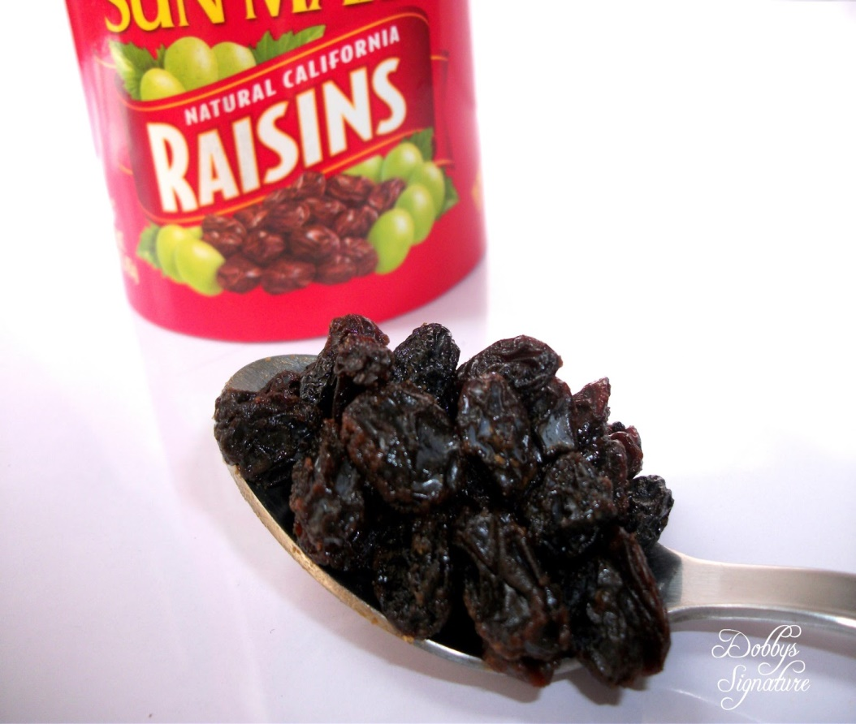
Mindful Eating
(Pratt, 2019)

Slide 29

Loving Kindness Meditation:
“Just Like Me” (Salzberg, 2014)
Notes:
This exercise can be formal or informal, we will practice a formal one, from Sharon Salzberg (2014) p.101. Moving from Me to We helps increase empathy, compassion for others, maybe even “difficult others” in our lives. We can use it when driving to work, when we are at work, with coworkers, challenging clients, at the DMV etc.
Close your eyes and picture one person for who you would like to feel increased compassion. Repeat along with me:
This person has a body …just like me
This person has feelings, emotions, and thoughts, just like me

Slide 30
Summary
Interventions to address the unmitigated effects of workplace stress are necessary. Cascading effects of unaddressed stress include burnout and compassion fatigue. Turnover , illness, injury, and quality/safety issues are also associated outcomes. Mindfulness is an inexpensive, easy to learn, readily available intervention with strong evidence of success in many settings.

Slide 31

Mindful Discussion….

Slide 32
References
Adler, C. Harris, D., & Warren, J. (2017). Meditation for fidgety skeptics. New York: Spiegel & Grau
American Psychological Association. (2011). Stress in the workplace survey summary. Retrieved 05/21/2018 from https://www.apa.org/news/press/releases/phwa-survey-summary.pdf
Beach, M. et al. (2013). A multicenter study of physician mindfulness and healthcare quality. Retrieved 05/28/2018 from https://www.ncbi.nlm.nih.gov/pubmed/24019273
Bradt, S. (2010). Wandering mind not a happy mind. Retrieved 05/28/2018 from https://news.harvard.edu/gazette/story/2010/11/wandering-mind-not-a-happy-mind/
Chaskalson, M. (2011). The mindful workplace. Developing resilient individuals and resonant organizations with MBSR. West Sussex, UK: Wiley
Dane, E., Brummel, B. (2014). Examining workplace mindfulness and its relations to job performance and turnover intention. Retrieved 05/28/2018 from http://journals.sagepub.com/doi/10.1177/0018726713487753
Goyal,M. et al. (2014). Meditation programs for psychological stress and well-being. Comparative Effectiveness Review No. 124. (Prepared by Johns Hopkins University Evidence-based Practice Center under Contract No. 290-2007-10061–I.) AHRQ Publication No. 13(14)-EHC116-EF. Rockville, MD: www.effectivehealthcare.ahrq.gov/reports/final.cfm.
Goleman,D. & Davidson, R. (2017). Altered traits: Science reveals how mediation changes your mind, brain, and body. New York: Avery.
Grepmair, L., Mitterlehner, F., Loew, T, Bachler, E. Rother, W. & Nickel, M. (2007). Promoting mindfulness in psychotherapists in training influences the treatment results of their patients: a randomized, double-blind, controlled study. Retrieved 05/28/2018 from https://www.ncbi.nlm.nih.gov/pubmed/17917468
Harris, R. (2007). The happiness trap: How to stop struggling and start living. MA: Shambala Publications.
Haupt, A. (2016). Mindfulness in schools: When meditation replaces detention. Retrieved 05/21/2018 from http://health.usnews.com/wellness/mind/articles/2016-12-08/mindfulness-in-schools-when-meditation-replaces-detention
Kabat-Zinn, J. (1990). Full catastrophe living: Using the wisdom of your body and mind to face stress, pain and illness. New York, NY: Dell
Kabat-Zinn, J. (2010). Retrieved 01/27/2018 from https://youtu.be/xoLQ3qkh0w0
Kravits, K., McAllister-Black, R., Grant, M., & Kirk, C. (2010). Self-care strategies for nurses: A psycho-educational intervention for stress reduction and the prevention of burnout. Applied Nursing Research, 23, 130-138, DOI:10.1016/j.apnr.2008.08.002
Lindsay, K., Young, S, Warren Brown K., Smyth, J., & Creswell J. (2019). Mindfulness training reduces loneliness and increases social contact in a randomized controlled trial. Retrieved 02/15/2019 from https://wwwpnas.org/content/early/2019/02/05/1813588116
Marsh, J. (2013). How to train the compassionate brain. Retrieved 05/28/2018 https://greatergood.berkeley.edu/article/item/how_to_train_the_compassionate_brain

Slide 33
References Continued
May,M. (2009). Eat what you love, love what you eat. Austin, TX: Greenleaf Book Group Press
Moore, A., Gruber, T., Derose, J. & Malinowski, P. (2012). Regular, brief, mindfulness meditation practice improves electrophysiological markers of attention control. Retrieved 05/28/2018 from https://www.ncbi.nlm.nih.gov/pubmed/22363278/
n.a. (2018) Freeman Health System-21-day mindfulness challenge. Retrieved from https://www.freemanhealth.com/blog/mindful-meditation
n.a. (2016). Mindful health and safety in the workplace research. Retrieved 05/21/2018 from https://www.ehs.uci.edu/gensafe/Mindful_Safety.html
n.a. (2019). Mindfulness at work for less than $40. Retrieved 02/16/2019 from https:// . Entrepreneur.com
n.a. (n.d.) Retrieved 05/21/2018 from https://en.oxforddictionaries.com/definition/mindfulness
n.a. (2017). https://www.youtube.com/watch?v=-Ps1zVnvYdw
O’Brien, M. (n.d.). What is mindfulness and what does it mean to you? Retrieved 05/28/2018 from https://mrsmindfulness.com/what-is-mindfulness/
Pratt, K. (n.a.) Mindful eating exercise. Retrieved 03/04/2019 from htts://healthypsych.com/mindful-eating-exercise/
Purewal, N. & Petriw,K. (2018). Let that sh*t go. Toronto, Ontario: Harper Collins.
Sabo,B. (2011). Reflecting on the concept of compassion fatigue. Online Journal of Issues in Nursing, 16(1),1 DOI: 10.3912/OJIN.Vol16No01Man01
Salzberg, S. (2014). Real happiness at work. NewYork: Workman.
Schafer, W. (1987). Stress management for wellness. New York: Holt, Rinehart, & Winston.
Siegel, D. (2007). The mindful brain: Reflection and attunement in the cultivation of wellbeing. New York: W. W. Norton
Stahl, B. & Goldstein, E. (2010). A mindfulness-based stress reduction workbook. Oakland, CA: New Harbinger Publications.
Sternberg, L. & Reising, H. (2015). Bringing mindfulness to corporate and community wellness: NWI webinar. Retrieved 05/21/2018
Stokowski,L. (2014). When nurses need nursing: The toll of emotional labor. Retrieved May 05/21/2014 from http://www.medscape.com/viewarticle/824689
Wongtongkam, N. , Krivokapic-Skoko, B. ,Duncan, R. & Bellio, M. (2017).The influence of a mindfulness-based, 134-143, DOI: 10.1080/14623730.2017.1316760
Yoder, E. (2010). Compassion fatigue in nurses. Applied Nursing Research 23, 191-197. DOI 10.1016/j.apnr.2008.09.003

