Slide 1
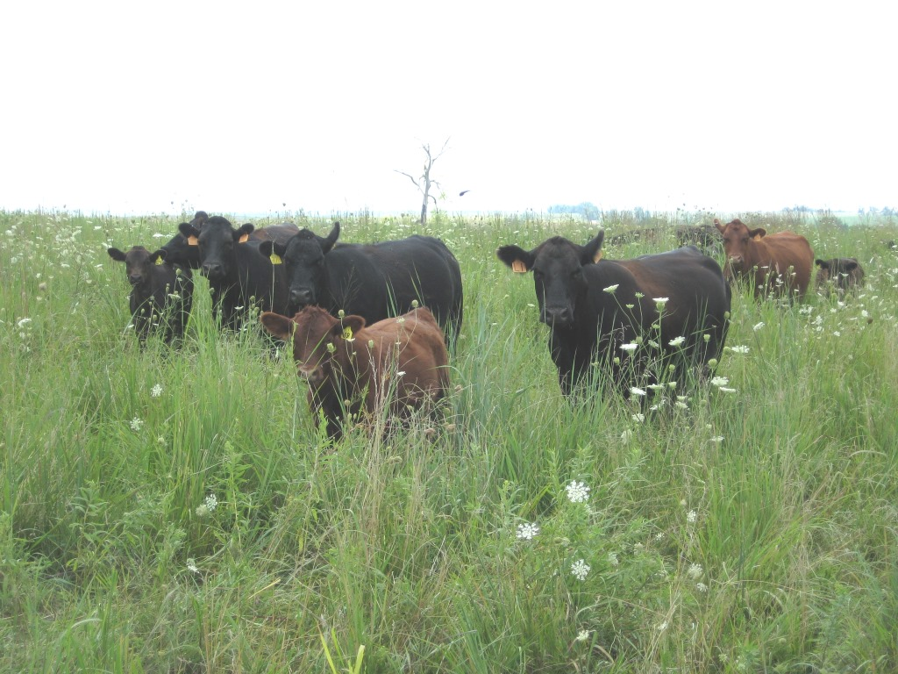

Native Forages for
Livestock and Wildlife

Slide 2
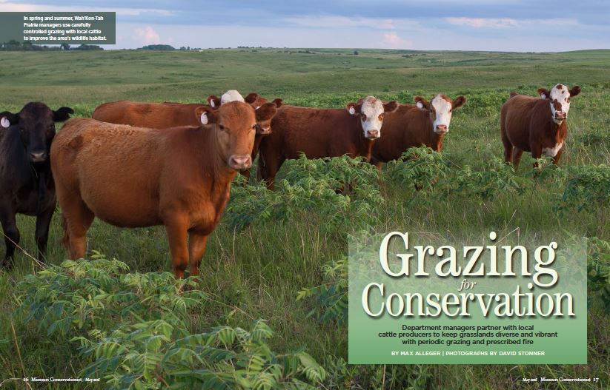
Notes:
You may be wondering why the Missouri Dept of Conservation is interested in grazing. We have learned enough about the benefits of grazing to wildlife that we have greatly increased grazing on our Conservation Areas – hopefully some of you saw this article in the Missouri Conservationist magazine a couple years ago.
We are not only encouraging more well-managed grazing on public land, but we are also looking for ways to help landowners improve habitat on working farms. . . Which brings us to this new partnership with MU Extension and NRCS.

Slide 3
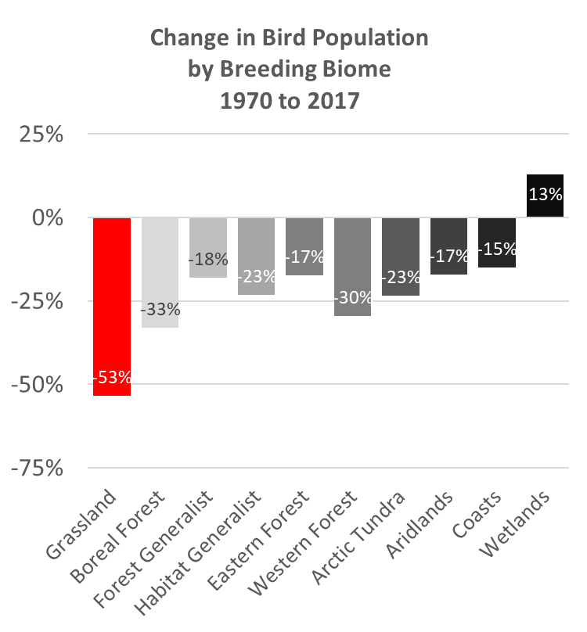
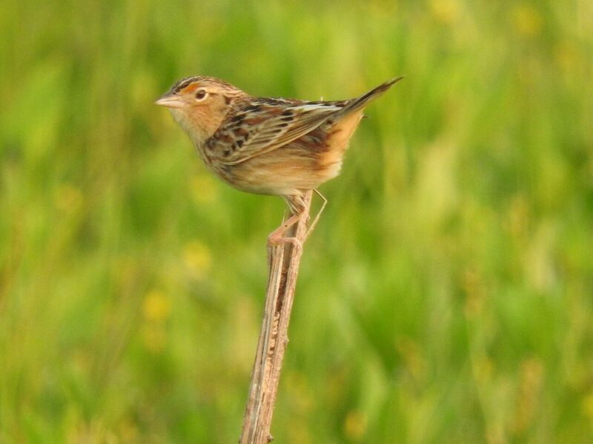

Alarming Declines
    Grassland birds have declined more than any group of birds.
    >50% decline in 50 years
    .
MRBO Photo
Notes:
The alarming decline of grassland birds has driven our renewed interest in grazing management and native forages.
Birds inhabiting open land habitats have been in steep decline for a half century. This slide shows Breeding Bird Survey population trends for from 1970 through 2017 for groups of birds by their principle habitats.

Slide 4
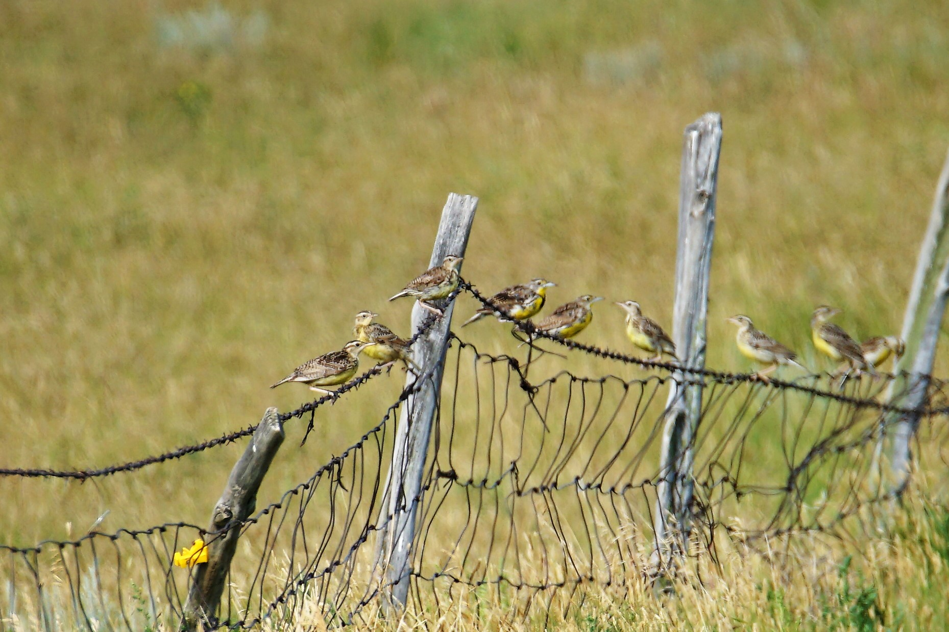
Some common birds are in steep decline
  Populations of several grassland species are projected to decline by half in the next 20-25 years.

Slide 5
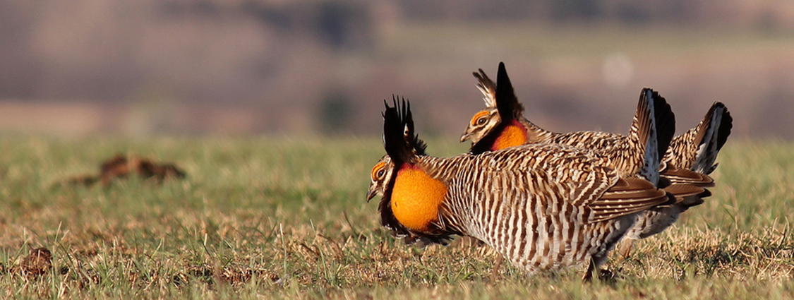
Some of the least adaptable species are disappearing altogether

Slide 6
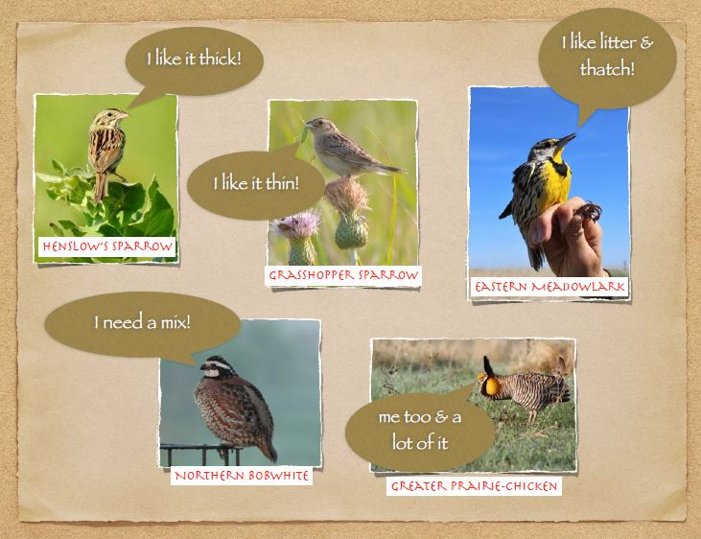
Notes:
One type of grassland can’t meet the needs of all these declining birds

Slide 7



Most Missouri grasslands provide only the habitat extremes
Public Land
& CRP
Fescue Pasture
Notes:
All or nothing

Slide 8
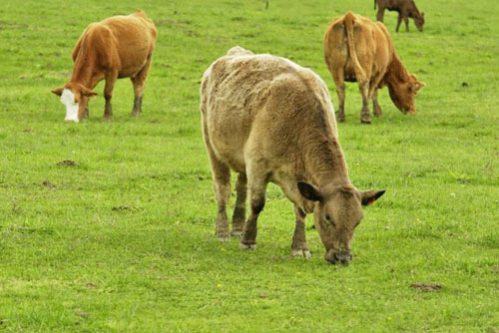
Notes:
We can all agree there is too much of this in Missouri

Slide 9
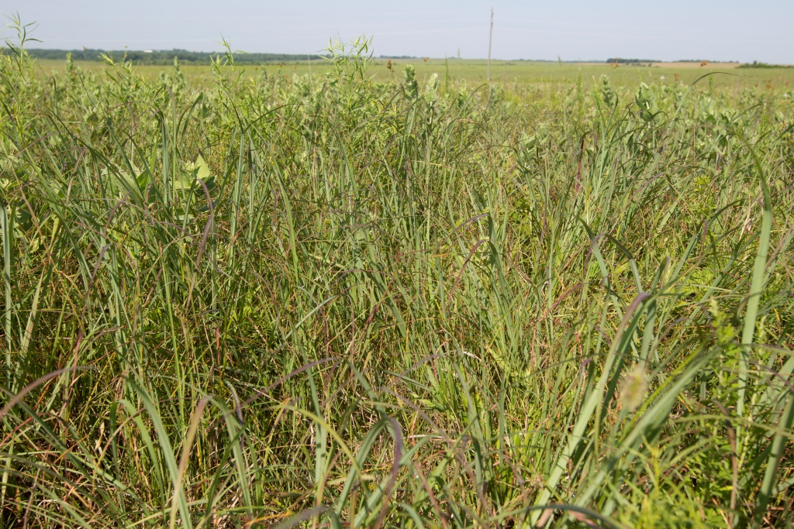
Notes:
Wildlife managers would also say that we have too much of this
Rank, undisturbed grass-dominated grasslands are not much better than chronically overgrazed pasture

Slide 10
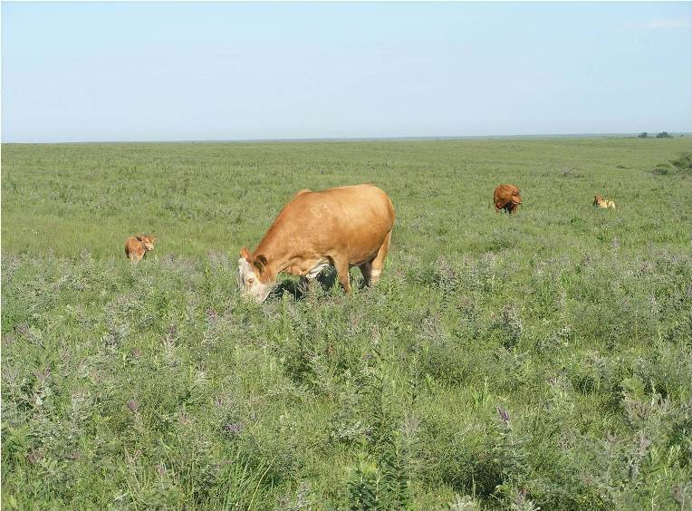
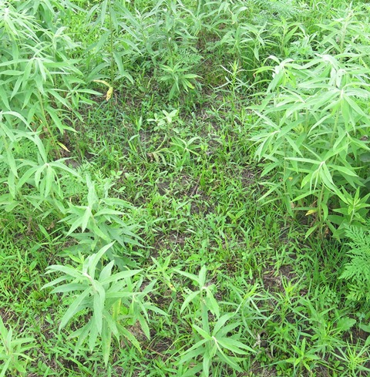
Grazing is a flexible management tool
Notes:
We have come to see grazing as a uniquely helpful management tool because it gradually removes dominant grasses and sculpts the vegetation to provide a nearly ideal mix of short, tall, dense and sparse cover at a scale that is useful to wildlife.

Slide 11
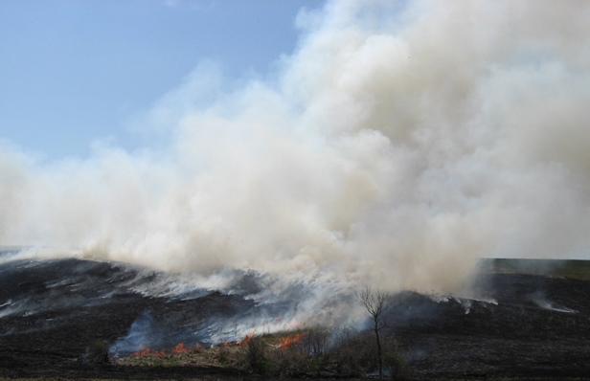
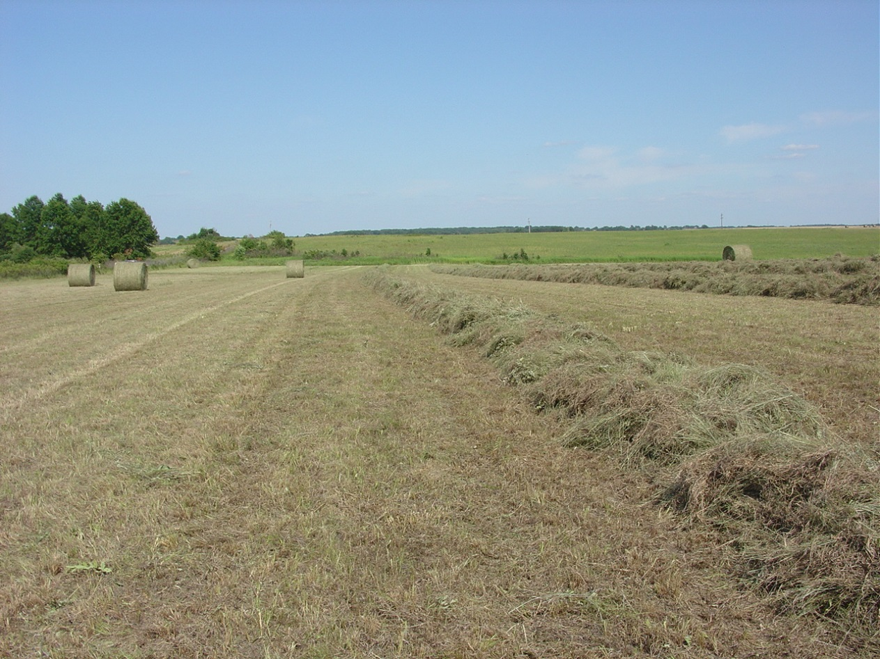
Other tools produce uniformity
Notes:
Other common prairie management tools such as prescribed fire or hay harvest, while helpful at times, create a uniform habitat treatment which does not meet the immediate needs of wildlife. These practices instantly change uniformly tall cover to uniformly short - or absent - cover, without providing low-mobility wildlife – like reptiles, amphibians and invertebrates - ample time to move to suitable sites.

Slide 12
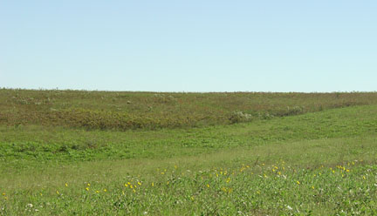
Notes:
Landscape scale of structural diversity – soft edge

Slide 13
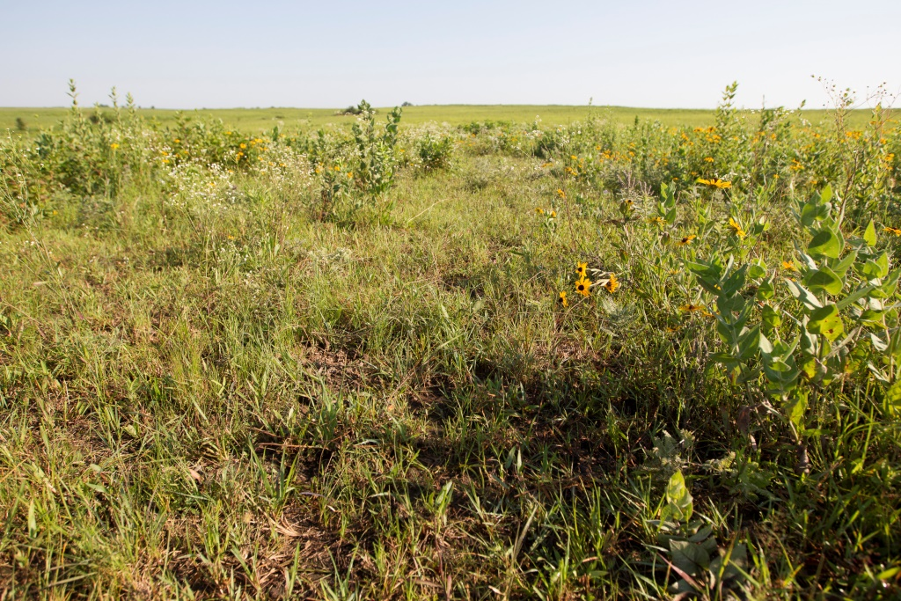

Slide 14
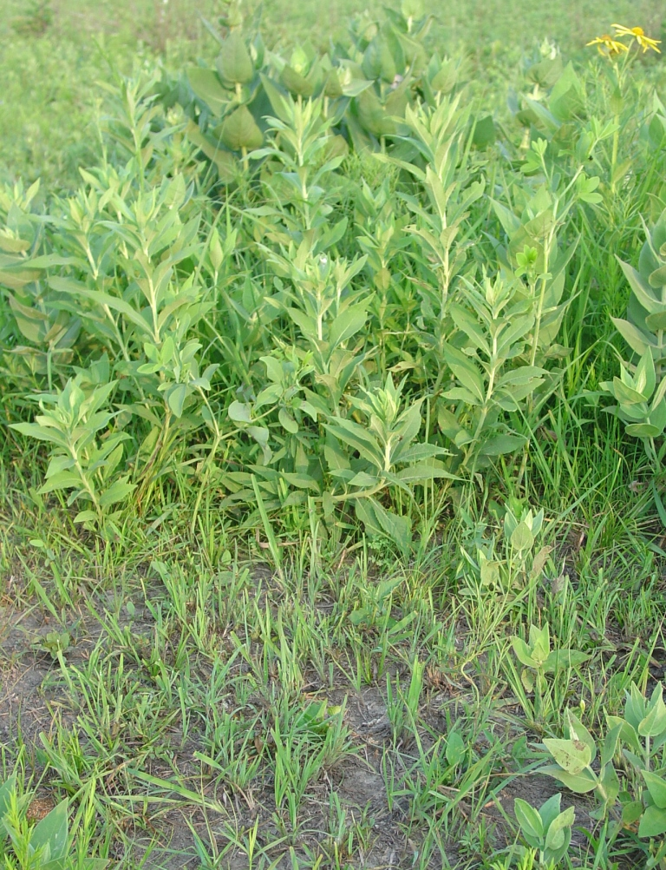

Slide 15
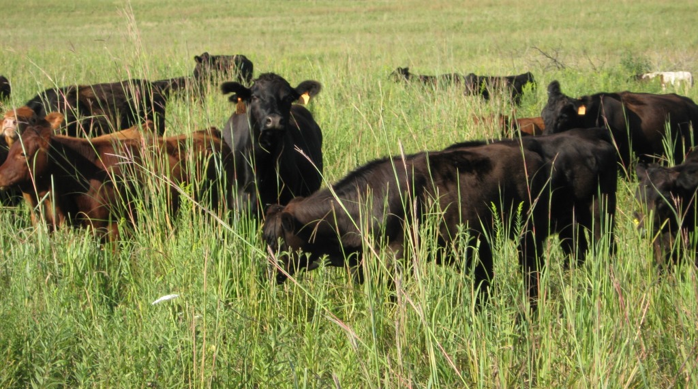

Slide 16
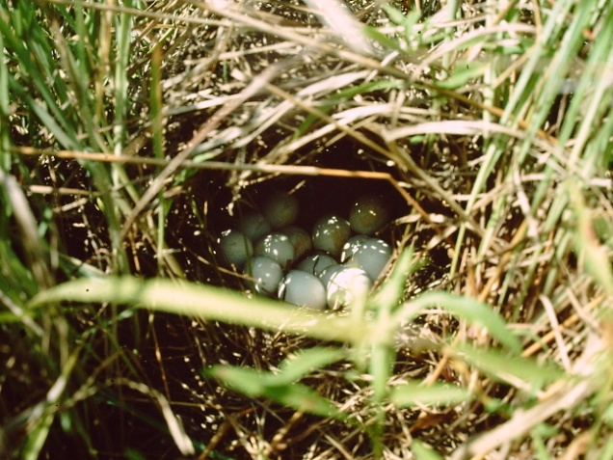
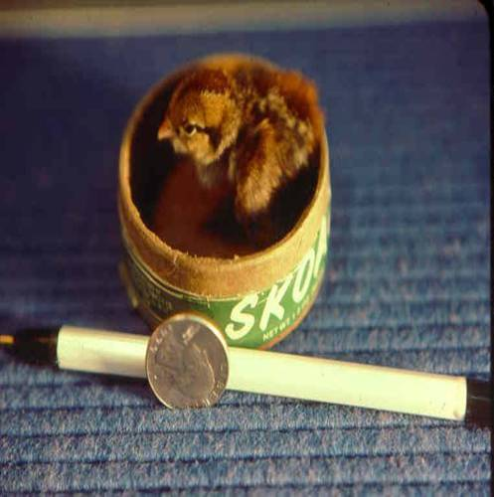
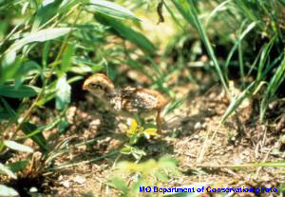
Notes:
Bobwhite quail chicks are precocial. They are up and out of the nest as soon as they hatch. . . on the move, and looking for food. Quail chicks are about the size of your thumb when they leave the nest. This is why it is so important to have areas of bare ground in close proximity to nesting habitat. Young quail chicks are not able to thermoregulate, or maintain their own body temperature. If the grass is too think and the chicks must walk through think, damp vegetation, it is possible they will get too cold and will die.

Slide 17
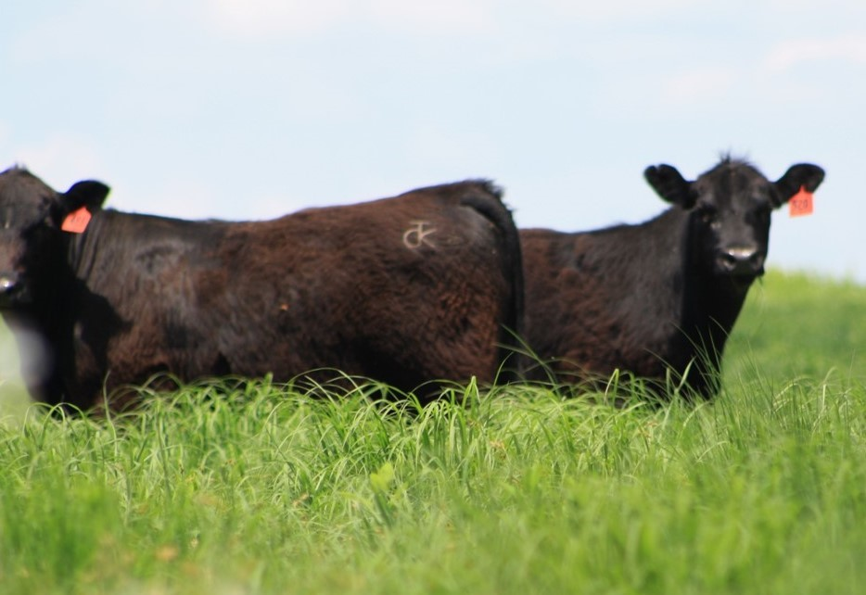
Grazing for Wildlife
NWSG Habitat Highlights:
Bunch Grass
Bare Ground
Insects
Overhead Cover
Notes:
Bunchgrass creates bare ground. Bare ground provides for diversity. Diversity leads to insects.

Slide 18
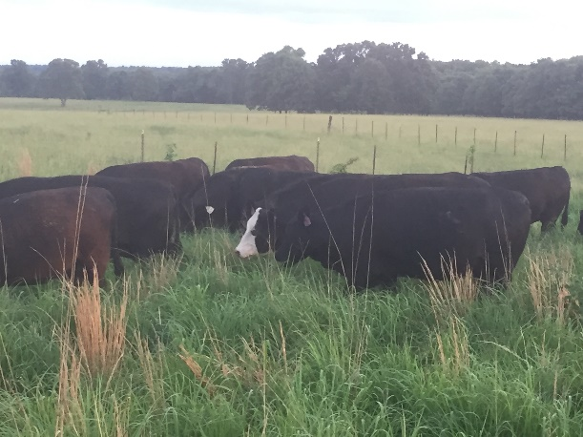
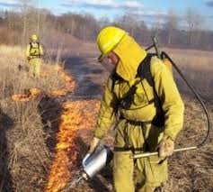
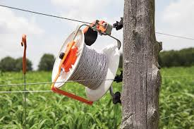
Grazing for Wildlife
CSGs can be managed to produce good habitat
Sod-forming
Low, Dense Growth
Generally Low Diversity
Limited Overhead Cover
Notes:
Wildlife can benefit from csg pastures, however it requires some creativity.
Many operations that we work with are fescue based, we are lucky to get 25-30% NWSG. You basically need to overgraze portions, let them recover……weedy response. Long rests.

Slide 19
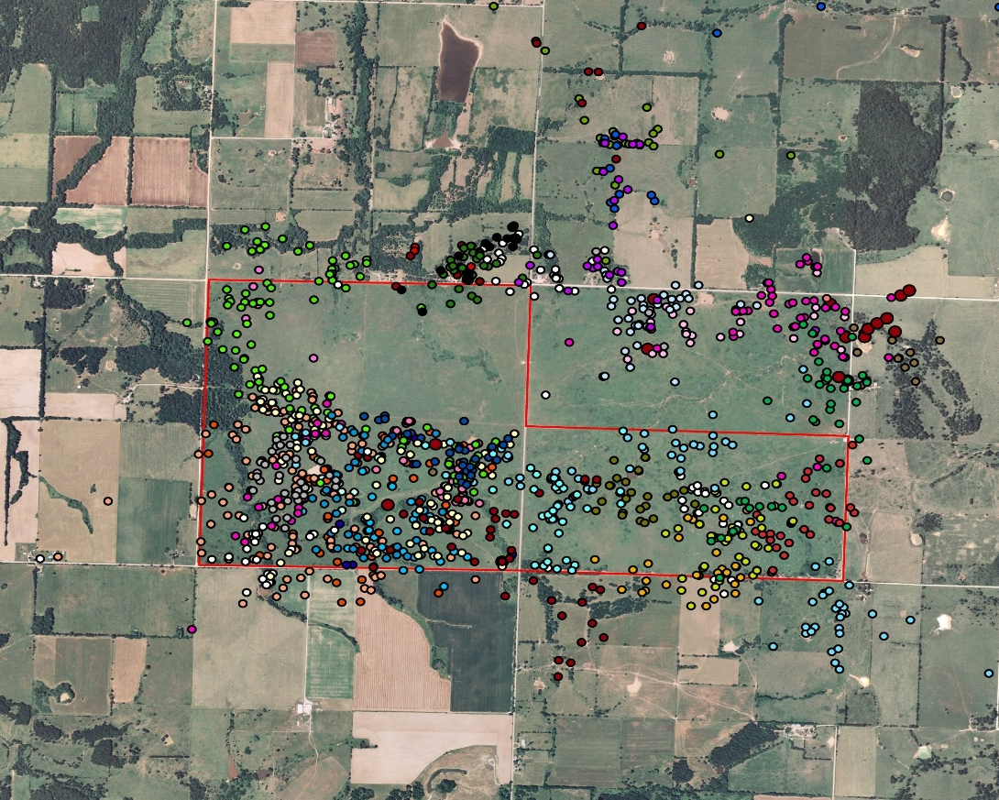
Grazing for Wildlife
SW MO Quail Study Highlights
Nest Success is Superior on Grazed Sites
Broods spent less than 5% of their time on ‘idle’ areas
Notes:
This was done on MDC prairies (often grass/forb mix, thin/rocky soils) . When we work on private land, we are often dealing with a much more dominate native grass stand. I believe the use of grazing in a private planting is especially important.
33% nest success in ungrazed prairie
65% nest success in grazed prairie
90% of all brood locations within grazed cover; 97% for broods <6 weeks

Slide 20
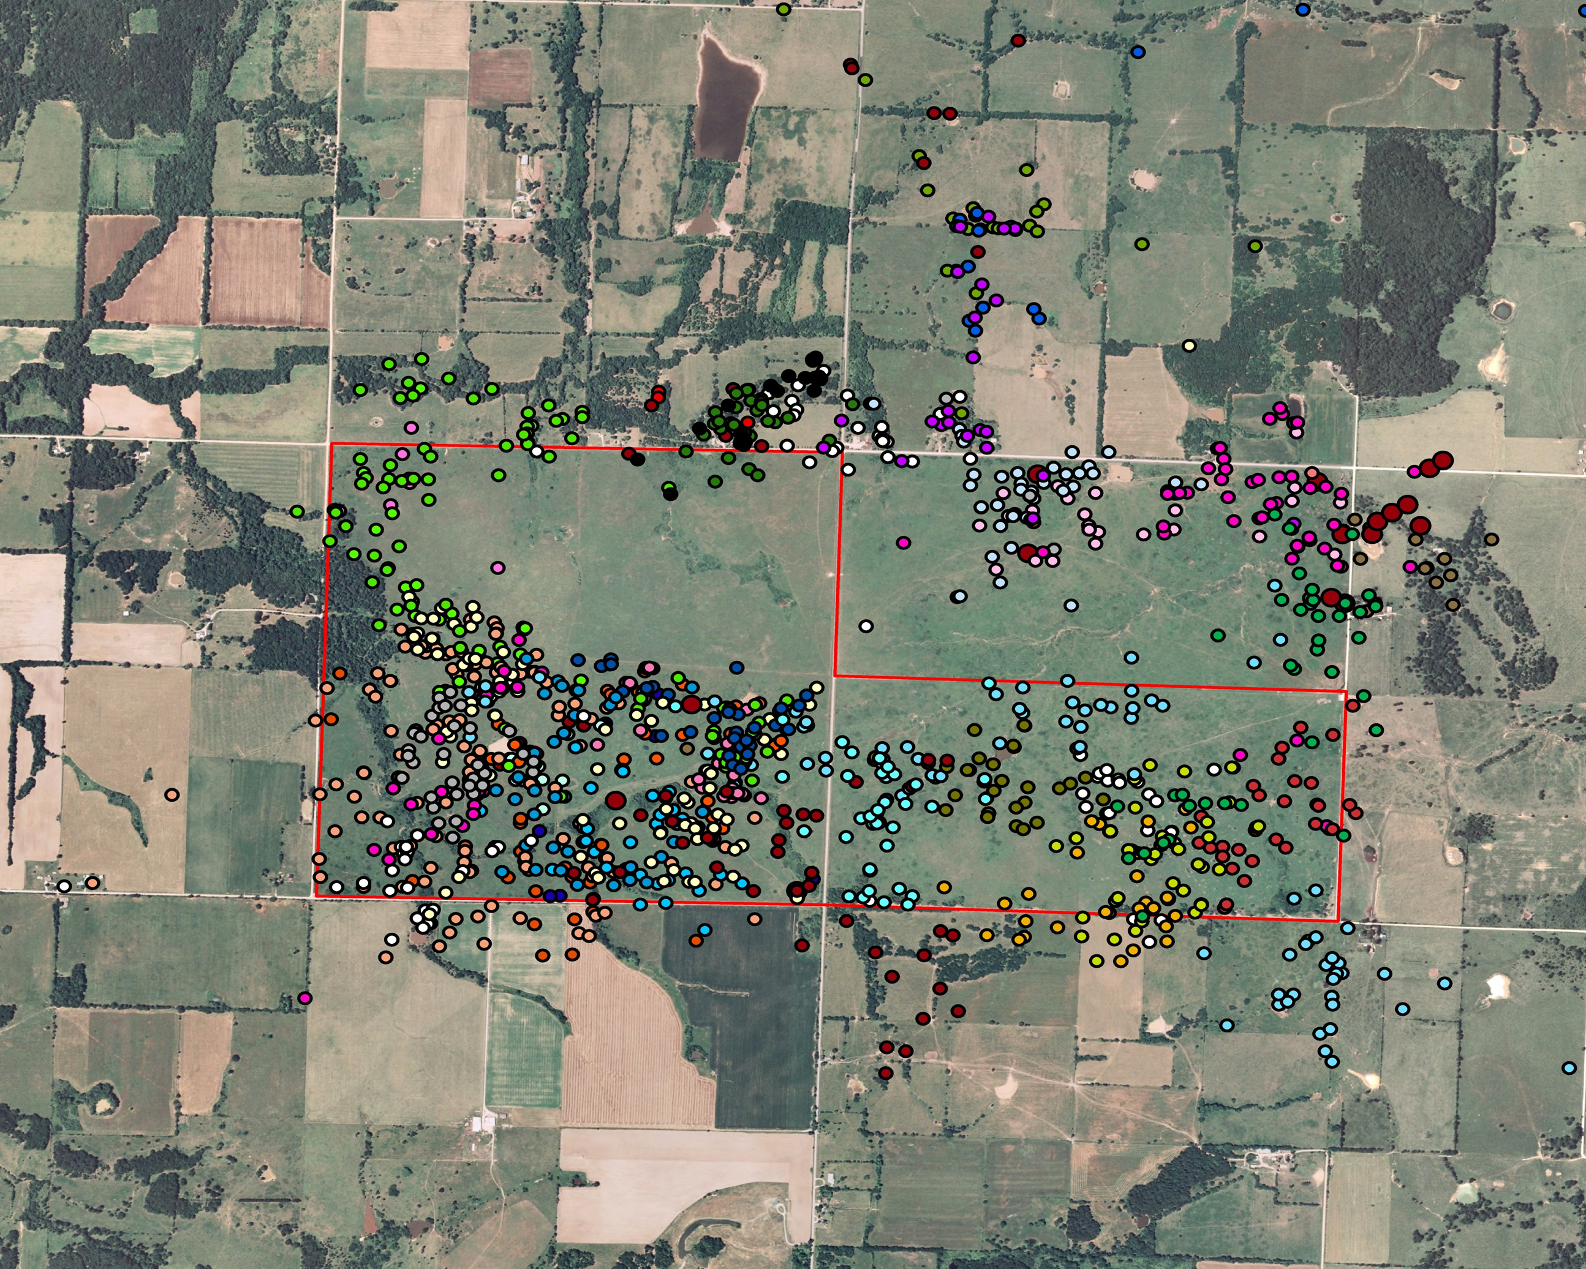
Notes:
Excerpt from SW Quail Study: Daily movements of broods. Red outline is Stony Point CA
It’s not hard to identify which portion was rested (not burned and not grazed).

Slide 21
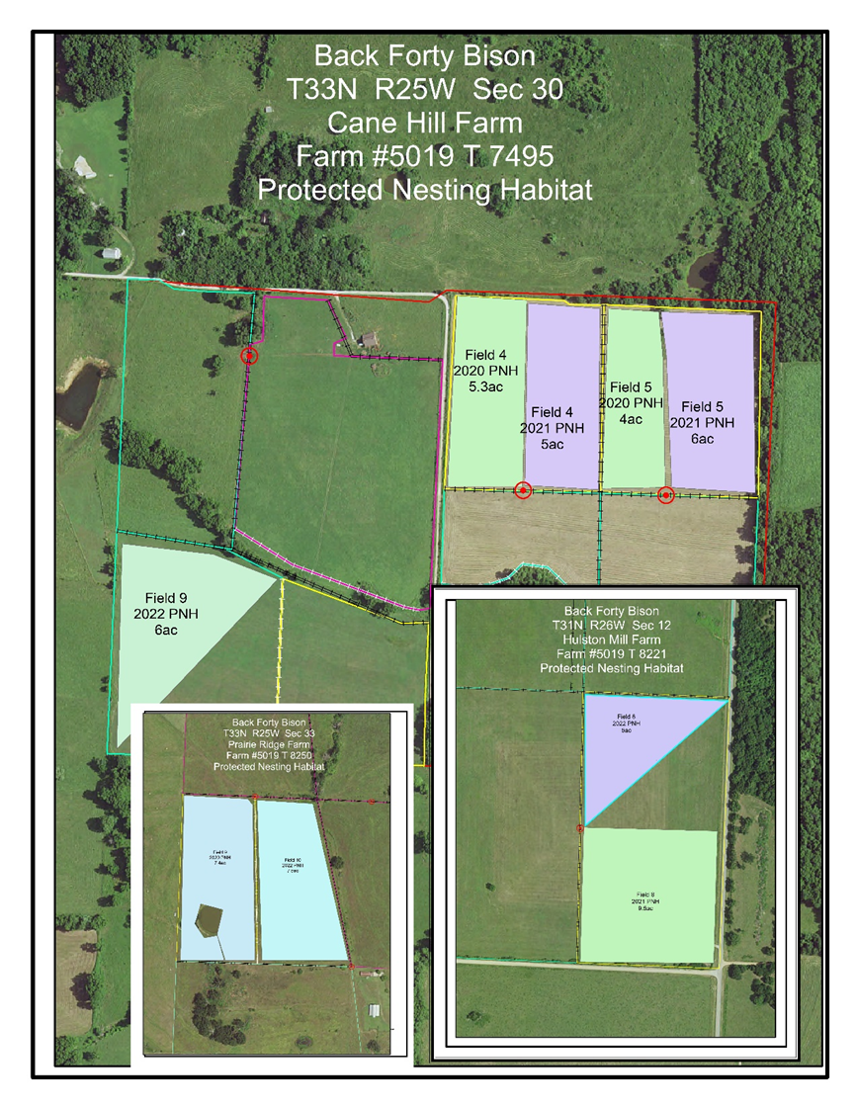
Notes:
Many times we work with rotational grazing systems on private land. This results in high stock density (not mob levels) for 3-5-7 day grazing periods followed by 12-24 day periods. To protect nesting birds, there should be areas identified as “protected nesting habitat” These areas should have some residual cover and receive no grazing until July 15. These areas should be located in close proximity to good brood cover.

Slide 22
GRAZING FOR WILDLIFE
UTILIZING NWSG IN A ROTATIONAL GRAZING SYSTEM
25-30% OF TOTAL PASTURE ACRES IN NWSG
NEST TRAMPLING COULD BE AN ISSUE
  1AU/AC=20% NEST LOST
  5AU/AC=100% NEST LOST
MITIGATE NEST TRAMPLING
  PROTECTED NESTING HABITAT
  40-48 DAYS
Notes:
Most common in private land.

Slide 23
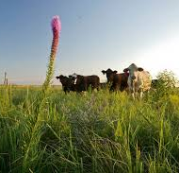
Funding Sources
USDA/NRCS
DNR
MDC LCAP
Notes:
Numerous cost share opportunities to establish NWSG and incorporate into a grazing system. Contact your local PLC or county USDA service center.

Slide 24
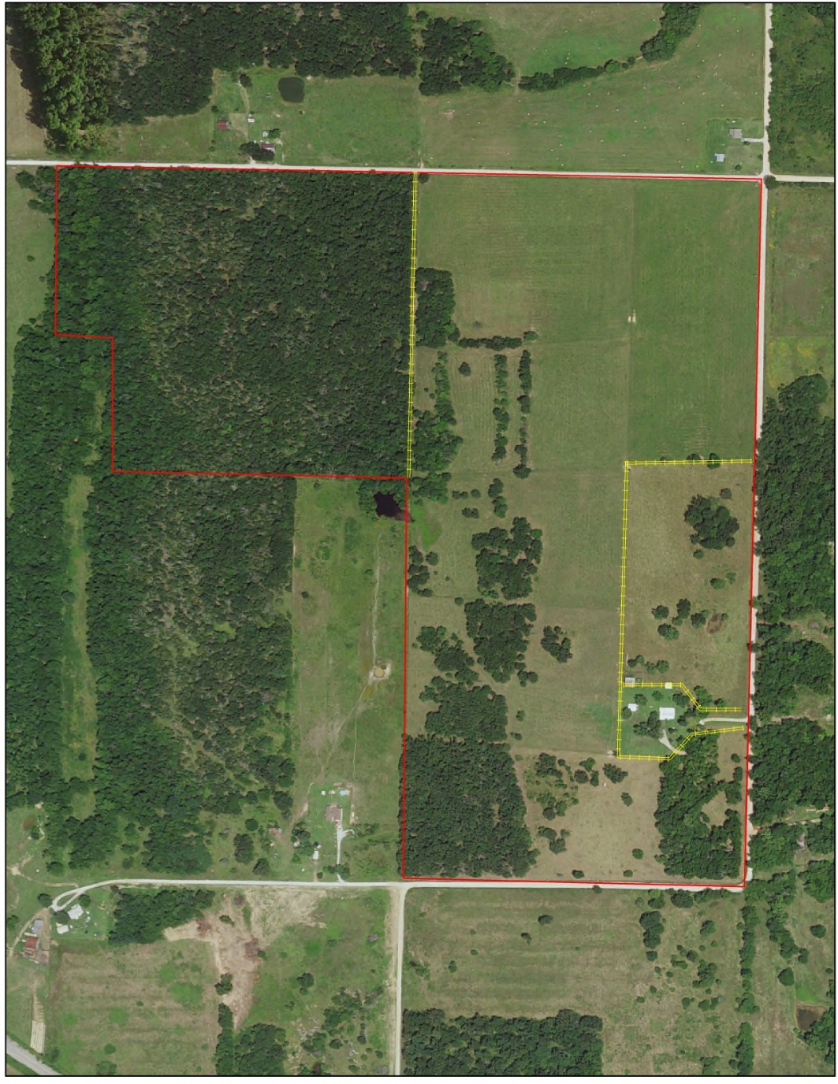
80-acre Dade County Farm
Notes:
80ac farm example. The use of a grazing system and NWSG establishment transforms this farm into a wildlife friendly, drought tolerant, soil building and profitable farm.

Slide 25
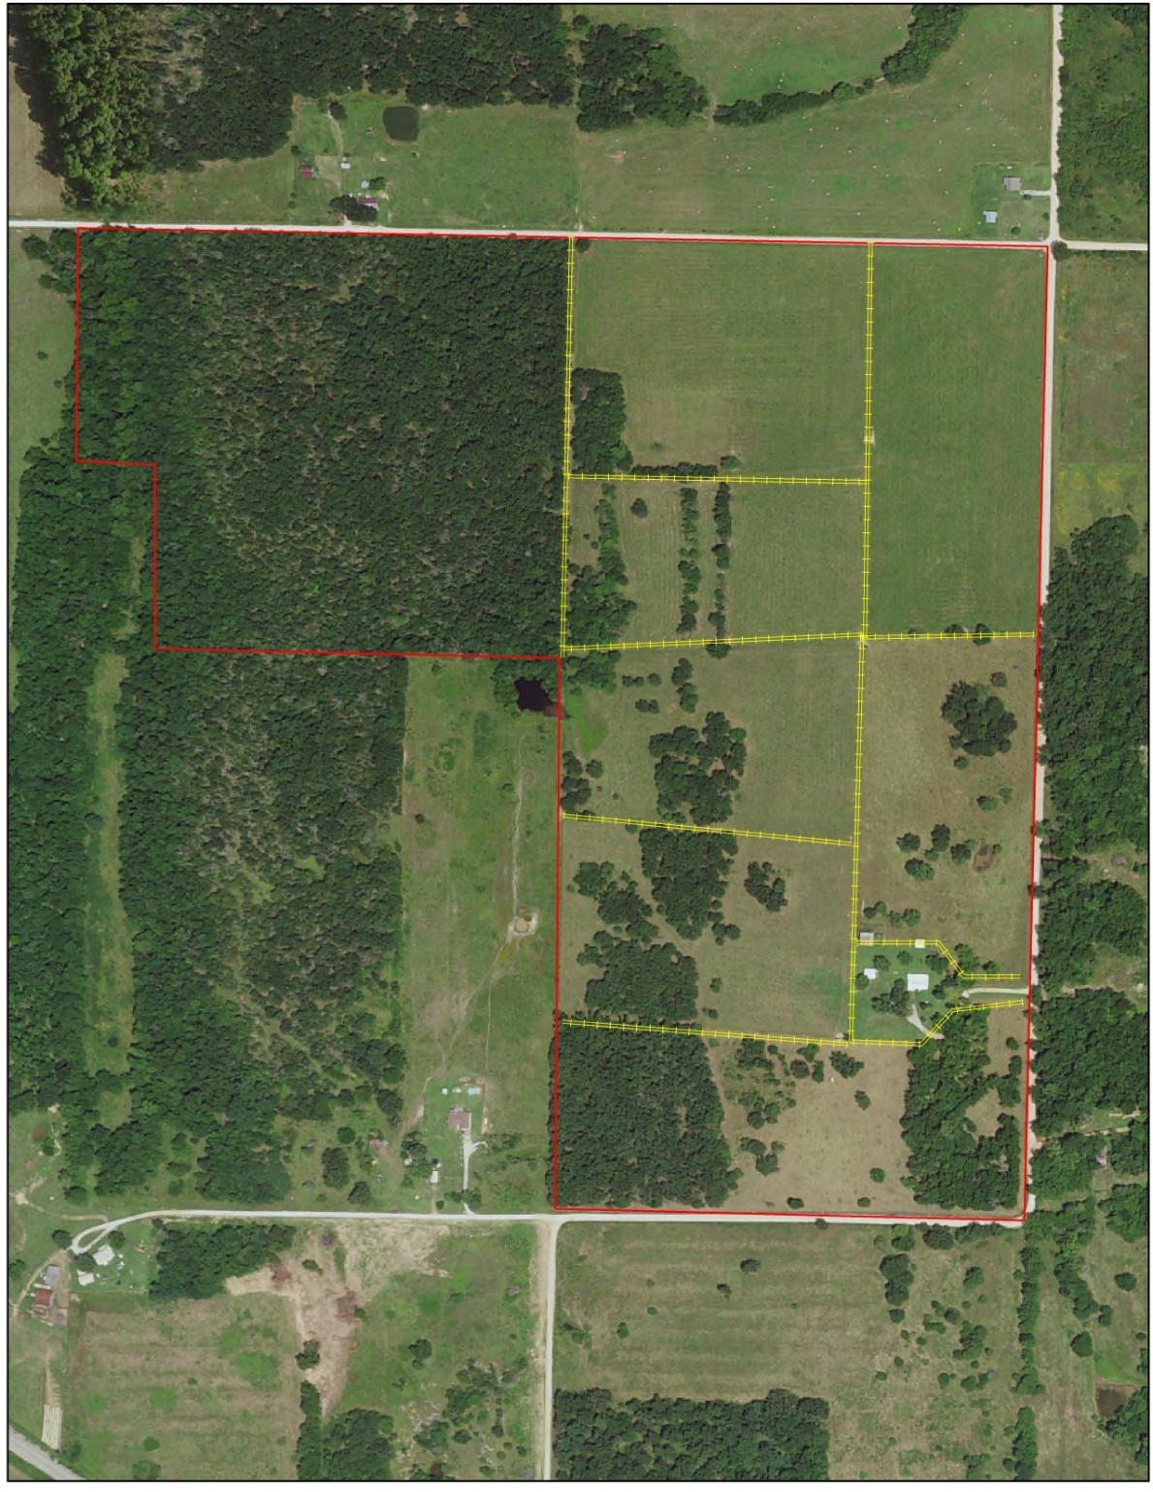
Notes:
Cross fences

Slide 26

Notes:
water

Slide 27
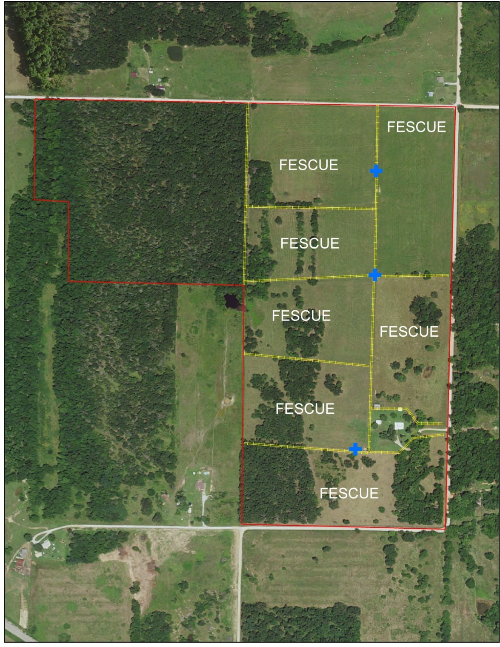

Slide 28
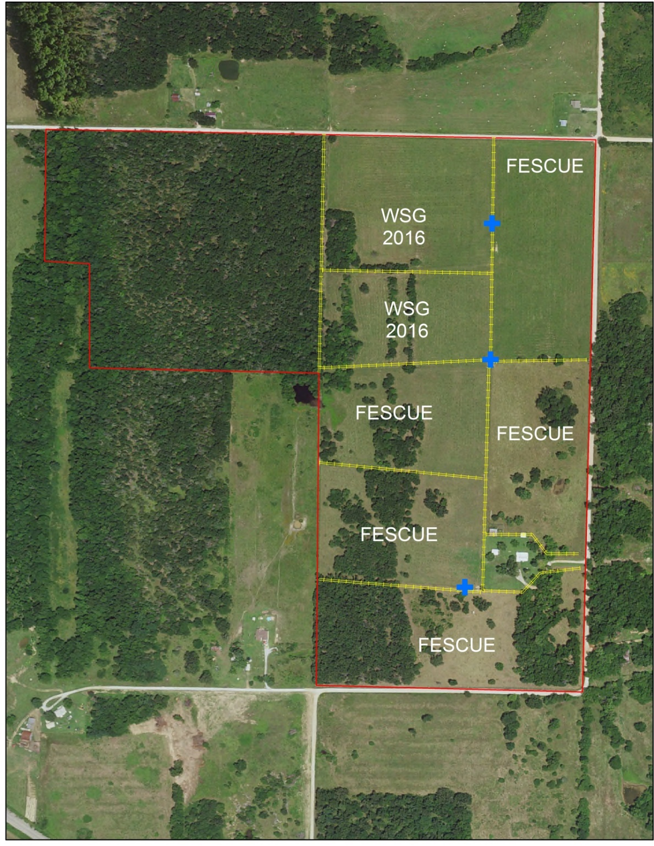

Slide 29
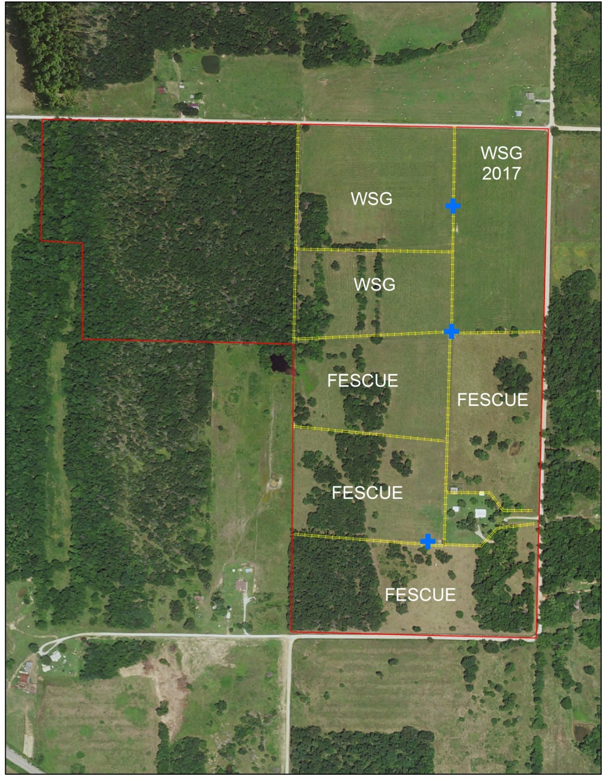

Slide 30
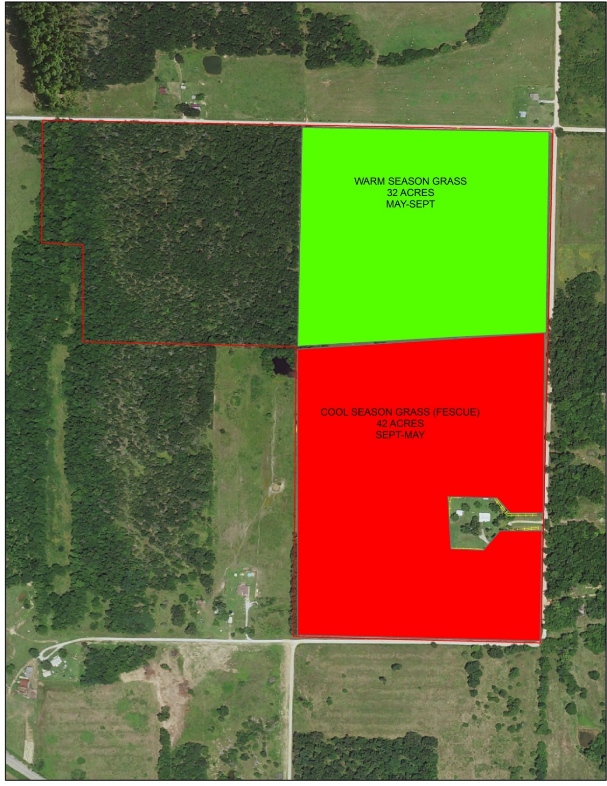

Slide 31
Stocking Rates
15 cow/calf pairs, initially
25 pairs after cross-fencing
30 pairs after NWSG establishment

Slide 32
Stocking Rates Increased due to. . .
  Increased forage diversity
  Increasing grazing efficiency
  Longer rest periods
Other benefits include decreased inputs and improved habitat

Slide 33
NWSG Advantages
Improved weaning weights on spring calves
Backgrounding opportunity for fall calves
More grazing days; more forage production
Improved conception in June & July. Plan to calve in mid-March through April
Help mitigate endophyte toxicosis
Notes:
High quality feed for Spring cows produces more milk=higher weaning weight on Spring calves
Fall calves are weaned in May, go directly to NWSG= 2lb+ gain/day
While grazing NWSG in summer months, CSG pastures are allowed to rest
Improved conception in June and July due to cow’s body temperature lower than on hot fescue. If you can successfully breed in June-July, your Spring calves are actually born in the Spring.
Endophyte toxicosis especially in summer—hot temps + hot fescue= health problems, low conception, poor BCS, feet problems, etc

Slide 34
NWSG Advantages
Added forage production during summer allows for added carrying capacity.
You no longer have to stock based on July and August production.
In our 80-acre example, NWSGs added 5 pairs to farm. . . 5 more calves adds $2,500 to $3,000.

Slide 35
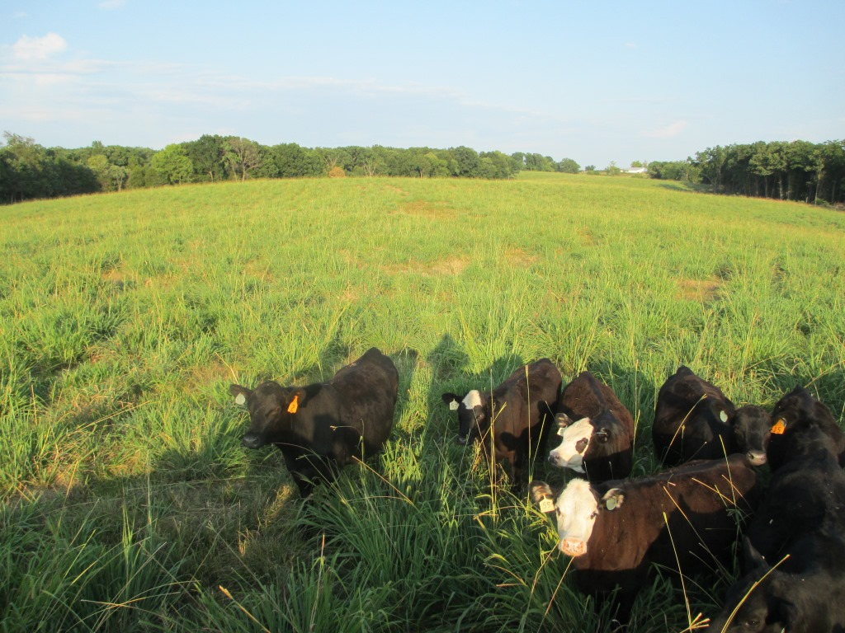
Take Home Points
The birds in greatest need don't nest in trees;
Native forages can help those birds while increasing the carrying capacity of your farm and boosting your bottom line!
Notes:
In closing, I want to offer a few points for further your consideration. . .

Slide 36

Notes:
Thank you for your time this morning. I will be happy to answer any questions that you may have.

