Slide 1
Integrating Wildlife Considerations with Livestock Grazing Lisa Potter, Missouri Department of Conservation Robert Pierce, MU Extension Wildlife Specialist

Slide 2
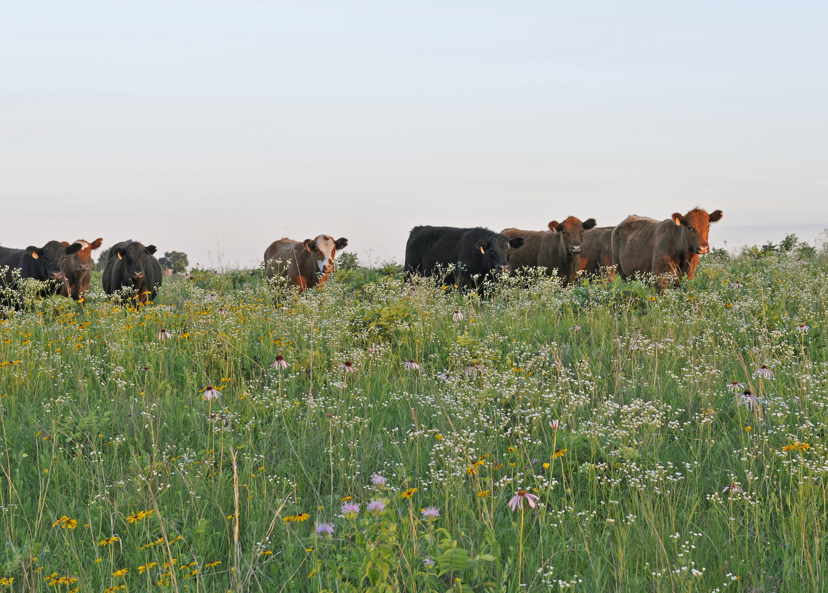
Grazing for Conservation
Combining Agriculture and Wildlife
Notes:
There are many opportunities for establishing and managing food and cover to provide wildlife habitat on lands both in and out of production. In this presentation will we review a few wildlife habitat management techniques you can use on lands not in production or in the odd areas of your farm to create wildlife habitat. We will also discuss grazing management techniques that can be beneficial to both production and wildlife. Wildlife considerations can be integrated with forage production objectives, both around grazing areas as well as within these areas, if landowners are able to plan ahead and are willing to make a few trade-offs. This presentation will also highlight a few of these management techniques that can be beneficial for both wildlife and forage and livestock production on your property.

Slide 3
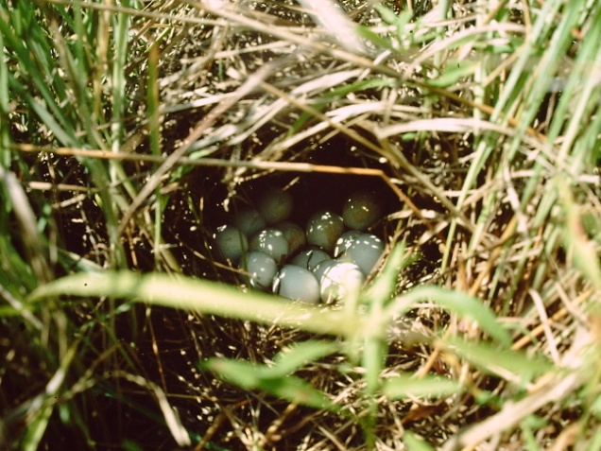
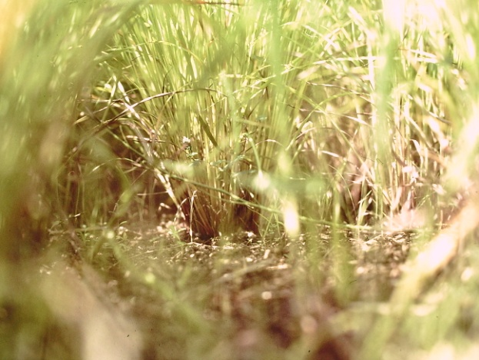
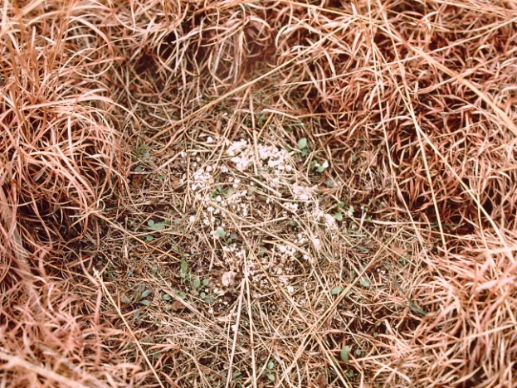
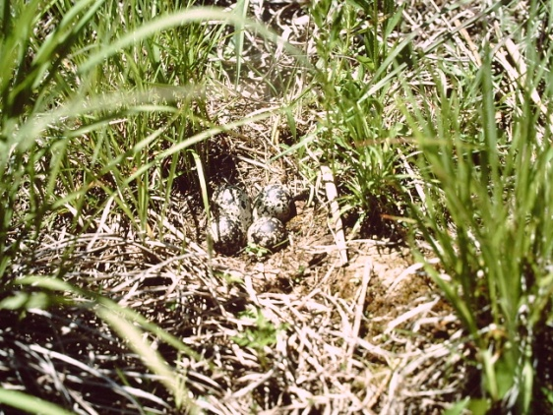
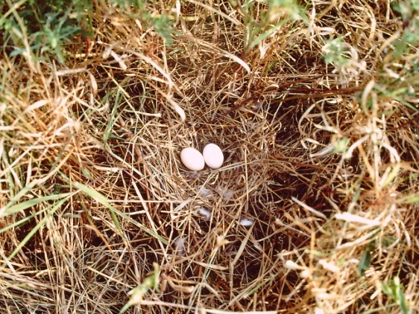
NATIVE GRASSES FOR WILDLIFE
Grassland wildlife evolved with native grasses and forbs which were regularly grazed and burned.
Vertical growth ensures overhead cover for nesting, brooding, movement, and roosting.

Slide 4
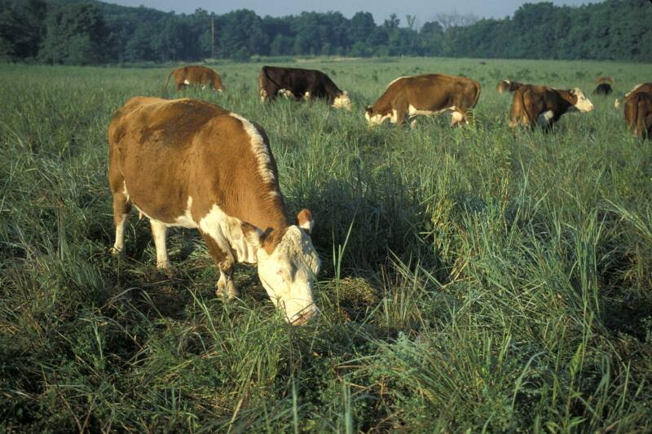
NATIVE GRASSES
Warm-Season
Big Bluestem Little Bluestem
Indiangrass Eastern Gamagrass
Sideoats Grama Switchgrass
Prairie Dropseed Tall Dropseed
Prairie Cordgrass Sand Lovegrass
Broomsedge Splitbeard
Silver Bluestem Buffalograss
Purple Lovegrass Purpletop
Notes:
Examples of native warm season grasses in Missouri.
Native warm-season grasses were the dominant component of these prairie grassland ecosystems. Native warm-season grasses have minimal requirements for supplemental water or fertilizer. Once established, they are very drought tolerant. Peak growth periods of these mostly perennial bunch grasses are from June through August. Like other native plants, they have coevolved with the local climate, soils, and rainfall, and are well suited to the growing conditions of the region. The growth form of native warm-season grasses is a key factor in their wildlife habitat value. The bunch grass open structure provides bare ground between the plants allowing for easy wildlife movement while providing protective overhead cover.

Slide 5
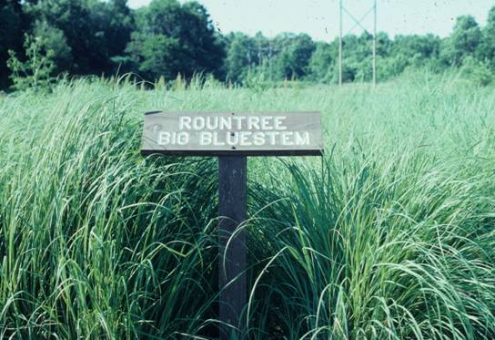
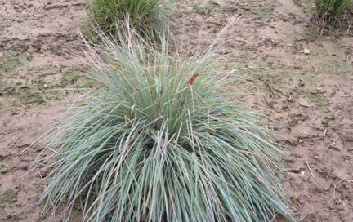
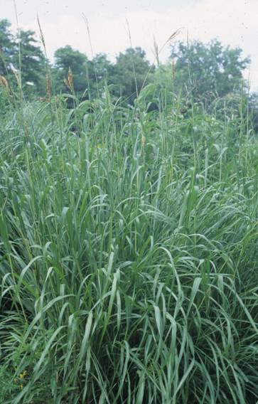
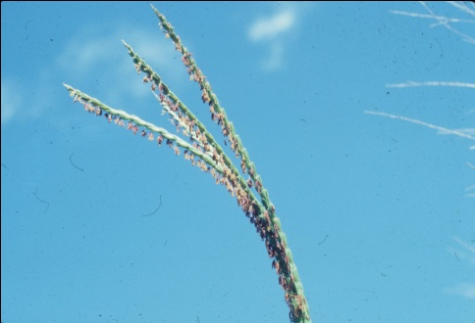
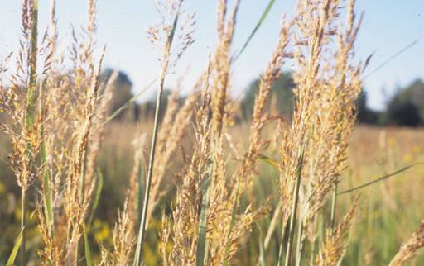
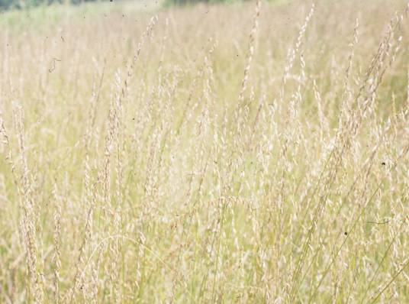
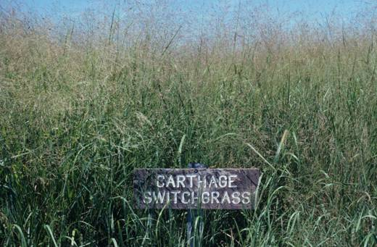
NATIVE GRASSES
Most Commonly Planted in the Midwest
Big Bluestem
Little Bluestem
Indiangrass
Eastern Gamagrass
Sideoats Grama
Switchgrass
Notes:
Commonly planted species with pictures

Slide 6
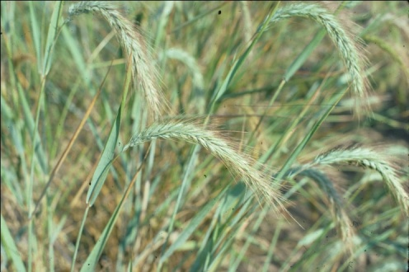
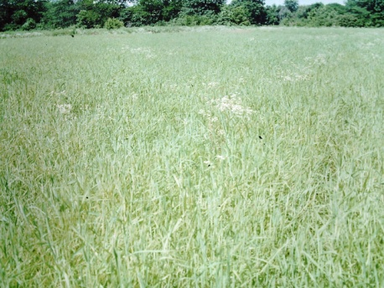
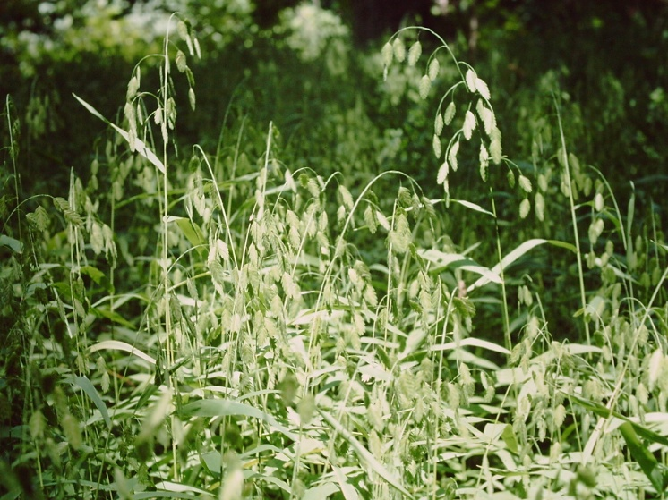
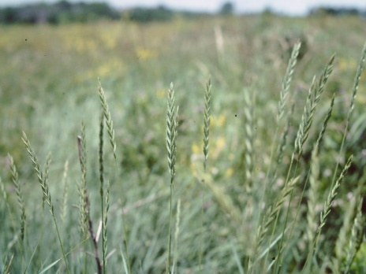
NATIVE GRASSES
Cool-Season
Canada Wildrye Virginia Wildrye
Western Wheatgrass Junegrass
Riveroats (uniola) Bottlebrush
Notes:
There are also many native cool season grasses as well. Here are few of the common species in Missouri. While native warm-season grasses are the essential backbone of prairies, native cool-season grasses also fulfill an important ecological role on prairies and other natural communities, by providing food (forage and seeds) early in the growing season as well as cover for wildlife. Native cool-season grasses grow and reproduce in cooler conditions, offering forage in early spring, fall, and part of winter, and seed by early summer, while warm-season grasses continue growing when cool-season grasses are dormant. By including both warm and cool season grasses in the same area, you can better provide year-round food and cover.

Slide 7
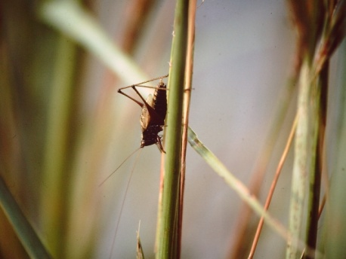
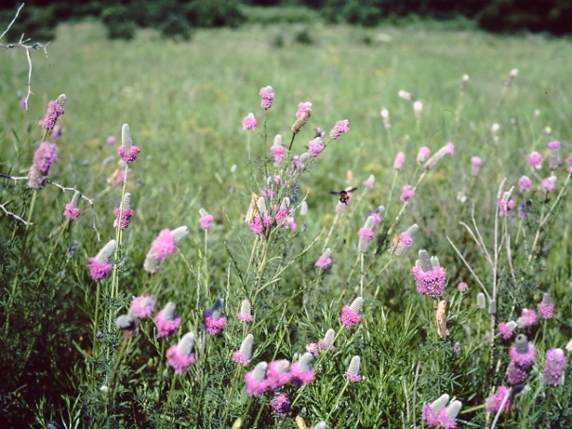
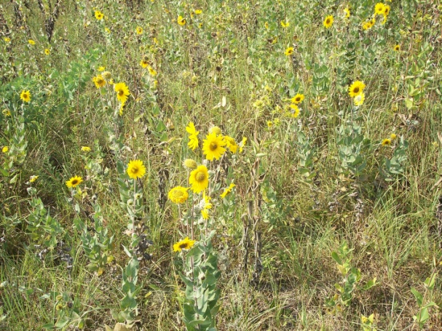
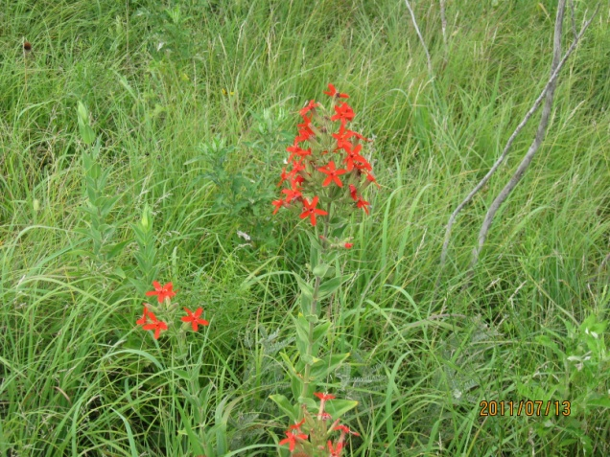
NATIVE GRASSES FOR WILDLIFE
Native grasses grow compatibly with hundreds of species of native forbs providing a rich diversity of cover, browse, seed, and insect foods for wildlife adults and broods.

Slide 8
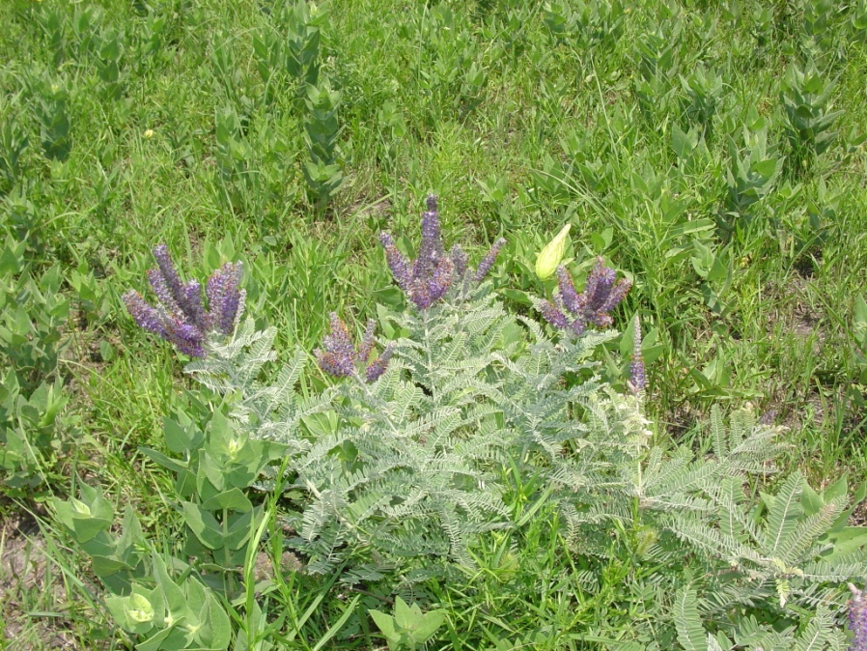
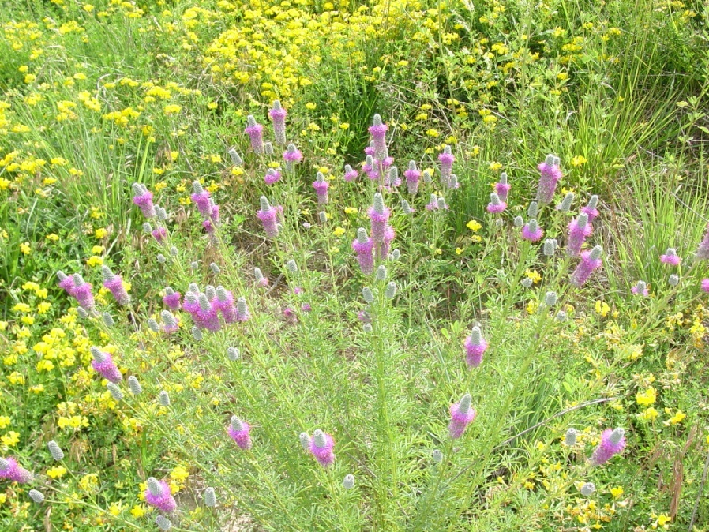
FORBS FOR LIVESTOCK AND WILDLIFE
Ashy Sunflower/Maximilian
Leadplant
Purple Prairieclover
White Prairieclover
Rattlesnake Master
Roundhead Lespedeza
Rosinweed
Ill. Bundleflower
Compassplant
Slender Lespedeza
Sensitive Briar
Blazing Star
Rigid Sunflower
Tickclovers
False Sunflower
Tall Indigo
Notes:
Flowering forbs are essential for pollinators and provide an important seed source for many species of wildlife. Not only are the pollinating insects important to the forbs themselves for pollination, but the insects are also an essential food component for many species of grassland birds. For instance, young quail chicks eat only insects for at least the first 2 weeks of life. Insects are also a very important source of protein for laying hens. Here are just a handful of forb species that can be beneficial to both livestock and wildlife.

Slide 9
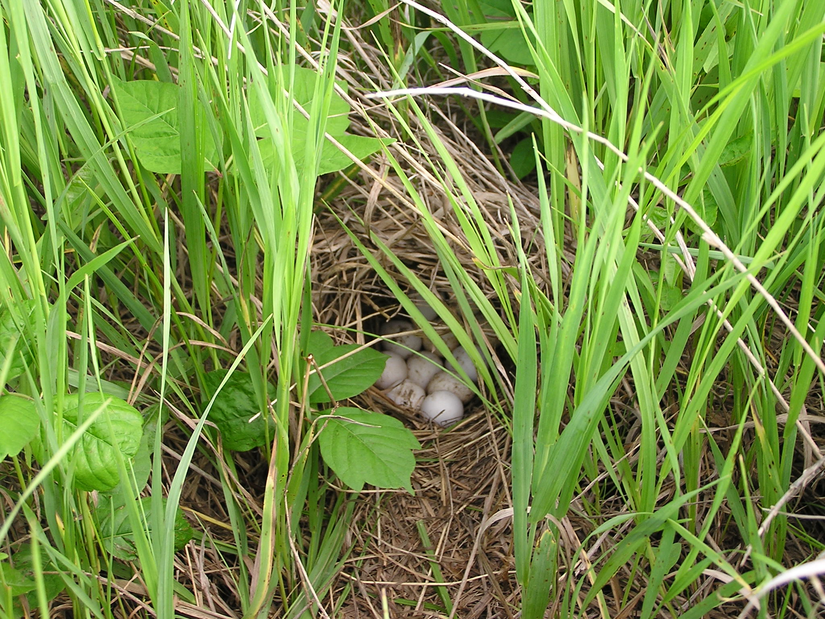
Nesting Habitat
Moderately dense stand of grasses, legumes and annual weeds with an open nature at ground level
Warm-season bunch grasses – at least 12” in height at maturity
Ground nesting birds construct their nests using the previous year’s litter
Most quail nests are located within 50 – 70 ft from an edge
Notes:
The next several slides will provide descriptions of quality bobwhite quail habitat. However, if you create good quail habitat, you are also creating great habitat for many other species of grassland birds, pollinators, and other wildlife species such as turkey and deer.
Native warm season grasses can provide excellent nesting habitat for grassland birds. The bunch-grass structure provides great overhead cover, from predators while leaving enough space for birds to easily access and flush from their nests. The open structure also allows for easier foraging for seed and insects and allows enough sunlight to hit the ground to stimulate forb production. Keep in mind, that unmanaged native warm season grasses can become too think which will reduce their value for many wildlife species. Management through disturbance, such as prescribed fire, grazing, or strip disking is important to keep the stand of grass from becoming too think and therefore eliminating the open ground needed for movement and foraging.

Slide 10
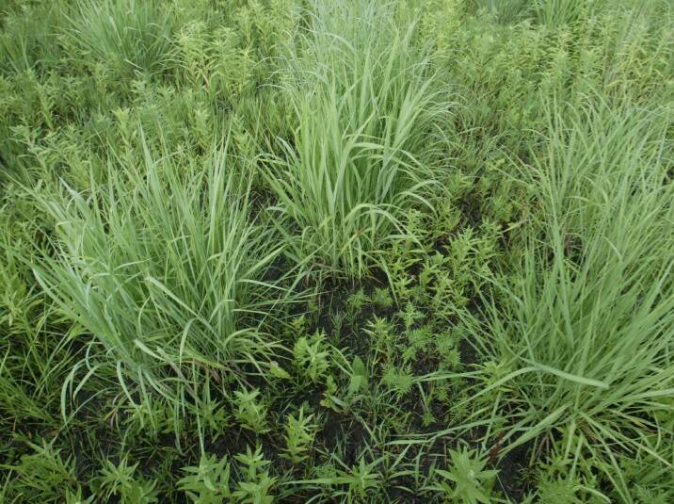
Bunchy growth provides better habitat for quail
Notes:
Radio-tagged quail in a north-Missouri study were found to select nest sites with an average of 10% grass composition, whereas a study in Iowa showed quail selecting sites with up to 69% grass composition. This tells us that quail will select nesting sites in locations with a relatively wide range of grass percentages, but that they do not use sites for nesting when the grass is too think. This picture shows a good example of how many clumps of grass are needed to provide optimal quail nesting habitat. This picture also shows how it is possible to create nesting and brood habitat in the same field! Notice the open ground and numerous forb species growing between the clumps of grass. Areas with as little as one potential nesting site (clump of NWSG) per 100 square feet can provide good nesting cover.

Slide 11
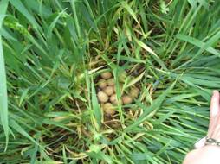
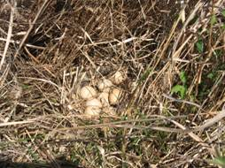
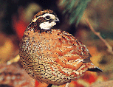
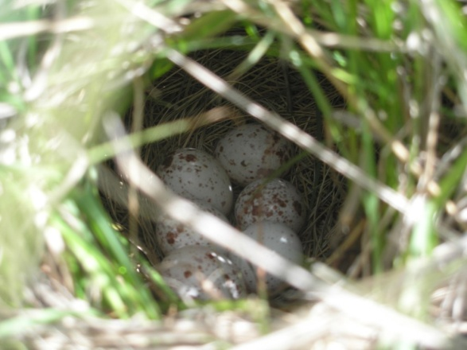
OPTIMUM VEGETATION HEIGHTS FOR grassland bird NEST SITES
Vegetation height at the time of nest initiation-new or old growth
14” about April 15 for Greater Prairie Chicken
17” about April 15 for Turkey
6” about May 15 for Bobwhite Quail
Notes:
Quail can begin nesting as early as April, however most nesting will begin in May, with a peak in mid-June and a second smaller peak in July. The first nesting attempt is often the most important since typically the most eggs will be laid in the first nest, however hens will usually attempt at least one more nest if their first nest is destroyed. Even if their first nest was successful, many female quail will attempt a 2nd nest in the same year if conditions are good.

Slide 12
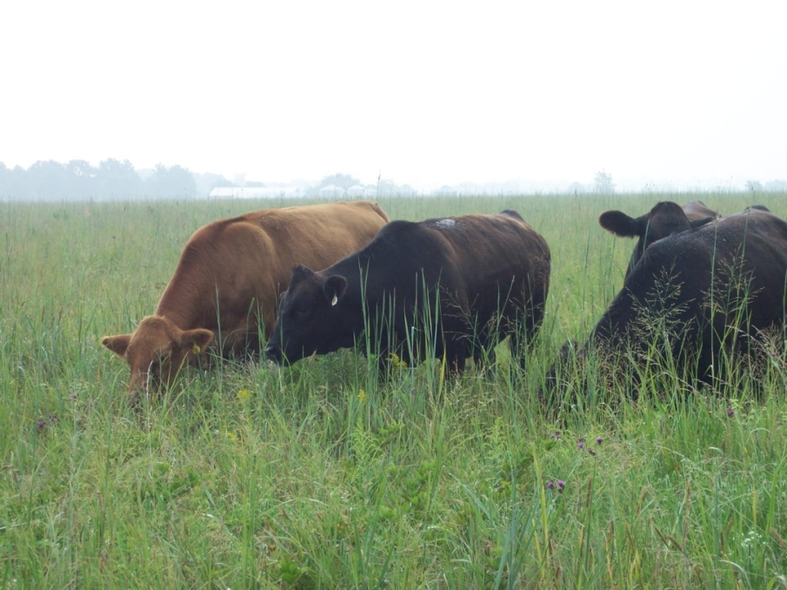
Factors that Influence nest survival
Stock density
1 animal/ac.= 20% nest loss to trampling
5 animals/ac.= No nests survive
Grazing Systems should incorporate rest periods or stock densities that allow
site selection—1-4 days
nest bowl construction—1-4 days
egg laying--12-16 days
incubation--21-25 days
chick departure
Total--40-48 days
Notes:
Research has shown that stocking density is an important factor that determines nest survival in grassland and pasture systems. Research has shown the following relation between stocking density and the likelihood that a ground nest will be trampled.
If grassland birds are a consideration, grazing systems should allow for at least 40 – 48 days resting periods for portions of their pasture and/or manage stock density at levels that are less likely to lead to trampling of nests.

Slide 13
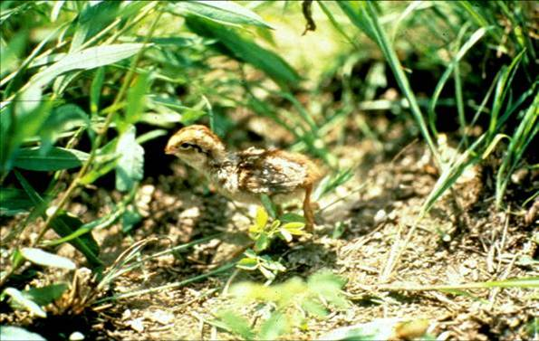
Brood Habitat
Area consisting of forbs, legumes and annual weeds that provides overhead cover with at least 25-50% bare ground
Brooding: May – October
Bugging Grounds: For the first 2 weeks of life, chicks eat almost exclusively insects
Notes:
Brood rearing cover, or habitat needed for raising young chicks, is characterized by a plant community made up of forbs, legumes and annual weeds. Insects are the most important food item for nesting hens and quail chicks. The forbs and annual weeds provide an abundance of insects needed for rapid chick development and are used by broods as feeding areas. Fields with less than 5% bare ground typically have vegetation that is too thick for broods to use.

Slide 14
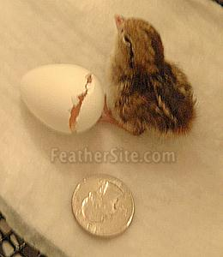
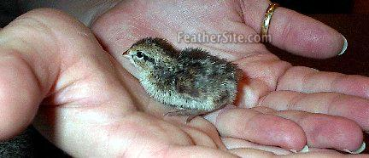
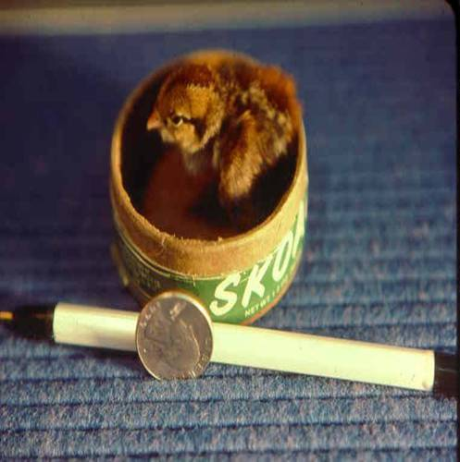
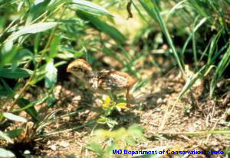
To put things into perspective…
Notes:
Bobwhite quail chicks are precocial, which means that once they hatch, they are up and out of the nest, on the move, and looking for food. Quail chicks are about the size of your thumb when they leave the nest. This is why it is so important to have areas of bare ground in close proximity to nesting habitat. Young quail chicks are not able to thermoregulate, or maintain their own body temperature. If the grass is too think and the chicks must walk through think, damp vegetation, it is possible they will get too cold and will die.

Slide 15
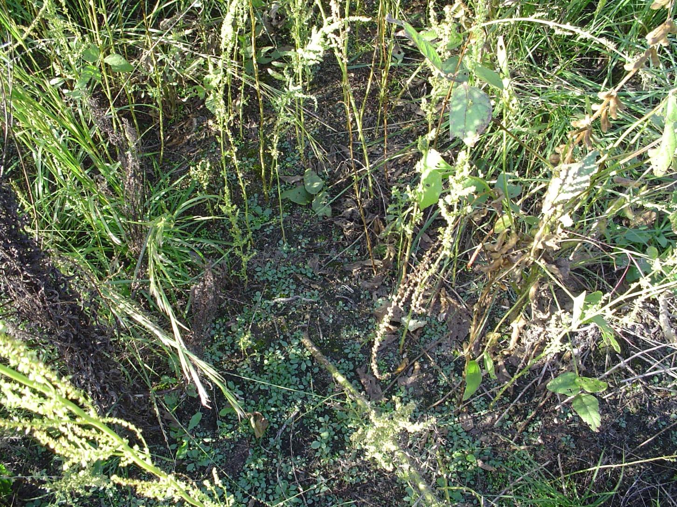
Components of Brood Habitat
Bare Ground
Facilitates movement
Facilitates foraging
Less chilling from dew
Notes:
Needs at least 25-50% bare ground

Slide 16
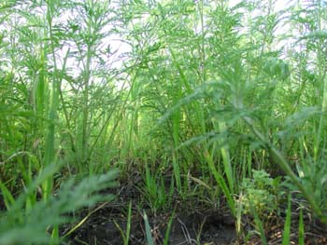
Components of Brood Habitat
Overhead Cover
Canopy provides concealment
Canopy provides shade
Notes:
Overhead canopy provides important protect cover from predators and weather.

Slide 17
Creating Brood Habitat
Prescribed Burning
Strip Disking
Food Plots
Notes:
Disturbance to grass stands is required to create brooding habitat and to keep grass stands from becoming too thick. Disturbance will help to maintain a diversity of grass and forb species. It is a good rule of thumb to manage grass stands once every 3 years. This will help maintain a diversity of grass and forb species and ensure grasses do not become too think.

Slide 18
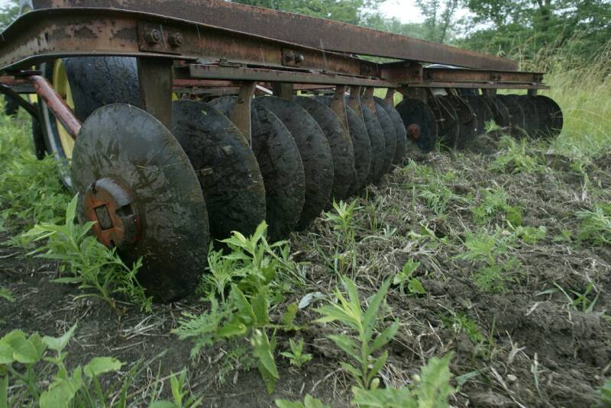
Disking
Notes:
Dense sod or vegetation can be improved by disking. Disking reduces residue, creates bare ground, and promotes desirable broadleaf plants that produce seeds and attract insects.

Slide 19
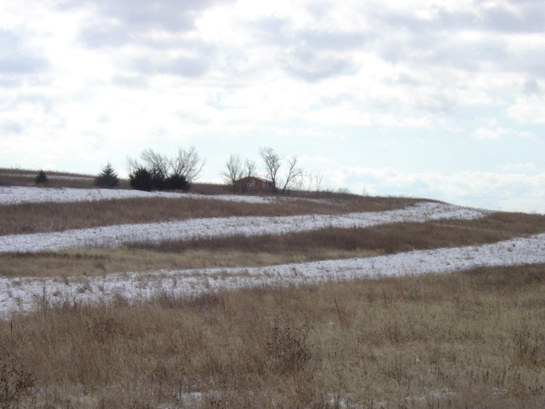
Disking
Strips should be 25 to 75 feet wide and separated by an area of undisturbed vegetation twice as wide
Ideally, only 1/3 of the field should be disked in any one year
Notes:
Disked strips should be 25 to 75 feet wide and be separated by an area of undisturbed vegetation twice as wide. (This helps create nesting and brooding habitat in close proximity and also helps reduce erosion concerns) Disk up to 1/3 of the field per year. The disked areas will produce succulent forbs and legumes, which attract insects and produce abundant seed, while the adjacent un-disked areas will provide nesting and roosting cover.

Slide 20
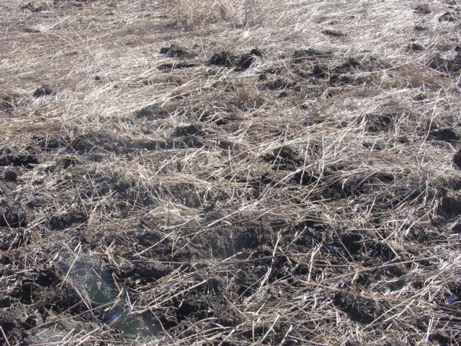
Disking
Disk 4-6 inches deep on contour
Goal is to create 30 to 70% bare ground
2 or more passes
required
Notes:
Disk 4-6 inches deep on the contour. Your goal is to turn over enough soil to create 30-70% bare ground. Heavy offset disks will require only one or two passes. If using a light tandem disk, you will typically have to disk many more times to get to 30-70% bare ground. Mowing prior to disking will make disking easier. Disked strips should be as long as possible and should follow the contour of the field to prevent erosion. Avoid disking in areas where concentrated flow is a concern. When possible, locate strips next to existing shrubby cover.

Slide 21
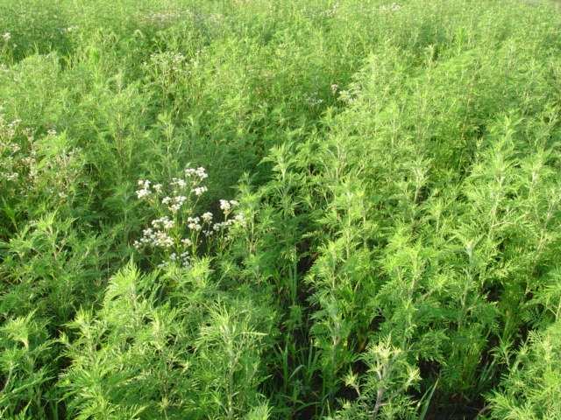
Disk between October 1st and April 30th
Fall/early winter disking promotes broadleaves (ragweed)
Spring disking promotes weedy grasses (foxtail)
Disking fescue in late spring will promote ragweed
Notes:
Fall disking tends to favor broadleaves. Spring disking tends to favor weedy grasses. Disk before February to get the best response from desirable broadleaf plants such as ragweed.
Disk fescue in late spring when fescue is actively growing and root reserves are low. The resulting bare soil allows annual plants to become established and produce seed. Research conducted in Illinois on CRP management found disking was ineffective at decreasing the percent of fescue cover for any amount of time greater than one growing season. It is critical to re-treat acres to maintain wildlife benefits.

Slide 22
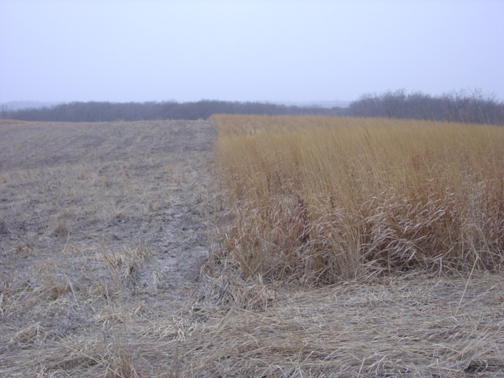
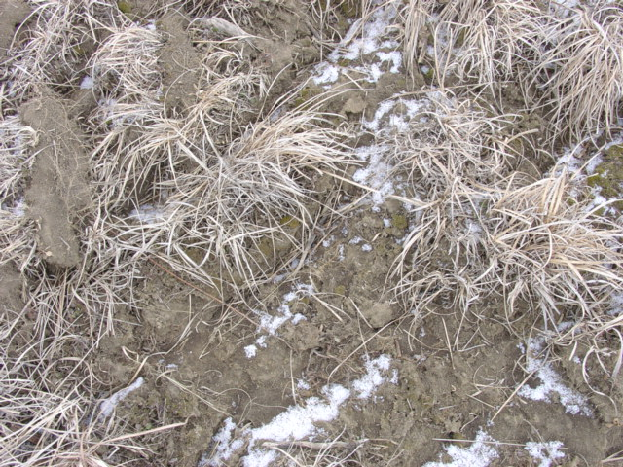
Good example
>50% bare ground
Notes:
Here is a good example of strip disking. Greater than 50% bare ground is exposed. Grass competition has been reduced and numerous weedy plants will germinate in the bare ground areas providing excellent brood rearing habitat. Native wildflowers and wildlife friendly legumes can be overseeded into the disked strips to improve diversity. However, DO NOT plant serecia lespedeza, birdsfoot trefoil, sweetclovers, or crownvetch.

Slide 23
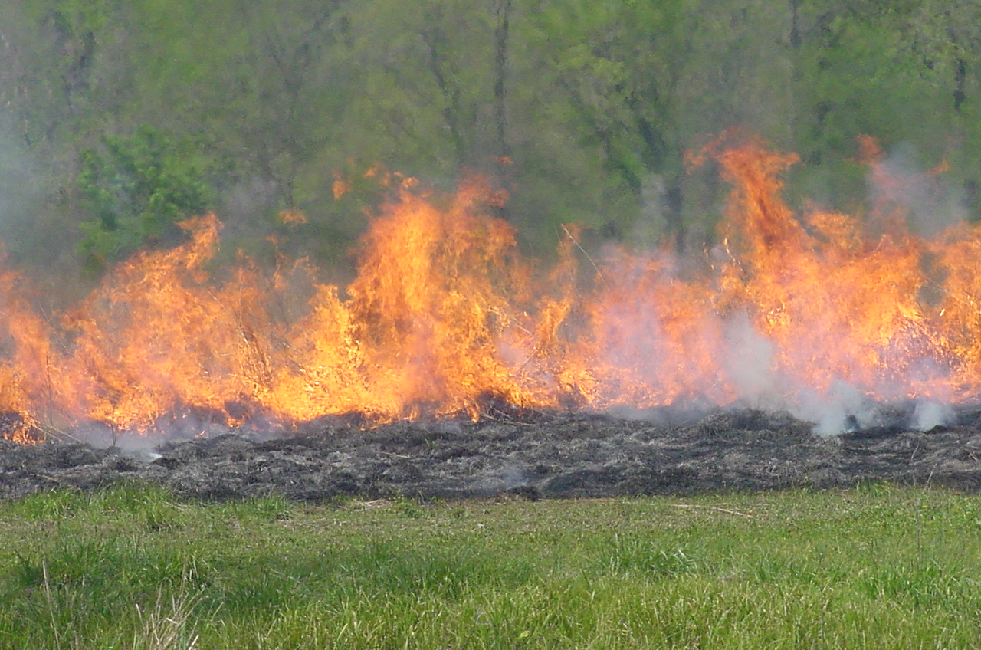
Prescribed Burning Creates Brood Habitat and Nesting Habitat
Notes:
Prescribed fire is a very effective tool to manage grass stands. It can be used to control woody invasion, stimulate desirable, or suppress undesirable plant species. You can dictate the vegetation response by the time of year you burn.

Slide 24
Timing – Things to Consider
Burn only 1/3 to ½ of field acreage to provide brooding and nesting cover adjacent to each other
Fall and winter burns favor forbs
Burning in spring and fall of the same year greatly reduces stands of fescue and brome
For greatest plant diversity, warm-season grasses should be burned July 16th – March 15th
Pay close attention to the growth stage of the plant - not just the month as weather varies from year to year
Notes:
The timing of the burn depends on the wildlife management objectives for the specific species. Consider wildlife needs such as nesting and feeding cover. Burn only 1/3 to ½ of the grassland acres in 1 year. Fall and winter burns generally favor forbs. Burning in the spring and fall of the same year greatly reduces stands of fescue and brome. Burn Feb.-March with less than 2” new growth to stimulate or enhance cool-season grass, prepare a seedbed for interseeding and herbicide application, and stimulate legumes in heavy stands. Burn April through May with 4-6” new growth to set back cool-season grass dominance, create bare ground, and control wood invasion. For greatest plant diversity, warm season natives should be burned July 16th – March 15th.
Pay close attention to the growth stage of the plant, not just the month as weather will vary from year to year.

Slide 25
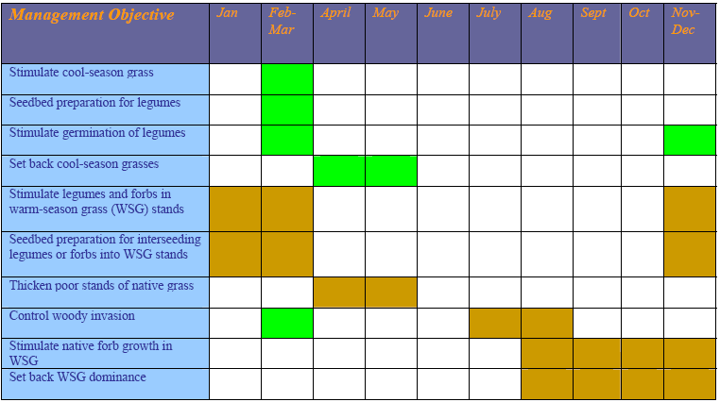
Green shading indicates cool-season grass activity Tan shading indicates warm-season grass activity
Do not burn in April and May unless you have one of these two goals!
Notes:
Timing review - Here is a quick reference chart for selected prescribed burning activities. Note the only time you should burn in the months of April and May is if your objective is to set back cool-season grasses or thicken a poor stand of native warm-season grass. Thick stands of native warm-season grasses should not be burned during these months.

Slide 26
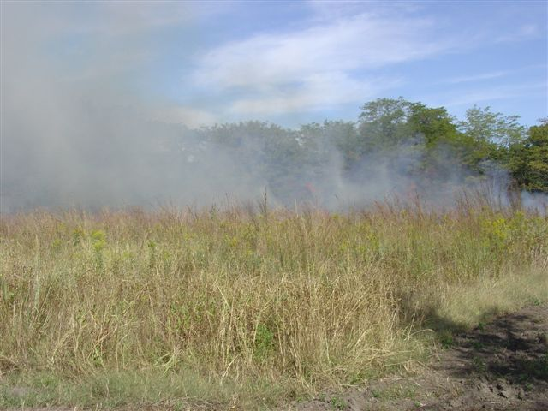
Prescribed Burning
Regardless of what time or type of grass you are burning, always have a written prescribed burn plan in place
Contact your local USDA Service Center, or wildlife biologist for assistance with burn plan writing
Notes:
Regardless of what time or type of grass you are burning, always have a written prescribed burn plan in place and only burn when conditions are suitable to meet your objectives. Contact your local USDA Service Center, MDC Private Land Conservationists or a Quail Forever wildlife biologist, for assistance with burn plan writing.

Slide 27
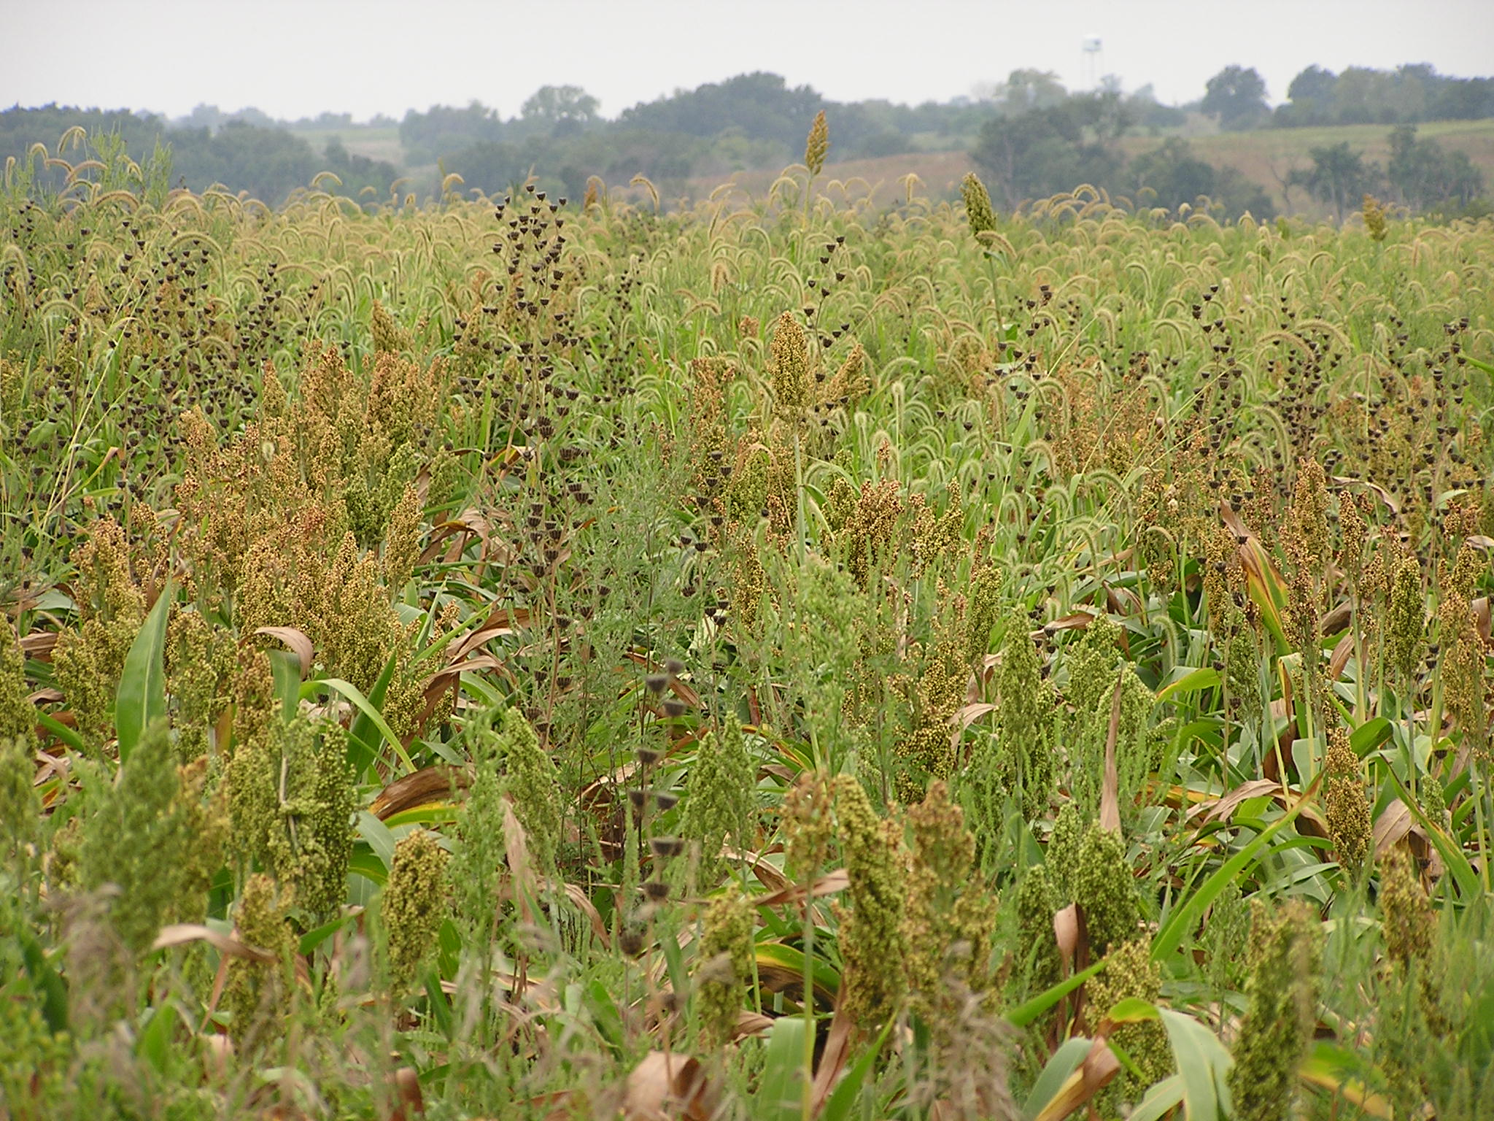
Remember…. Food Plots are Not Crop Fields!
Notes:
Food plots are a great way to provide bare ground for easy foraging with overhead cover. Food plots are used to provide a wide variety of foods for a host of wildlife species. Typically they are planted to an annual agricultural crop, such as corn or milo, to provide a high energy source of food for wildlife in the winter. Interest in other types of plants for food plots, such as ladino clover for green browse or forage sorghum for escape cover and food, has increased in recent years. Although food is seldom the primary limiting habitat component for wildlife in Missouri, the use of food plots can provide important food and cover plants—both planted and natural—resulting in an increased abundance and diversity of foods available to a wide range of wildlife species. Grain plots also create important brooding/bareground habitat. But remember, food plots should not look like clean crop fields. Weedy food plots simply provide more seed sources for wildlife to eat.
In general, food plots should be a minimum of 0.25 acres in size, at least 30 feet in width, and preferably located adjacent or within 70 ft of good woody escape cover and diverse herbaceous cover.

Slide 28
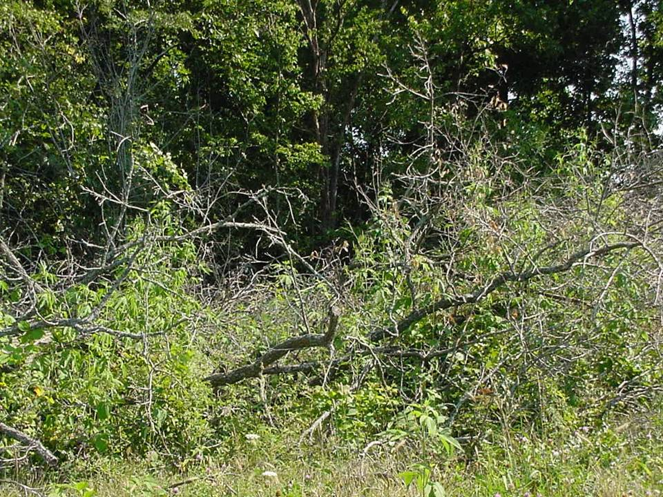
Escape and Loafing Habitat
Covey Headquarters: Stands of shrubby cover that provide overhead protection from predators and contain sparse vegetation at ground level.
Needed year-round
30’ x 50’ area of shrubby cover (1500 ft²)
3 - 12 feet in height
3 covey headquarters for every 40 acres
Wildlife Friendly Shrubs and Trees
★ Plums  False Indigo
★ Blackberries  Dogwoods
★ Sumacs  Buckbrush
Notes:
Protective escape cover is used by bobwhites throughout the year and is necessary for eluding predators such as hawks, owls, foxes, and house cats. Protective cover must persist throughout the year, especially during cold weather when thermal protection is needed and during the summer for protection from heat and sun. The lack of escape cover is often identified as a limiting factor on many farms in Missouri. The distribution of these CHQ across the farm is also extremely important. Research conducted during winter months in Missouri found that the average distance between known quail locations and woody cover was only 70 ft. In other words, the usable space a quail can use in a particular field consists of a relatively narrow band next to woody cover. To distribute the quail population across a larger portion of the farm, establish CHQs throughout the farm and place them about 150 ft apart (150 ft is the average distance a quail will flush)

Slide 29
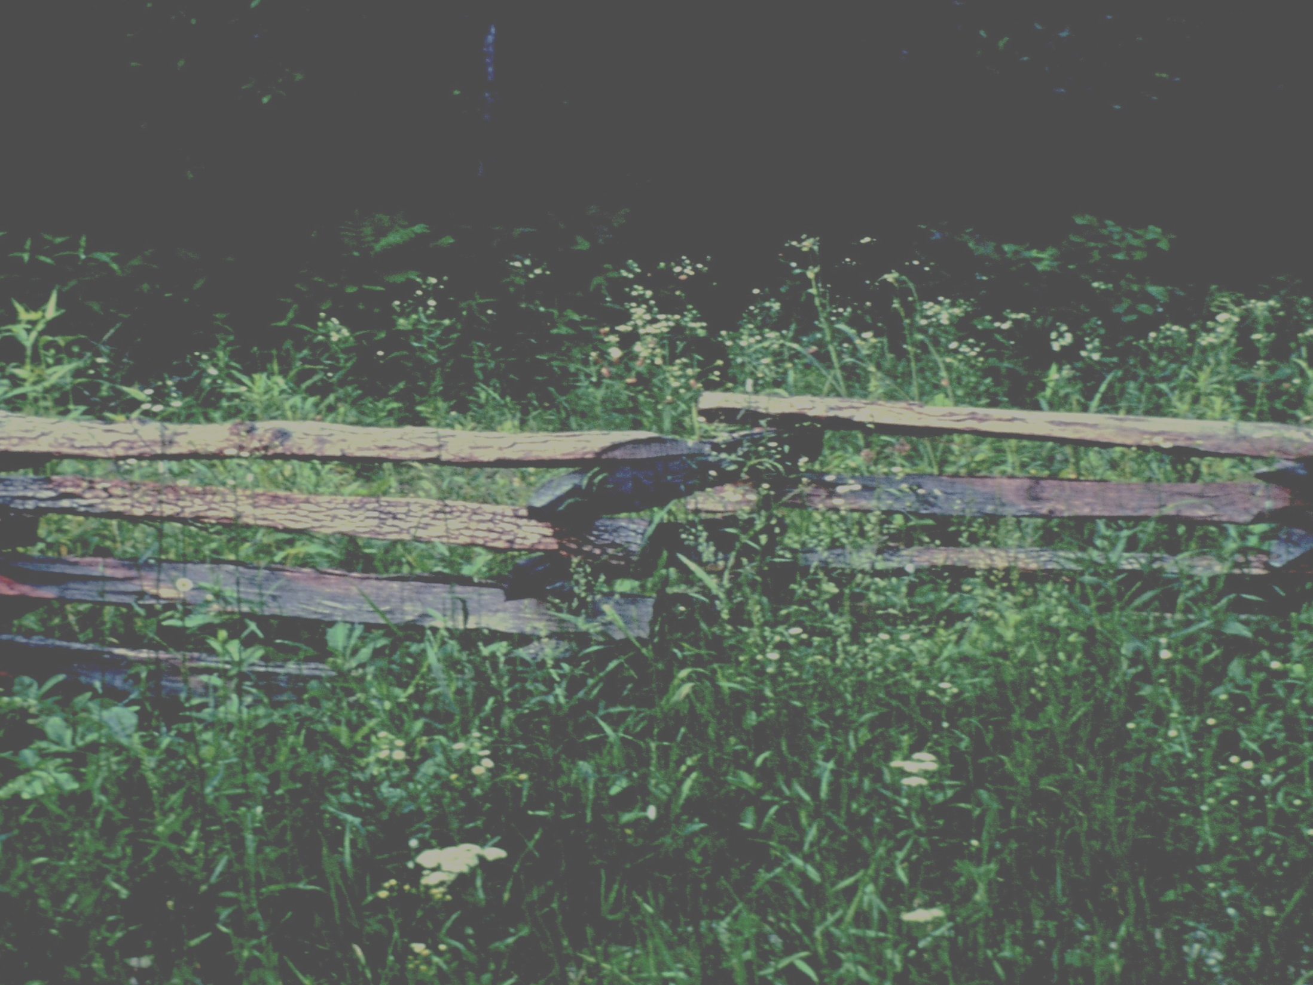
Creating Escape and Loafing Habitat
Edge Feathering
Downed Tree Structures
Planting Native Shrubs
Notes:
Common ways to create escape cover, often called covey headquarters (CHQ).

Slide 30
` The minimum size of an area to renovate is 30’x50’ ` Leave trees where they lay ` Use chemical to control invasive and other undesirables
Edge Feathering
Notes:
Be sure to treat existing grass, especially sod-forming grasses such as tall fescue and smooth brome, with an approved contact herbicide before cutting trees. This will create bare ground and provide good growing conditions for annual food plants and shrubs. Studies have shown that quail will avoid good dense woody cover if there is an understory of sod forming grass. Pick at least a 30’x50’ area where you can cut all trees over 12 feet tall. Leave native shrubs like dogwood or plum if they are less than 12 feet tall. Leave trees where they fall or “windrow” them along the fence or woody draw. Do not push the trees into a dense pile. To gauge whether the CHQ is the right density, imagine a volleyball thrown into the top of a CHQ. The ball should hit several branches and fall within the CHQ to the ground. If the canopy/CHQ is too thick, the ball will roll off and away from the CHQ. If the canopy is too thin, the chances of the volleyball hitting a shrub are low.
Downed tree structures (DTS) are created the same way, however are often placed away from existing fence lines or woody draws. DTS provide an immediate temporary source of woody cover in areas where shrubby cover is lacking. By distributing DTS throughout a field, approximately 150 ft apart, can create much more usable space for quail. Remember, in winter, quail rarely travel farther than 80 ft from protective shrubby cover. So by placing the DTS throughout the field, you will provide quail the opportunity to use the entire area. To be effective, place DTS within or adjacent to early-successional vegetation such as managed wildlife friendly grasses/legumes/forbs, field borders, food plots, or cropland.

Slide 31

Notes:
Example of edge feathering along a fence line.

Slide 32

Notes:
Example of the hinge-cut method for Edge feathering

Slide 33

Edge protection
Notes:
When possible, protect edge habitat, including CHQs from grazing cattle. This will help the structures last longer. You can also think about planting native grasses and forbs in a buffer between the shrubby cover and exclusion fence to provide nesting, brood, and escape cover all together.

Slide 34

Behind the Fence – Inside the Fence
Inside the Fence
Notes:
Now we will discuss a few management techniques and recommendations for actively grazed land that can be beneficial to both livestock and wildlife.

Slide 35

Practices Beneficial to Livestock and Wildlife
Convert a paddock to NWSG
Interseeding legumes or forbs
Use exclusion of timber stands and riparian areas
Resting/Deferment

Slide 36


Grazing is a flexible management tool
Notes:
The floristic community of tallgrass prairie co-evolved with the interaction of large grazers and fire. Cattle can be a great management tool for maintaining and enhancing grassland communities. Grazing is a unique management tool because it gradually removes dominant grasses and sculpts the vegetation to provide a nearly ideal mix of short, tall, dense and sparse cover at a scale that is useful to wildlife. The primary implications of grazing NWSG on wildlife are related to structural characteristics of the available cover.

Slide 37
COMMON NATIVE GRASSES FOR PASTURE
Benefits of NWSG
Drought Tolerant
Low Inputs
High forage quality during ‘Summer slump’
Wildlife Friendly
Switchgrass
Eastern Gamagrass
Big Bluestem
Little Bluestem
Indiangrass
Notes:
Encouraging a diversified forage base can help meet seasonal forage needs, reduce the need to harvest hay and increase usable space for quail and other grassland birds. NWSGs can provide high quality forage during Missouri’s ‘summer slump’, when cool season grass production is lacking.

Slide 38

Notes:
This is a slide from the Center for Native Grasslands Management out of the University of Tennessee (Dr. Pat Keyser) which shows the drought tolerance of warm season grasses. On the y-axis is the Survival (days post watering) and on the x-axis is several NWSG that are commonly found in Missouri. Natives have rooting depths as much as 10-12 feet. Such deep roots allow these drought-hardy species to find water not available to species with shallower roots. If you are wanting some “drought insurance”, having a native grass pasture can help balance out your cool-season forage base and give you some alternatives during drought periods.

Slide 39

Notes:
This was taken in July 2012. If you recall, in 2012 there was a significant drought in Missouri. Notice on the left side of the fence is a hayfield of NWSG established in 2009. On the right is a pasture of fescue.

Slide 40

Complimenting Tall Fescue with Native Warm Season Grasses
Grazed May-July w/
yearlings, or
June, July & August
w/ cows--8” residual
Big bluestem
Indiangrass
Sideoats grama
Little bluestem
Cool-Season
Grass
Cool-Season Grass
Cool-Season Grass
Notes:
If you have never planted native grasses and you are interested in establishing NWSGs for grazing or haying, it would be best to start relatively small, maybe 3 – 5 acres. Select an area that is already in need of renovation, or perhaps an odd area that has been out of production for a while. Starting at a modest scale and/or on marginal land reduces risk by having a minimal area out of production and limits exposure in case drought or other issues impact establishment success. Once you have established this smaller area, you can gain some experience in managing these grasses and from there, decide how much more you would like to plant. In the long-term, having 25 – 50% summer forages is a good goal.
This diversification also helps provide wildlife cover because grazing and rest cycles follow seasonal changes in forage quality.
Information source: Managing Native Grass Forages Dr. Patrick Keyser, Professor and Director, Center for Native Grasslands Management
How Much Warm-season Grass Do I Need?

Slide 41
Timing of Grazing NWSG
Notes:
Grazing is typically initiated in late April or early May when NWSG height is approximately 15 inches tall. If grazing is initiated earlier, grass growth and livestock performance may be reduced. If grazing is initiated later, the grass will be overmature and stemmy; thus, not as palatable and less nutritious. Typically, NWSG should not be grazed past early August to allow sufficient growth for winter cover. At this point, livestock grazing NWSG can be moved to CSG pasture that has rested through
the summer.
(Information from “Wildlife Considerations When Haying or
Grazing Native Warm-Season Grasses – University of Tennessee)
Optimally, native pastures should be split into at least two pastures. Graze approximately half of available acres from April through mid-June. Then, rotate grazing to the portion that was rested during the early part of the season. This approach allows livestock to graze peak-quality forage during the early portion of the season and provides undisturbed nesting habitat through the June nesting period. Additionally, regrowth on the portion grazed early in the season will likely be attractive and beneficial to late-season nesters as well.
(Recommendations from the Center for Native Grasslands Management, University of Tennessee Institute of Agriculture.)

Slide 42

Grazing Heights
Wait to initiate grazing until average canopy height has reached 13 to 15 inches in the spring.
To maintain palatability don’t allow grasses to get beyond 24 – 26 inches or form seed heads.
Graze warm-season grasses no shorter than 6-8 inches in summer
Notes:
Native forage grasses such as switchgrass and big bluestem are tall grasses and therefore, require taller harvest heights. There are several reasons why this is important. First, tall species have elevated growing points – the anatomical structure in grasses that produce foliage. For instance, in switchgrass, the growing point starts out early in the growing season at ground level. As the season progresses though, it ends up being 8 inches or more above the ground. Another reason low cutting/grazing heights are not desirable for native grasses is that you gain very little forage from the bottom of the plant. Below 8 inches on these plants there is very little forage – mostly stem. Taking this portion of the plant then, adds little by way of desirable forage yield to your harvest.
Wait to initiate grazing until average canopy height has reached 13 to 15 inches in the spring. To maintain palatability don’t allow grasses to get beyond 24 – 26 inches or form seed heads. It’s recommended to graze warm-season grasses no shorter than 6-8 inches in summer and remove livestock in late summer to allow re-growth for nesting cover the following year. Whether harvesting hay or grazing, it is important to leave enough canopy to keep plants vigorous. These recommendations are designed to maintain both the palatability and long-term health of mixed stands of native grasses and forbs.
(Info taken from “Managing Native Grass Forages” Patrick Keyser, Professor and Director, Center for Native Grasslands Management)

Slide 43
End of Season Rest Period
Remove cattle in late summer to allow re-growth for nesting cover the following year
Allow 4-6 weeks of rest before the average first frost date
Rule of Thumb: Leave stand heights of 18 inches or more at first killing frost.
Notes:
Like many warm-season perennials, native grasses need rest prior to fall dormancy. This rest period allows the grass to store adequate energy (carbohydrates) in the root systems to overwinter successfully. Aggressive use of native warm-season grasses in late summer can lead to weakened stands and unacceptable levels of weed encroachment. In turn, this will lead to reduced carrying capacity and production – and eventually, even stand loss.
Grasses should be allowed 4 - 6 weeks of rest before the average first frost date for your location. Approximately 4 weeks for rotational grazed and 6 weeks for continuous grazed pastures. Grazing of NWSGs should cease well prior to the first killing freeze. A good rule of thumb would be to have stand heights of 18 inches or more at the first killing frost. Generally eight inches of stubble on Sept. 1st will regrow to 12 inches by November 1st. This approach favors long-term maintenance of the stand and provides the necessary residual for nesting cover the following spring. The actual amount of rest a grazed stand requires can be gauged by canopy condition/stand height in late summer.
(Information from Managing Native Grass Forages Patrick Keyser, Professor and Director, Center for Native Grasslands Management Fall Rest for Native Grass Forages)

Slide 44

Use Exclusion for Wildlife
Exclude livestock from woodland and riparian areas
Maintain a minimum 30 foot buffer outside the fence
Eradicate cool-season grasses
Plant to wildlife friendly grasses and forbs
Install CHQs or native shrubs
Notes:
Also: Protects trees and plants from soil compaction and reduces soil erosion

Slide 45


Interseeding Legumes = More Diversity
Notes:
Introduced CSG pastures generally lack diversity that might benefit wildlife. To improve the diversity for forage and wildlife, considering establishing or interseeding compatible legumes. Examples are annual lespedezas, red and ladino clover, Illinois bundleflower, partridge pea, leadplant, Maximillian sunflower, ashy sunflower, and alfalfa. Periodic rest is occasionally necessary to allow legumes to set seed.

Slide 46
References
NRCS eFOTG - Wildlife Job Sheets
Edge feathering, DTS, Prescribed Burning, Strip Disking, and more
https://efotg.sc.egov.usda.gov/efotg_locator.aspx
MU Extension
http://extension.missouri.edu/
Center for Native Grasslands Management – University of Tennessee Institute of Agriculture
http://nativegrasses.utk.edu/manage.htm
Missouri Department of Conservation
https://mdc.mo.gov/property
Quail Forever
https://quailforever.org/

Slide 47

Questions?

