Slide 1
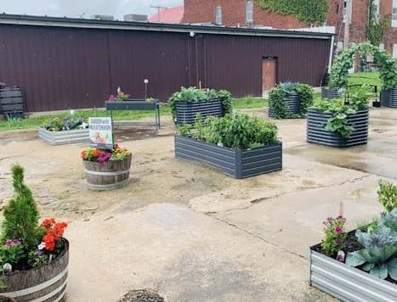

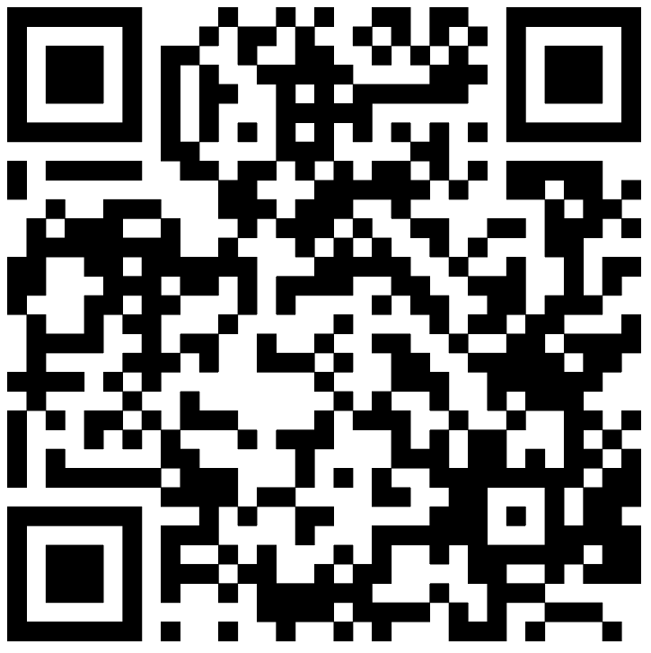
Become an
MU Extension Changemaker!
Do you want to help make healthy changes in your community?
Extension Changemakers will:
Work with local MU Extension specialists
Learn how to determine community health needs
Learn how to implement their chosen project
Sample projects could include:
Starting a community garden
Marking a community walking trail
Doing a healthy food drive
for a local food pantry
Help Make Change!
extension.missouri.edu/programs/extension-changemakers
Interested? Please contact:
Debbie Bennett
660-582-8101
bennettdl@missouri.edu
Notes:
Print flyer:
Add details and photo to the flyer.
Click “File” > “Save as”. Select folder where you’d like to save the flyer.
Name flyer.
Change document type to “.pdf”
Click Save.
If prompted to select which slide you want to save, click on “just this one.”
Open document and print.
NOTE: The exported PDF should NOT be used in a digital format. It will not be accessibility compliant (April 2026) without further editing in Adobe Acrobat.

