Slide 1





MU Extension in
(insert) County
For questions about giving or to make a donation by phone, contact the MU Extension in (insert) County office at (phone number) or (email address).
Give online at (xxxxx.xxx)
To give by mail, make your check payable to University of Missouri in (insert name) County and mail your donation to:
MU Extension in (insert name) County
Street address
City, State, Zip
Give local.
Get local results.
An equal opportunity/ADA institution
Notes:
To customize:
Highlight the text you want to change. Hit “delete.”
Type your text in the appropriate space.
Once you’ve completed the customization, save the file as a pdf.
See notes on page two for printing instructions.
Contact Laura Lindsey (lindseylau@missouri.edu) with questions.

Slide 2
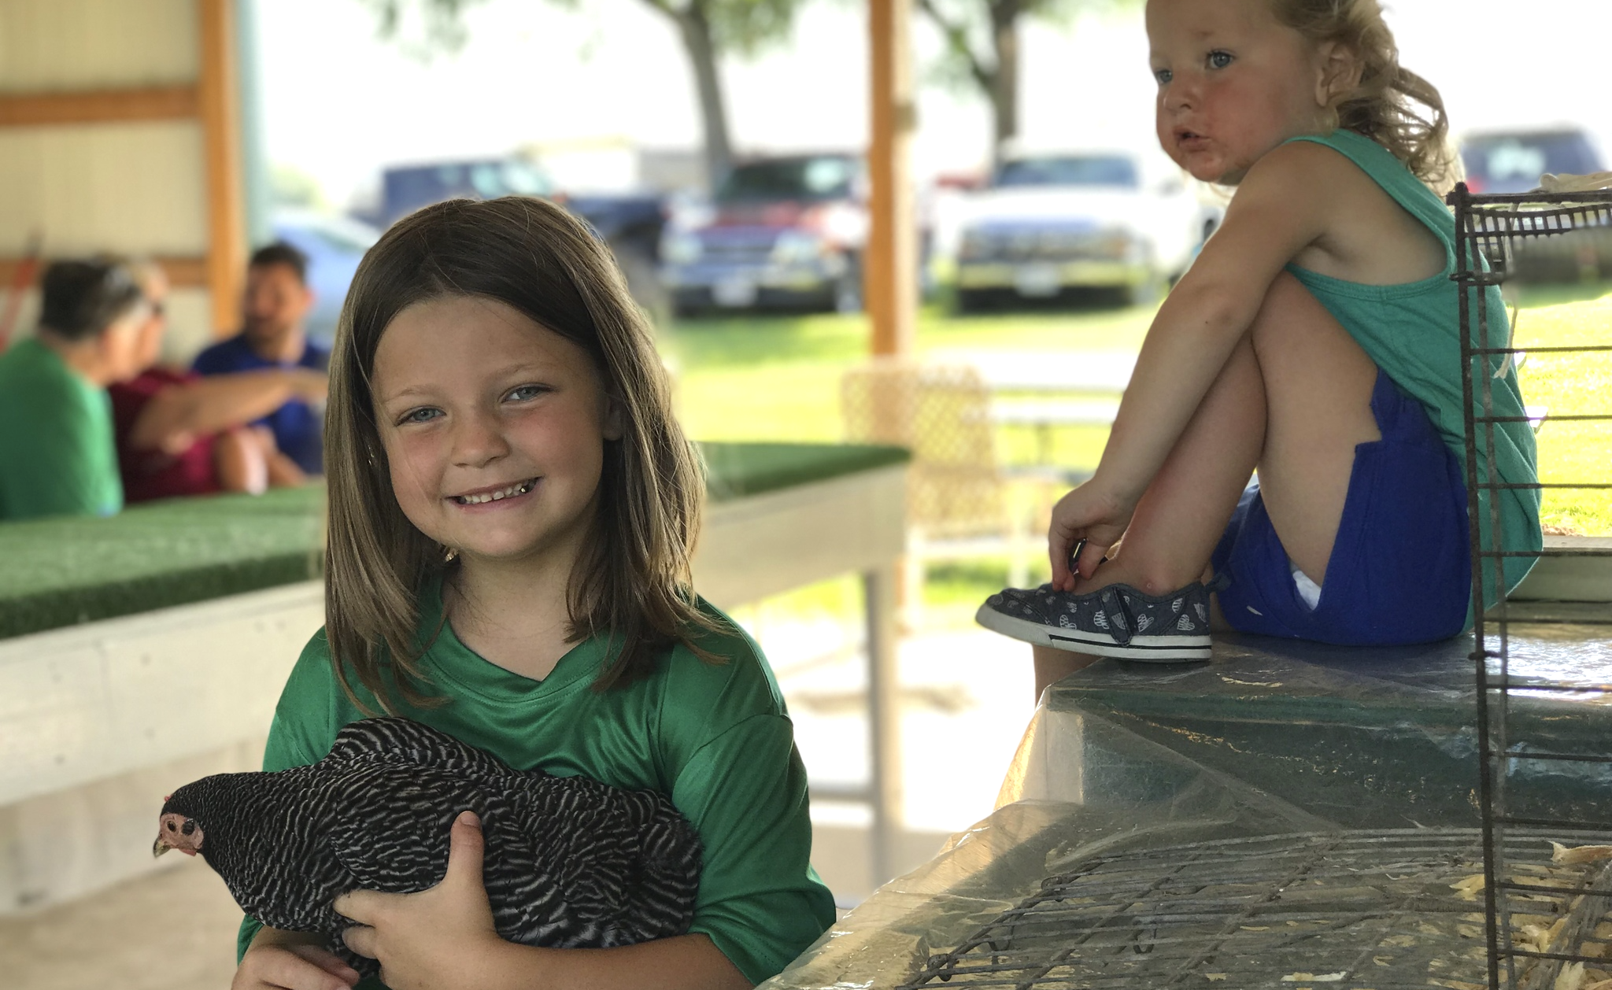


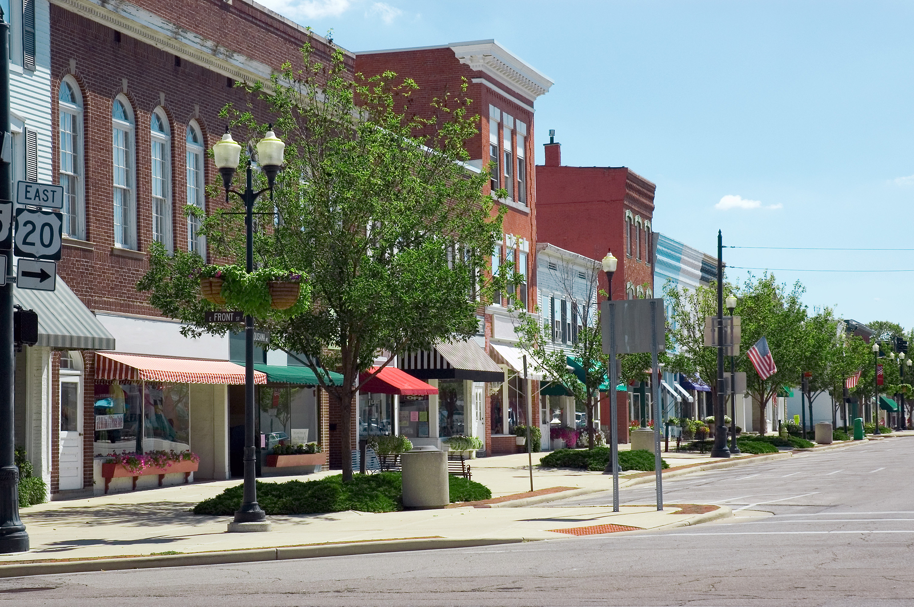
MU Extension in
(insert) County:
Give local.
Get local results.
If you want to add a different picture, click on existing photo and hit delete. Click on icon to select picture from your files and insert.
Photo should automatically size to fit the area.
Note: Be sure to use horizontal photos for a horizontal area and a vertical photo for a vertical area.
For (number) years, University of Missouri Extension in (name) County has met the unique needs of the community by providing credible solutions and resources.
Today, we’re committed to bringing the full benefits of research and resources from the University of Missouri to you by focusing on three key areas:
economic opportunity
educational access and excellence
health and well-being
We ask for your help to continue this important partnership. Your gift will help us engage youth, build a vibrant economy, strengthen our community and meet the changing needs of (name) County.
We need you
Your support of any amount to the (name) County Endowment Fund will ensure we can continue to offer solutions that empower you to improve your life, business and community.
• Program name
• Program name
• Program name
• Program name
• Program name
• Program name
• Program name
• Program name
• Program name
• Program name
Your gift is tax deductible.
Add the names of your most popular and relevant programs in a bulleted list here. Do not list more than 10.
If you want to add a different picture, click on existing photo and hit delete. Click on icon to select picture from your files and insert.
Photo should automatically size to fit the area.
Note: Be sure to use horizontal photos for a horizontal area and a vertical photo for a vertical area.
Notes:
*****PRINTING NOTES*****
RECOMMENDED:
Save as a PDF and order via ”Upload and Print” on the extension website. You can access this tool by logging in and clicking on ”My account” at the top right of the page. Click on “account settings” to access your dashboard. “Upload and print” is on the left.
Once you’ve entered the Upload and Print tool you’ll see some introductory info before you click the UPLOAD AND PRINT button at the bottom of the page. From there you’ll need to click CUSTOMIZE to enter the tool.
The tool will default to ”Copies” as the product you are ordering, but to the right click the drop down to select “brochures.”
First upload your PDF to generate a preview. Next, select the “Print options” tab to enter quantity to name your job order. Please select the following options to complete this tab: paper size: LETTER; KEEP SIZE, FULL COLOR; DOUBLE SIDED; LANDSCAPE. For paper type, it’s recommended that you print on
“Gloss Text Premium White – 80lb.”
Lastly, click the “Finishing” tab and select “Half Vertical” in the ”Folding” dropdown menu. From there you can click CONTINUE to review and complete your order.
OR:
To print yourself:
Use at least a premium 70 lb. or 28 lb. paper weight for best results.
Select “Actual size” under Page Sizing and Handling
select “Print on both sides of paper” and choose “Flip on short edge”
Select “Auto portrait/landscape” for orientation.
Indicate correct printer and number of copies desired.

