Slide 1
Orientation
County Council
Notes:
Note: The presentation contains many places where information about your county should be included. These places are noted within the speaker notes.
Welcome to the <Name> County Extension council. This training session is designed to give you an overview of your role as a council member and the workings of Extension.
As a county Extension council member, you play a vital role in meeting the educational needs of people in <Name> County.
County Extension councils were created by state statutes to work with the University of Missouri in carrying out local educational programs.

Slide 2
Land-Grant Mission
Morrill Act of 1862 - established the University of Missouri as a land-grant university
Morrill Act of 1890 - established the Lincoln University
Hatch Act 1887 established agricultural experiment stations – Delta Fisher Research Center in SE / Wurdack Research Center (Cook Station)
Smith-Lever Act of 1914 established the Cooperative Agricultural Extension Service - Distinct mission of service fulfilled through Extension
Notes:
Extension is grounded in the land-grant mission established by the federal Morrill Acts of 1862 and 1890.
The land-grant mission mandates resident instruction, research and service, and it is this mission that distinguishes the University of Missouri and Lincoln University from other colleges and universities in the state.
Through Extension, the Universities fulfill their service mission by delivering science-based information and education to the people of Missouri through county Extension centers.
Wurdack Research Center - Nestled along the Meramec River near Cook Station in the northeast Ozarks, this Center conducts demonstrations and research in integrated livestock, forages, forestry, agroforestry and wildlife management practices that are economically viable, environmentally sound and sociologically acceptable for the Ozark Region of Missouri. Timber covers most of the acreage, while 260 acres provide the base for forage production, rotational grazing and cattle production. Current research includes programs to improve forage, beef, agroforestry and timber.

Slide 3
Extension Mission
County Extension councils
University of Missouri System
Lincoln University
US Dept. of Agriculture
Other stakeholders and partners
Notes:
(Mission Continued)
As an integral part of the land-grant mission, University of Missouri Extension is a joint venture of the:
University of Missouri campuses (including Columbia, Kansas City, Rolla and St. Louis)
Lincoln University Cooperative Extension
The people of Missouri through county Extension councils
Cooperative State Research, Education and Extension Service of the U.S. Department of Agriculture
And other stakeholders and partners.

Slide 4
Extension Mission: Our distinct land-grant mission is to improve lives, communities and economies by producing relevant, reliable and responsive educational strategies that enhance access to the resources and research of the University of Missouri.
  Highest priorities in the county
  Applying research-based knowledge - unbiased
Notes:
The Extension mission is to:
“Improve Missourians’ lives by addressing their highest priorities through the application of research-based knowledge and resources.”

Slide 5
Engagement
Added in 2016
Goal – engage entire MU system with communities across the state
Statewide Engagement Council created to provide focus
Notes:
(Mission Continued)
In 2016 the director of Extension’s title was changed to “Vice Chancellor for Extension and Engagement.” This change elevated the position to the Chancellor level and added “engagement” to the title.
Engagement efforts aim to connect the residents of our state with all of the resources of the University system, not just those who have traditionally been a part of our Extension program efforts.
The MU Engagement Council has been created to bring together university leaders to focus on the engagement initiatives of the university. By strengthening public engagement and connecting the people of the state to the University, we hope to increase our public understanding and support.

Slide 6
County Council Responsibilities
Notes:
Lets discuss the responsibilities of your Extension council.

Slide 7

Councils created by statutes 262:550 to 262:620 work with the University
Responsibilities
Programs
Governance
Membership
Notes:
State statutes give Extension council members specific legal responsibilities. These responsibilities can be categorized into three general areas:
Educational program development and implementation
Governance
and Membership.
In this session, we will take a brief look at each of these areas. More specific information about these areas of responsibilities is explored in depth in other council training modules.

Slide 8
Council Responsibilities
Identify concerns 262.587
Make recommendations 262.587
Work with regional faculty 262.593
Ensure access 262.587
Secure local funding to support programs and administer local budget 262.597
Annual elections 262.573
Manager Office Operations 262.583
Notes:
Council members’ responsibilities for Educational Program Development and Implementation include assisting regional faculty in planning and carrying out Extension programs in their county. As council members, we:
Identify concerns in our communities
Make recommendations to the University and work with local faculty
And ensure access to local residents, groups and organizations.

Slide 9
Council Responsibilities
Membership
Recruit candidates
Ensure diverse voices, representing all citizens
Orient new members
Provide ongoing member training
Notes:
Membership on the Extension council is comprised of elected and appointed representatives.
The council holds responsibility for recruiting candidates and conducting the election.
The key to a council’s effectiveness is recruiting individuals who represent the broad educational needs and backgrounds of people who live in the county.
Membership responsibilities also include orienting new members to the council and providing ongoing training to enhance the ability of members to serve their constituents.

Slide 10
Governance
Important Considerations
  Legally obligated to operate within State Statutes
  Comply with Sunshine Law
  Avoid conflict of interest
    Divulge conflict
    Remove yourself from conflict
Notes:
County Extension councils and their operations are set forth in state statutes. Choosing to ignore state law opens you up to liability.
Councils are required to comply with Missouri’s Sunshine Law. Notice of meetings must be posted, and requests for records fulfilled.
The University makes recommendations to help you be aware of “best practices” but the council is free to make their own decisions – but they also are responsible for repercussions from those decisions.
All nonprofits and government agencies are required to refrain from conflict of interest. Defined as putting personal benefit before the welfare of the organization. If potential conflicts arise, disclose it to the group. Remove yourself from the decision making process (discussion as well as vote.)

Slide 11
Local Faculty and Staff
Notes:
Let us introduce you to the people who provide Extension programs to your county.

Slide 12
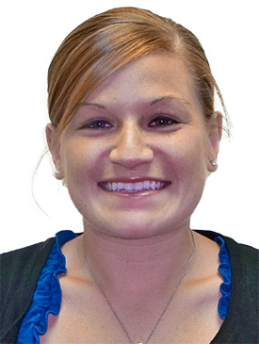
County Office Staff
County Engagement Specialist – Bethany Bachmann (Nutrition)
  Liaison among council, staff and University
  Off-campus faculty in triad
    Genevieve Mendoza Perez 4-H Youth Development
Notes:
Note: Add name and photograph of your county’s
CES.
(Name) is our County Engagement Specialist.
The County Engagement Specialist, often referred to as the CES, is a off-campus specialist assigned by the University to serve as a liaison among the county Extension council, and other faculty who serve our county and the University. (Name) ensures that the educational programs in our county meet the high-priority needs of our constituents.

Slide 13
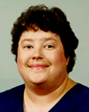
Clerical Staff
Council funded employees
Support
Office operations
Programming
Joann Steffens
Office Support
Notes:
Clerical staff in the Extension center are employed by the Extension council or MU Extension through a MOU with University of Missouri. Through the MOU, the council pays all the payroll costs for the staff person. In either arrangement, these individuals provide support for both office operations and programs.

Slide 14
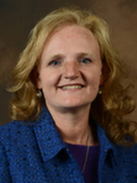
Paraprofessionals
University employees – concentrated program effort
Program specific focus
Dianna Koenig YPA
Amanda Kiszczak NPA
Council may support full salary or partial salary
Family Nutrition Education Program (NPA)
4-H Youth Development Program (YPA)
Notes:
Counties also are served by paraprofessionals who work with the:
Family Nutrition Education Program
Small Farm Family Program
And 4-H Youth Development.
These staff members are University employees. (Note: If council shares salary responsibility, include that information here.) Paraprofessionals are supervised by regional specialists.

Slide 15
Regional Field Specialists
University faculty appointments
Multi-county assignments – multiple specialties
Provide education in their specialty
Notes:
As a council member, you will interact regularly with the faculty and staff who work in the county. Regional Extension specialists, as the title implies, specialize in a particular field. They are faculty members of the University of Missouri. While regional specialists are headquartered in a specific county, most have multicounty assignments. This structure allows each county access to expertise in a number of specialty areas that might not otherwise be available.
Councils play an important role in hiring those specialists, serving on personnel teams during the hiring process and approving candidates for positions in their county. Councils also participate in annual performance reviews of regional specialists.

Slide 16
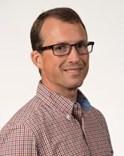
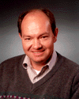
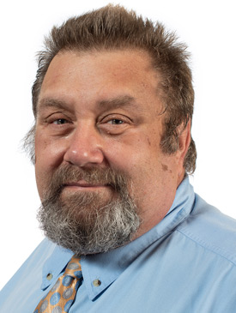
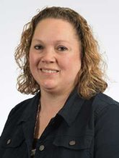
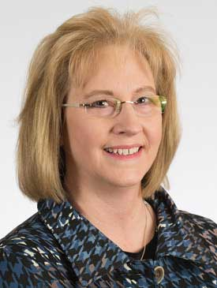
Field Specialists Serving
Anthony Ohmes
FIELD SPECIALIST IN AGRONOMY
David Reinbott
FIELD SPECIALIST IN AGRICULTURAL BUSINESS
Richard Proffer
FIELD SPECIALIST IN COMMUNITY DEVELOPMENT
Donna Aufdenberg
FIELD SPECIALIST IN HORTICULTURE
Mary Engram
FIELD SPECIALIST IN HUMAN DEVELOPMENT
https://extension.missouri.edu/counties/southeast-region
Notes:
Note: Use this slide and make additional slides as necessary to list regional specialists 1) assigned to the county and 2) serving the county. Photos from the Extension staff directory may be added to the slide.
In our county, we have (number) of specialists headquartered here. They are:
(list name and title)
These specialists also serve our county:
(list name, title, headquarter county – use additional slides as necessary)

Slide 17
MU Extension
Organizational
Structure
Notes:
Let’s discuss how Extension is organized in our state

Slide 18
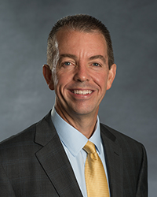
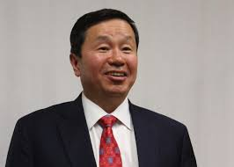
Leadership
Extension Led by
Vice Chancellor for MU
Extension and Engagement
Marshall Stewart
Reports to
MU Chancellor and President of University System
Dr. Mun Choi
Notes:
The University of Missouri Extension program is administered by the Columbia campus, MU. Dr. Marshall is Vice Chancellor for MU Extension and Engagement.
He reports to MU Chancellor, the campus’s chief academic officer. Garnett Stokes currently serves as Interim Chancellor
While administrative responsibility is assigned to Columbia, Extension collaborates with the University of Missouri campuses in Kansas City, Rolla and St. Louis to fulfill the land-grant mission.

Slide 19
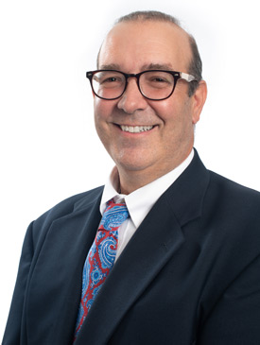
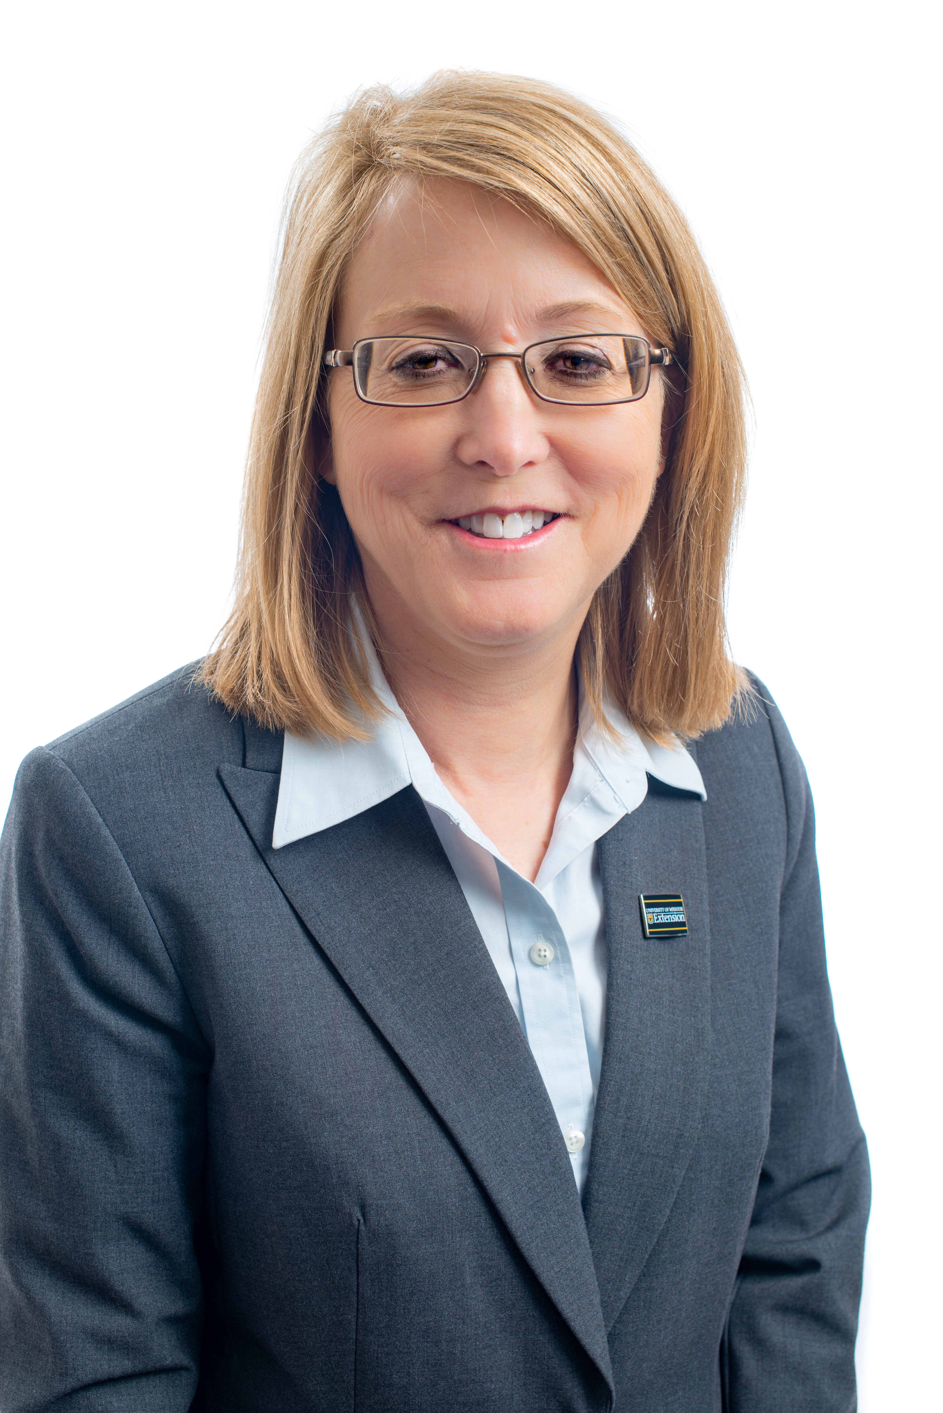
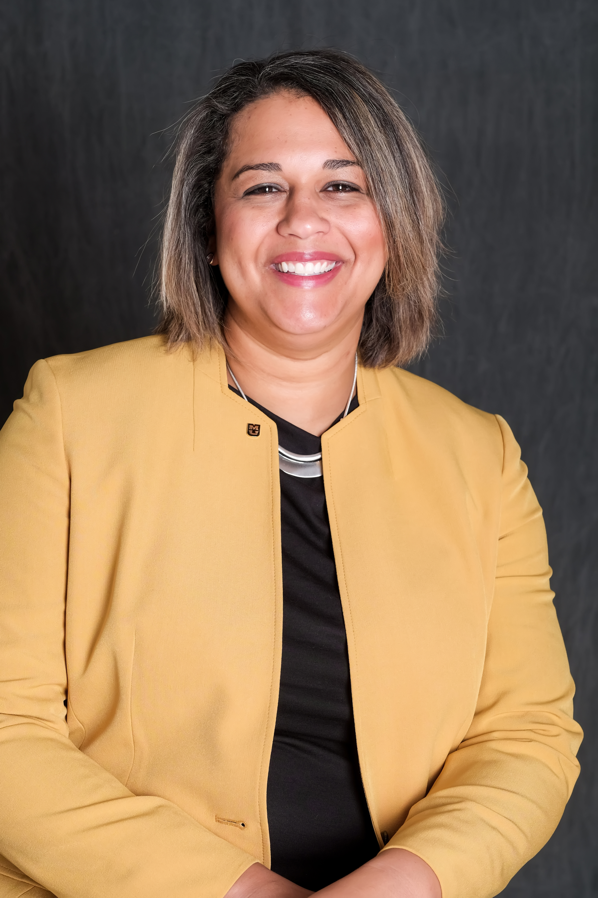
Leadership
Chadwick Higgins
Associate Vice Chancellor for Extension and Engagement
Callie Glasscock
Director of Finance and Human Resources
Susan Renoe
Associate Vice Chancellor for Research, Extension and Engagement
Notes:
The Extension Leadership Team also includes:
Blake Naughton, Associate Vice Chancellor for Extension and Engagement
Susan Reno, Assistant Vice Chancellor for Research, Extension and Engagement

Slide 20
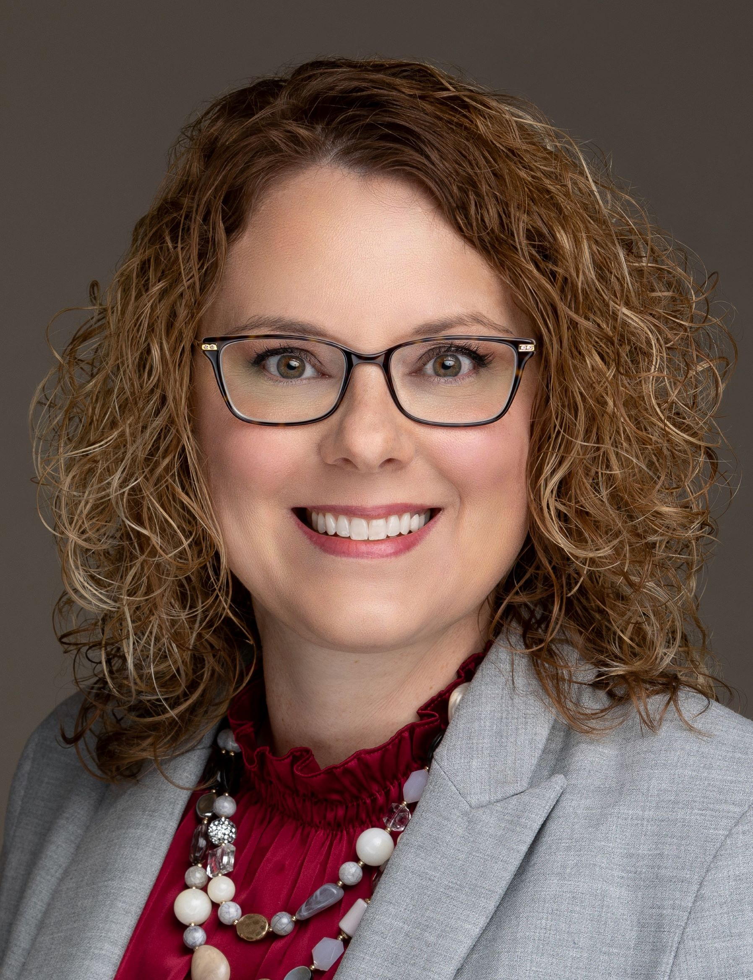
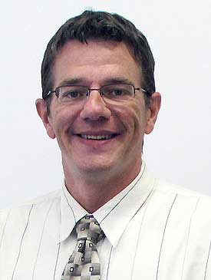
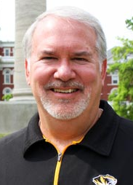
Leadership
Sarah Traub
Director of Education
& Impact
Kyle Blomenkamp
Interim, Communication / Marketing Director
James Preston
Chief Development Officer
Notes:
The Extension Leadership Team also includes:
Blake Naughton, Associate Vice Chancellor for Extension and Engagement
Susan Reno, Assistant Vice Chancellor for Research, Extension and Engagement

Slide 21
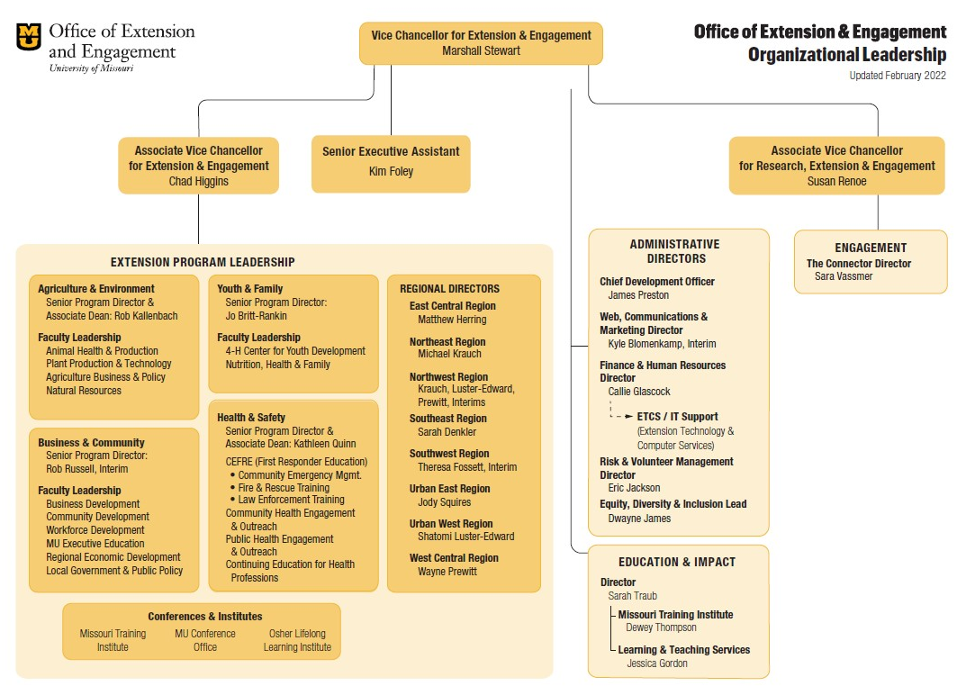
Organizational Structure
Notes:
This organizational chart shows how MU Extension’s leadership team is organized

Slide 22
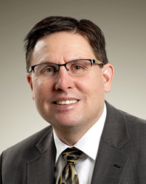
Agriculture and Environment
  Animal Health & Production
  Plant Health & Production
  Agriculture Business & Policy
  Natural Resources & Environment
Rob Kallenbach
Senior Program Director, Associate Dean
Notes:
Through a recent reorganization, MU Extension programmatic leadership is organized around outcomes.
In Agriculture and Environment, leadership is provided by Rob Kallenbach, Senior Director and Assistant Dean. Programming in this area includes
Animal Health & Production
Plant Health & Production
Agriculture Business & Policy
Natural Resources & Environment

Slide 23
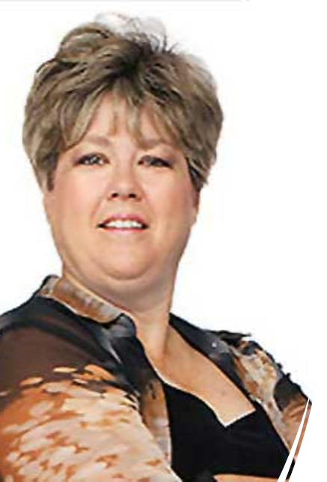
Youth and Families
  Nutrition & Wellness Education
  Family & Home Education
Jo Britt-Rankin
Senior Program Director
Notes:
Leadership in the area of Youth and Families is provided by Jo Britt-Rankin, Senior Program Director and Associate Dean.
Youth and Families programs will include:
4-H Center for Youth Development
Nutrition & Wellness Educations
Family & Home Education

Slide 24
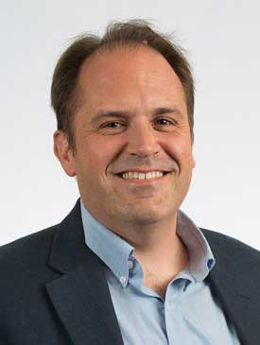
Businesses and Communities
  Business Development
  Community Development
  Workforce Development
Rob Russell
Interim, Senior Program Director
Notes:
Business and Communities is led by Steve Devlin, Program Director and Associate Dean. Programming in this area focuses on:
Business Development
Community Development
Workforce Development

Slide 25
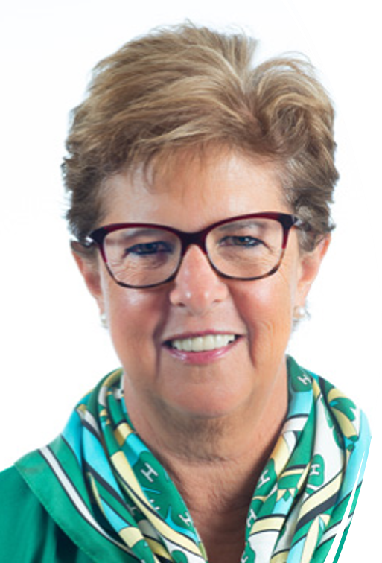
4-H Center for Youth Development
  Youth Development
  Volunteer Development
Lupita Fabregas
Senior Program Director
Notes:
Business and Communities is led by Steve Devlin, Program Director and Associate Dean. Programming in this area focuses on:
Business Development
Community Development
Workforce Development

Slide 26
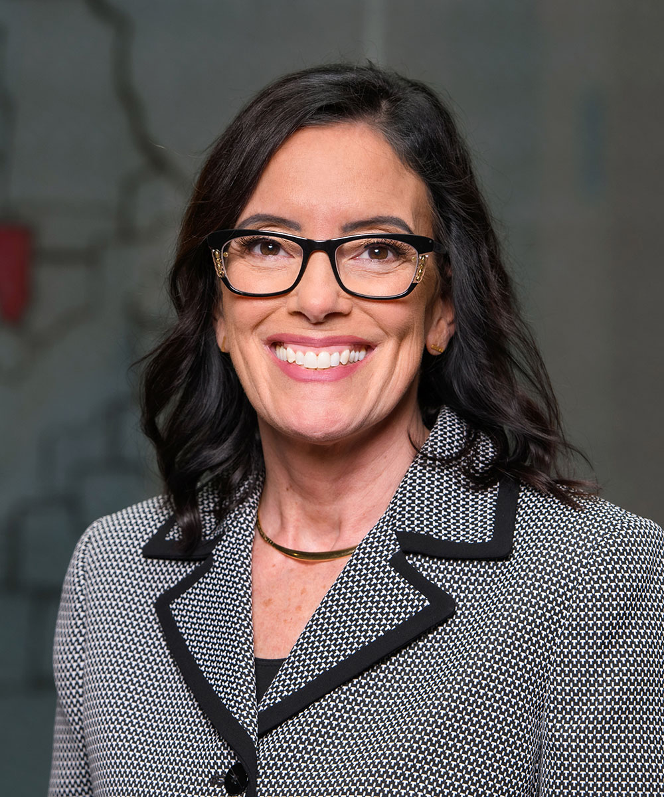
Health and Safety
  Community Health
  Continuing Medical Education
  Nursing Outreach
  Law Enforcement Training
  Fire & Rescue Training
  EMS Education
  Community Emergency Mgmt.
Kathleen Quinn
Senior Program Director, Associate Dean
Notes:
Additionally, MU Extension will continue to provide programming around health and safety, including:
Continuing Medical Education
Nursing Outreach
Law Enforcement Training
Fire & Rescue Training
Blake Naughton, Associate Vice Chancellor for Extension and Engagement, will provide leadership in this area

Slide 27
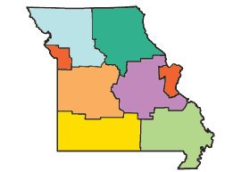
Extension Regions:
Northwest
Northeast
West Central
East Central
Southwest
Southeast
Urban (West and East)
Notes:
Across the state, Extension is divided into seven administrative regions, supervised by Regional Directors.

Slide 28
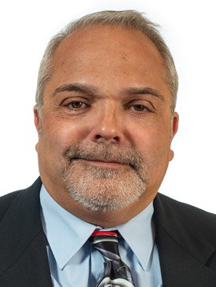
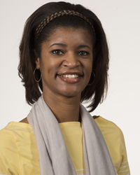
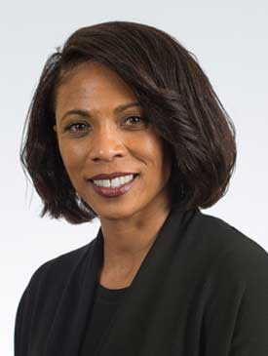
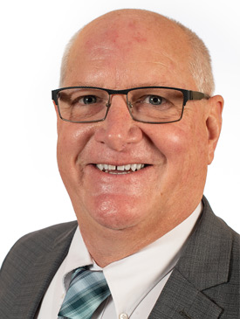
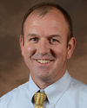
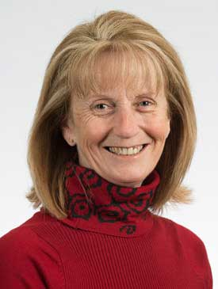
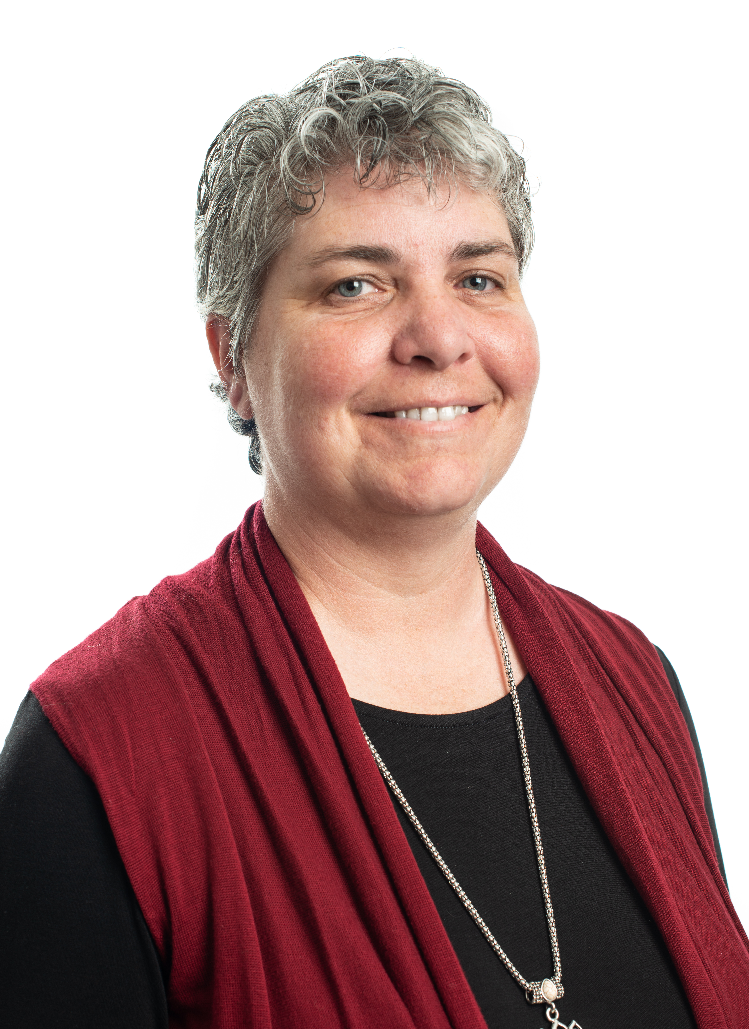
Mike Krauch
Northeast
Shatomi Luster-Edward
Urban West
Jody Squires
Urban East
Regional
Directors
Matt Herring
East Central
Wayne Prewitt
West Central
Teresa Fossett
Southwest - Interim
Sarah Denkler
Southeast
Notes:
Business and Communities is led by Steve Devlin, Program Director and Associate Dean. Programming in this area focuses on:
Business Development
Community Development
Workforce Development

Slide 29
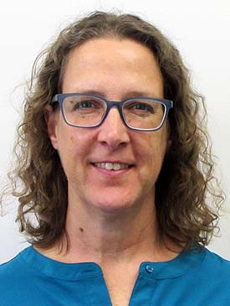
Michelle Chapman
Family Nutrition Education Program (FNEP)
Associate Director
Nancy Keim
Family Nutrition Education Program (FNEP)
Associate Director
Notes:
Note: Choose only the Regional Director slide for your region.
We are in the Southeast Region, and our Regional Director is Sarah Denkler, whose office is at the Delta Center in Portageville.
Regional Directors provide leadership for programming, coordination and evaluation at the county level. Each Regional Director supervises the work of regional Extension specialists.

Slide 30
County Extension Council Members
  Identify needs
  Secure funds
  Ensure access
Notes:
At the core of this structure are County Extension Council members who ensure the system works by:
Identifying local educational needs
Securing funds
And ensuring that the research-based information of the state’s land-grant universities is available to people in their communities.

