Slide 1
Orientation
Notes:
Note: The presentation contains many places where information about your county should be included. These places are noted within the speaker notes.
Welcome to the <Name> County Extension council. This training session is designed to give you an overview of your role as a council member and the workings of Extension.
As a county Extension council member, you play a vital role in meeting the educational needs of people in <Name> County.
County Extension councils were created by state statutes to work with the University of Missouri in carrying out local educational programs.

Slide 2
Objectives:
Understand MU Extension mission
Understand Council responsibilities
Understand role of Council members
Understand MU Extension structure
Notes:
The objectives of this orientation module are to help you understand:
Your role as a county Extension council member
The county Extension council’s relationship with the University.

Slide 3
Extension Mission:
Improve Missourians’ lives
Highest priorities
Applying research-based knowledge
Notes:
The Extension mission is to:
“Improve Missourians’ lives by addressing their highest priorities through the application of research-based knowledge and resources.”

Slide 4
Extension Mission
County Extension councils
University of Missouri
Lincoln University
US Dept. of Agriculture
Other stakeholders and partners
Notes:
(Mission Continued)
As an integral part of the land-grant mission, University of Missouri Extension is a joint venture of the:
University of Missouri campuses (including Columbia, Kansas City, Rolla and St. Louis)
Lincoln University Cooperative Extension
The people of Missouri through county Extension councils
Cooperative State Research, Education and Extension Service of the U.S. Department of Agriculture
And other stakeholders and partners.

Slide 5
Land-Grant Mission
Morrill Acts
University of Missouri (1862)
Lincoln University (1890)
Distinct mission of service
Fulfilled through Extension
Notes:
Extension is grounded in the land-grant mission established by the federal Morrill Acts of 1862 and 1890.
The land-grant mission mandates resident instruction, research and service, and it is this mission that distinguishes the University of Missouri and Lincoln University from other colleges and universities in the state.
Through Extension, the Universities fulfill their service mission by delivering science-based information and education to the people of Missouri through county Extension centers.

Slide 6
Engagement
Added in 2016
Goal – engage entire MU system with communities across the state
Engagement Council created to provide focus
Notes:
(Mission Continued)
In 2016 the director of Extension’s title was changed to “Vice Chancellor for Extension and Engagement.” This change elevated the position to the Chancellor level and added “engagement” to the title.
Engagement efforts aim to connect the residents of our state with all of the resources of the University system, not just those who have traditionally been a part of our Extension program efforts.
The MU Engagement Council has been created to bring together university leaders to focus on the engagement initiatives of the university. By strengthening public engagement and connecting the people of the state to the University, we hope to increase our public understanding and support.

Slide 7
County Council Responsibilities
Notes:
Lets discuss the responsibilities of your Extension council.

Slide 8

Councils created by statutes to work with the University
Responsibilities
Programs
Governance
Membership
Notes:
State statutes give Extension council members specific legal responsibilities. These responsibilities can be categorized into three general areas:
Educational program development and implementation
Governance
and Membership.
In this session, we will take a brief look at each of these areas. More specific information about these areas of responsibilities is explored in depth in other council training modules.

Slide 9
Council Responsibilities
Educational Programs
Identify concerns
Make recommendations
Work with regional faculty
Ensure access
Secure local funding to support programs
Notes:
Council members’ responsibilities for Educational Program Development and Implementation include assisting regional faculty in planning and carrying out Extension programs in their county. As council members, we:
Identify concerns in our communities
Make recommendations to the University and work with local faculty
And ensure access to local residents, groups and organizations.

Slide 10
Council Responsibilities
Governance
Administer local budget, operations
Manage county-paid personnel
Office operations
Annual elections
Marketing
Notes:
Governance includes a number of operational functions and responsibilities, such as:
Administering the local budget and operations
Managing county-employed personnel
Office Operations
Council Elections
Council meetings
Legal Requirements
Regional and State Extension council relationships
Marketing
And decision making.

Slide 11
Governance
Important Considerations
Legally obligated to operate within State Statutes
Comply with Sunshine Law
University recommends – you set local policy
Avoid conflict of interest
Divulge conflict
Remove yourself from the decision
Notes:
County Extension councils and their operations are set forth in state statutes. Choosing to ignore state law opens you up to liability.
Councils are required to comply with Missouri’s Sunshine Law. Notice of meetings must be posted, and requests for records fulfilled.
The University makes recommendations to help you be aware of “best practices” but the council is free to make their own decisions – but they also are responsible for repercussions from those decisions.
All nonprofits and government agencies are required to refrain from conflict of interest. Defined as putting personal benefit before the welfare of the organization. If potential conflicts arise, disclose it to the group. Remove yourself from the decision making process (discussion as well as vote.)

Slide 12
Council Responsibilities
Membership
Recruit candidates
Ensure diverse voices, representing all citizens
Orient new members
Provide ongoing member training
Notes:
Membership on the Extension council is comprised of elected and appointed representatives.
The council holds responsibility for recruiting candidates and conducting the election.
The key to a council’s effectiveness is recruiting individuals who represent the broad educational needs and backgrounds of people who live in the county.
Membership responsibilities also include orienting new members to the council and providing ongoing training to enhance the ability of members to serve their constituents.

Slide 13
Local Faculty and Staff
Notes:
Let us introduce you to the people who provide Extension programs to your county.

Slide 14
County Office Staff
County Engagement Specialist
Off-campus faculty member
Subject matter: 4-H Youth, Nutrition and Health, Business and Community
Single county (urban) duel, trio & quad assignments
Liaison among council, staff and University
photo
name
Notes:
Note: Add name and photograph of your county’s CES.
(Name) is our County Engagement Specialist.
The County Engagement Specialist, often referred to as the CES, is a off-campus specialist assigned by the University to serve as a liaison among the county Extension council, and other faculty who serve our county and the University. (Name) ensures that the educational programs in our county meet the high-priority needs of our constituents.

Slide 15
Clerical Staff
Council funded employees
Support
Office operations
Programming
Notes:
Clerical staff in the Extension center are employed by the Extension council or MU Extension through a MOU with University of Missouri. Through the MOU, the council pays all the payroll costs for the staff person. In either arrangement, these individuals provide support for both office operations and programs.

Slide 16
Clerical staff serving our county
Notes:
Note: Add names and photos of clerical staff members.
In (Name) County, we are pleased to have:
(List names and titles)
to support our local office.

Slide 17
Field Specialists
University employees with faculty appointments
Usually Multi-county assignments
Hiring
Annual performance appraisal
Council participates in:
Assignment of positions
Notes:
As a council member, you will interact regularly with the faculty and staff who work in the county. Regional Extension specialists, as the title implies, specialize in a particular field. They are faculty members of the University of Missouri. While regional specialists are headquartered in a specific county, most have multicounty assignments. This structure allows each county access to expertise in a number of specialty areas that might not otherwise be available.
Councils play an important role in hiring those specialists, serving on personnel teams during the hiring process and approving candidates for positions in their county. Councils also participate in annual performance reviews of regional specialists.

Slide 18
Field Specialists Serving Our County
Notes:
Note: Use this slide and make additional slides as necessary to list regional specialists 1) assigned to the county and 2) serving the county. Photos from the Extension staff directory may be added to the slide.
In our county, we have (number) of specialists headquartered here. They are:
(list name and title)
These specialists also serve our county:
(list name, title, headquarter county – use additional slides as necessary)

Slide 19
Paraprofessionals
University employees
Council may support salary
Family Nutrition Education Program
4-H Youth Development Program
Support:
Notes:
Counties also are served by paraprofessionals who work with the:
Family Nutrition Education Program
Small Farm Family Program
And 4-H Youth Development.
These staff members are University employees. (Note: If council shares salary responsibility, include that information here.) Paraprofessionals are supervised by regional specialists.

Slide 20
Paraprofessionals serving our county
Notes:
Note: Add names and program for paraprofessionals headquartered in the county. Include photos where available.
The paraprofessionals serving our county are:
(List name and title)

Slide 21
MU Extension
Organizational
Structure
Notes:
Let’s discuss how Extension is organized in our state

Slide 22
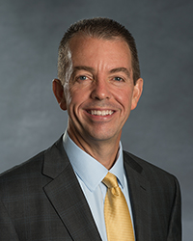
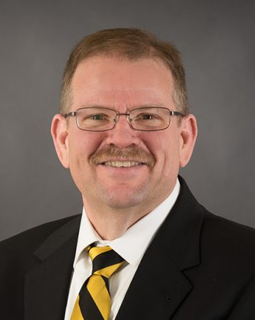
Leadership
Led by Vice Chancellor for MU Extension and Engagement Marshall Stewart
Reports to MU Chancellor Alexander Cartwright
Notes:
The University of Missouri Extension program is administered by the Columbia campus, MU. Dr. Marshall is Vice Chancellor for MU Extension and Engagement.
He reports to MU Chancellor, the campus’s chief academic officer. Garnett Stokes currently serves as Interim Chancellor
While administrative responsibility is assigned to Columbia, Extension collaborates with the University of Missouri campuses in Kansas City, Rolla and St. Louis to fulfill the land-grant mission.

Slide 23
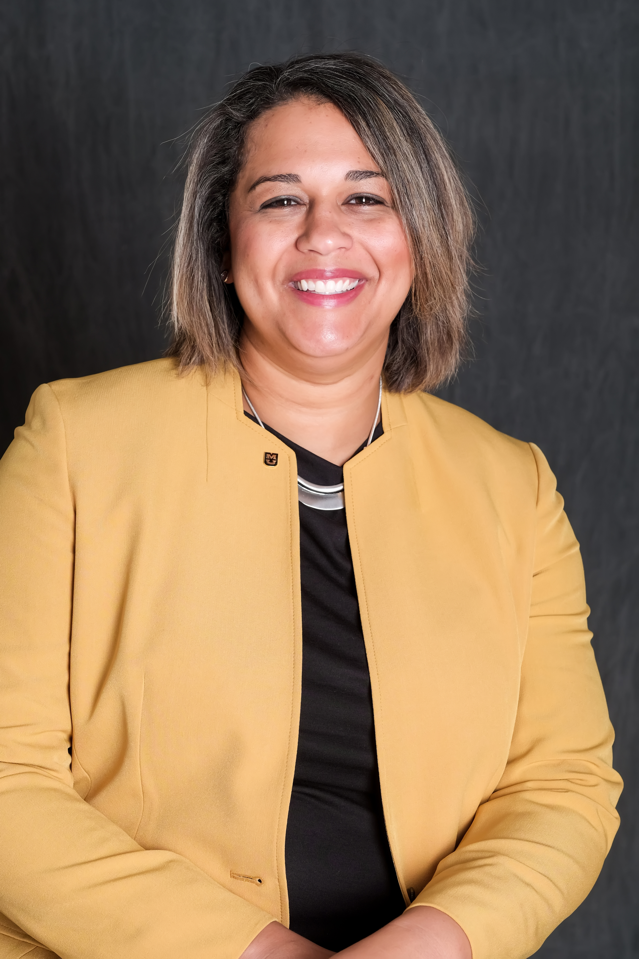
Leadership
Vacant
Associate Vice Chancellor for Extension and Engagement
Susan Renoe
Assistant Vice Chancellor for Research, Extension and Engagement
Notes:
The Extension Leadership Team also includes:
Blake Naughton, Associate Vice Chancellor for Extension and Engagement
Susan Reno, Assistant Vice Chancellor for Research, Extension and Engagement

Slide 24
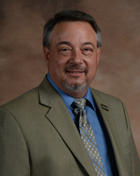
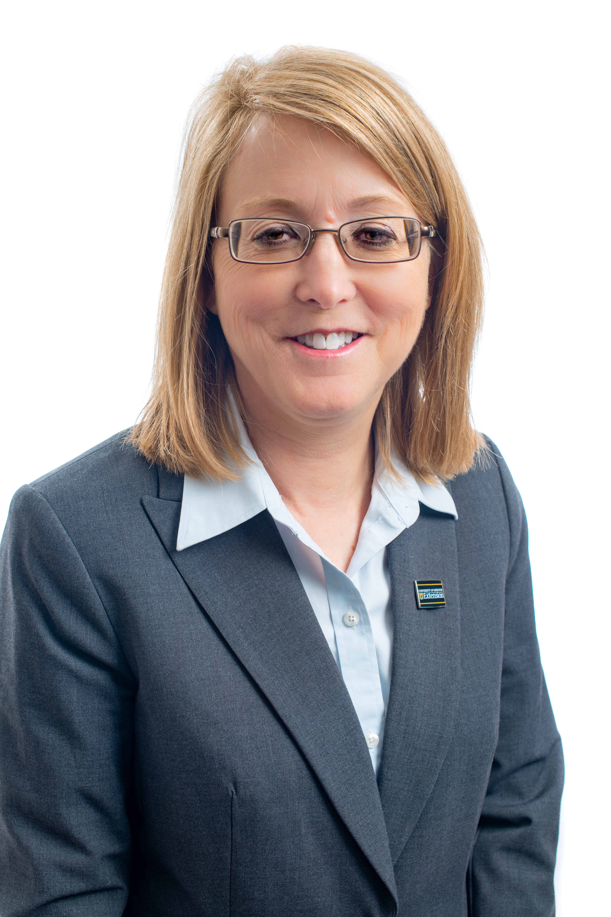
Leadership
Mark Stewart
Director of Off-Campus Operations
Callie Glasscock
Director of Human Resources and Finance
Notes:
Mark Stewart is currently serving as Director of Off-Campus

Slide 25
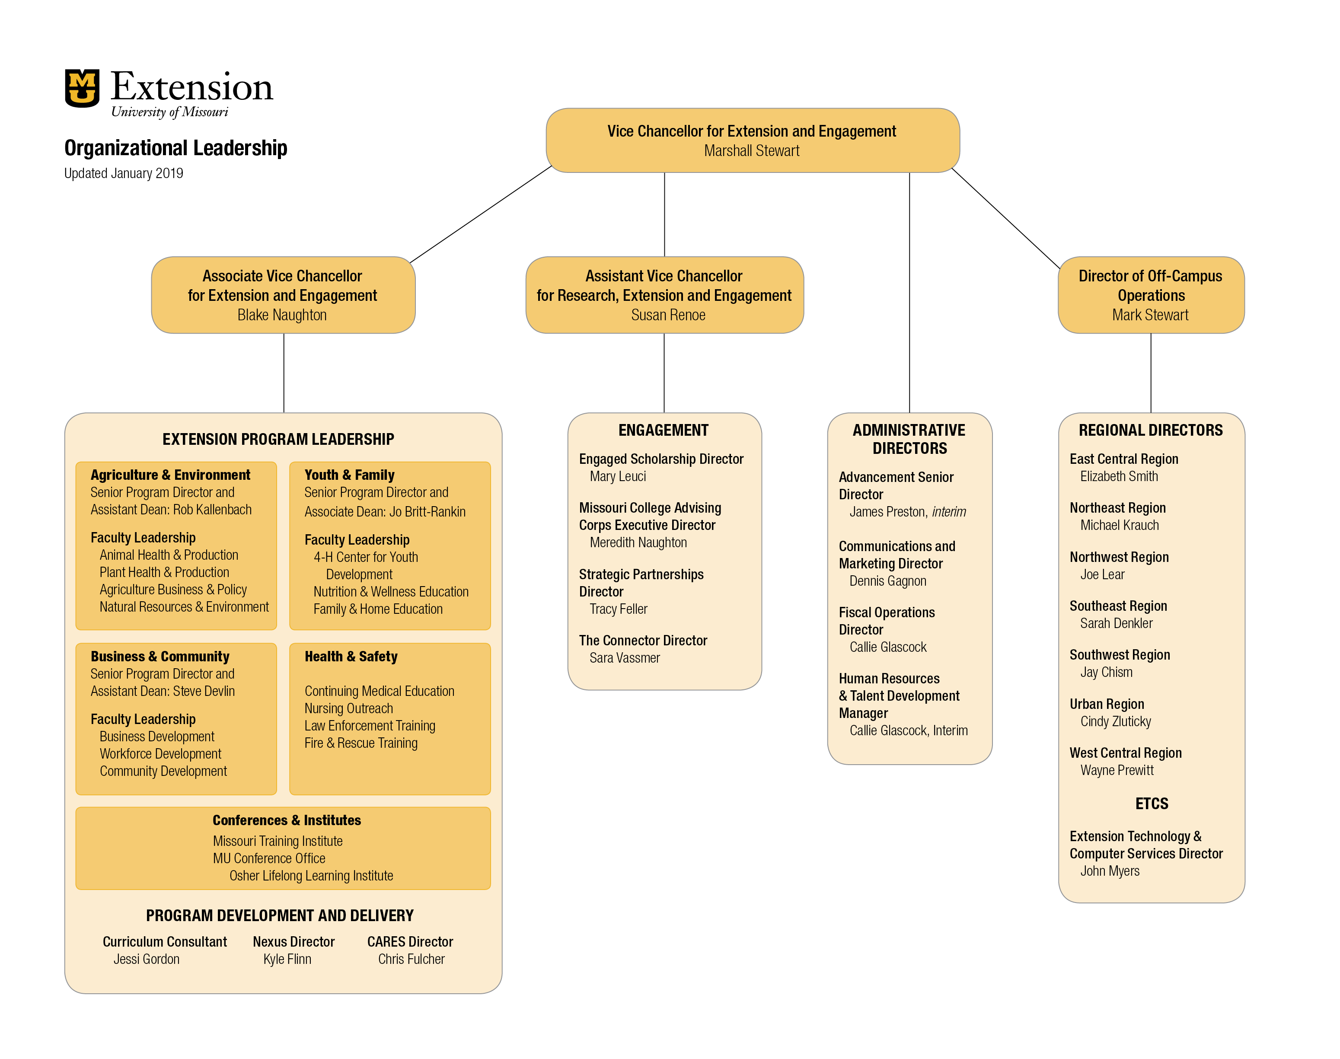
Organizational Structure
Notes:
This organizational chart shows how MU Extension’s leadership team is organized

Slide 26
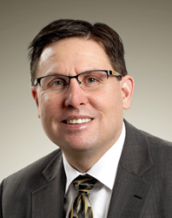
Agriculture and Environment
Animal Health & Production
Plant Health & Production
Agriculture Business & Policy
Natural Resources & Environment
Rob Kallenbach
Senior Director, Assistant Dean
Notes:
Through a recent reorganization, MU Extension programmatic leadership is organized around outcomes.
In Agriculture and Environment, leadership is provided by Rob Kallenbach, Senior Director and Assistant Dean. Programming in this area includes
Animal Health & Production
Plant Health & Production
Agriculture Business & Policy
Natural Resources & Environment

Slide 27
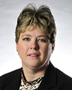
Youth and Families
4-H Center for Youth Development
Nutrition & Wellness Educations
Family & Home Education
Jo Britt-Rankin
Senior Program Director, Associate Dean
Notes:
Leadership in the area of Youth and Families is provided by Jo Britt-Rankin, Senior Program Director and Associate Dean.
Youth and Families programs will include:
4-H Center for Youth Development
Nutrition & Wellness Educations
Family & Home Education

Slide 28
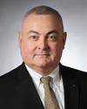
Businesses and Communities
Business Development
Community Development
Workforce Development
Steve Devlin
Program Director, Associate Dean
Notes:
Business and Communities is led by Steve Devlin, Program Director and Associate Dean. Programming in this area focuses on:
Business Development
Community Development
Workforce Development

Slide 29
Health and Safety
Continuing Medical Education
Nursing Outreach
Law Enforcement Training
Fire & Rescue Training
Vacant
Associate Vice Chancellor for Extension and Engagement
Notes:
Additionally, MU Extension will continue to provide programming around health and safety, including:
Continuing Medical Education
Nursing Outreach
Law Enforcement Training
Fire & Rescue Training
Blake Naughton, Associate Vice Chancellor for Extension and Engagement, will provide leadership in this area

Slide 30
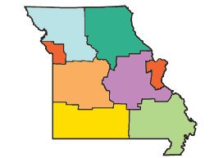
Extension Regions:
Northwest
Northeast
West Central
East Central
Southwest
Southeast
Urban (West and East)
Notes:
Across the state, Extension is divided into seven administrative regions, supervised by Regional Directors.

Slide 31
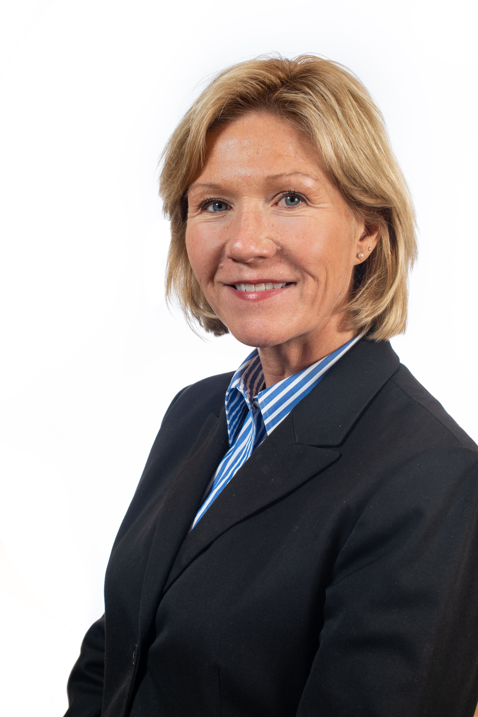
Regional Director
Elizabeth Smith
East Central Region Director
Rolla, MO
Notes:
Note: Choose only the Regional Director slide for your region.
We are in the East Central Missouri Region, and our Interim Regional Director is Matt Herring, whose office is in Union, MO.
Regional Directors provide leadership for programming, coordination and evaluation at the county level. Each Regional Director supervises the work of regional Extension specialists.

Slide 32
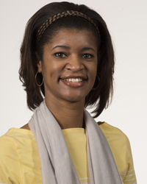
Regional Director
Shatomi Luster-Edward
Urban West Regional Director
Independence, MO
Notes:
Note: Choose only the Regional Director slide for your region.
We are in the Urban Region, and our Interim Regional Director is Jody Squires, whose office is at St. Louis, Mo.
Regional Directors provide leadership for programming, coordination and evaluation at the county level. Each Regional Director supervises the work of regional Extension specialists.

Slide 33
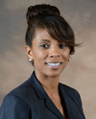
Regional Director
Jody Squires
Urban East Regional Director
St Louis, MO
Notes:
Note: Choose only the Regional Director slide for your region.
We are in the Urban Region, and our Regional Director is Jody Squires, whose office is at St. Louis, Mo.
Regional Directors provide leadership for programming, coordination and evaluation at the county level. Each Regional Director supervises the work of regional Extension specialists.

Slide 34
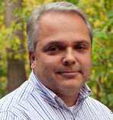
Regional Director
Mike Krauch
Northeast Region Director
Columbia, MO
Notes:
Note: Choose only the Regional Director slide for your region.
We are in the Northeast Region, and our Regional Director is Mike Krauch, whose office is in Columbia.
Regional Directors provide leadership for programming, coordination and evaluation at the county level. Each Regional Director supervises the work of regional Extension specialists.

Slide 35
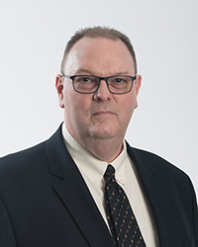
Regional Director
Joe Lear
Northwest Region Director
St. Joseph, MO
Notes:
Note: Choose only the Regional Director slide for your region.
We are in the Northwest Region, and our Regional Director is Joe Lear, whose office is in St. Joseph.
Regional Directors provide leadership for programming, coordination and evaluation at the county level. Each Regional Director supervises the work of regional Extension specialists.

Slide 36
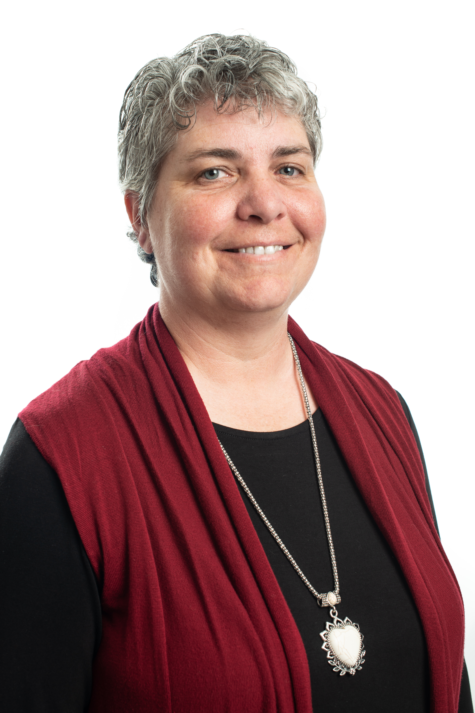
Regional Director
Sarah Denkler
Southeast Region Director
Portageville, MO
Notes:
Note: Choose only the Regional Director slide for your region.
We are in the Southeast Region, and our Regional Director is Sarah Denkler, whose office is at the Delta Center in Portageville.
Regional Directors provide leadership for programming, coordination and evaluation at the county level. Each Regional Director supervises the work of regional Extension specialists.

Slide 37
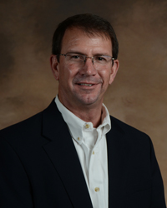
Regional Director
Jay Chism
Southwest Region Director
Springfield, MO
Notes:
Note: Choose only the Regional Director slide for your region.
We are in the Southwest Region, and our Regional Director is Jay Chism, whose office is in Springfield.
Regional Directors provide leadership for programming, coordination and evaluation at the county level. Each Regional Director supervises the work of regional Extension specialists.

Slide 38
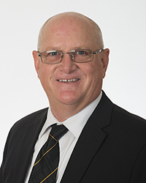
Regional Director
Wayne Prewitt
West Central Region Director
Clinton, MO
Notes:
Note: Choose only the Regional Director slide for your region.
We are in the West Central Region, and our Regional Director is Wayne Prewitt, whose office is in Clinton, MO.
Regional Directors provide leadership for programming, coordination and evaluation at the county level. Each Regional Director supervises the work of regional Extension specialists.

Slide 39
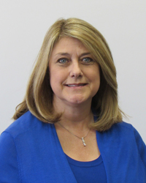
Resource people
Tracy Feller
Director, Partnership and Stakeholder Development
Notes:
MU Extension had two additional key people who are available to support the efforts of the Council.
Tracy Feller is the Director of Partnerships and Stakeholder Development. She can assist your council in communicating with important stakeholders, such as County Commissioners or legislators.

Slide 40
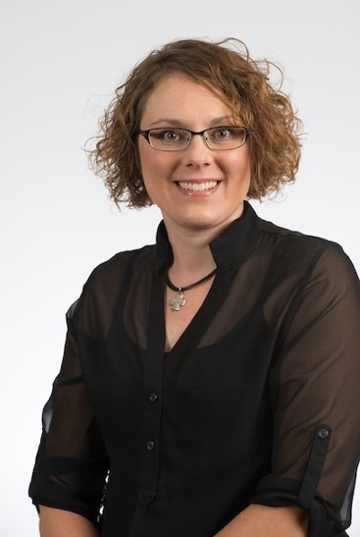
Resource people
Sarah Traub
Engagement Facilitator
Notes:
MU Extension had two additional key people who are available to support the efforts of the Council.
Tracy Feller is the Director of Partnerships and Stakeholder Development. She can assist your council in communicating with important stakeholders, such as County Commissioners or legislators.

Slide 41
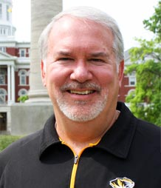
Resource people
James Preston
Director for Advancement
Notes:
James Preston is the Interim Director for Advancement. He can assist with local fundraising for endowments for any programming or area of extension work.

Slide 42
County Extension Council Members
Identify needs
Secure funds
Ensure access
Notes:
At the core of this structure are County Extension Council members who ensure the system works by:
Identifying local educational needs
Securing funds
And ensuring that the research-based information of the state’s land-grant universities is available to people in their communities.

Slide 43
County Extension Council Members
(list names of council officers and members)
Notes:
List names of members and area of representation. Be sure to include council offices held by members.

Slide 44
Regional Extension Councils
Represents each county
(Name) County representatives
Name
Name
Notes:
The (Name) Regional Extension Council addresses issues of multicounty or regional concern. Each county has two representatives on the regional council. Our representatives are:
(List names)

Slide 45
Additional topics in this series:
Be An Effective County Extension Council Member
Setting Priorities for Program Development
What Is My Role in Program Implementation?
Evaluating and Reporting Program Outcomes
Understanding County Budgets and Fiscal Reports
Recruiting Candidates for Effective County Councils
Mastering the Nuts and Bolts of Council Elections
Notes:
These training modules are designed to help you, as county Extension council members, understand your role and help you fulfill the requirements of your office. The other modules in this series are:
Be An Effective County Extension Council Member
Setting Priorities for Program Development
What Is the Council’s Role in Program Implementation?
Evaluating and Reporting Program Outcomes
Understanding County Budgets and Fiscal Reports
Recruiting Candidates for Effective County Councils
Mastering the Nuts and Bolts of Council Elections

