Slide 1
Conducting Council Elections
Notes:
Council members are elected and appointed public officials.
The Revised Statutes of Missouri require county extension councils to organize and conduct an election of membership each January.
All citizens of voting age are eligible to vote in the election.

Slide 2
Objectives
Comply with state statutes
Suggest election strategies
Publicize election
Notes:
In this module we will learn:
About state statutes regarding election of members.
Suggested processes for conducting the election to provide all eligible voters the opportunity to participate.
Methods for publicizing the election to all citizens.
A companion module, “Recruiting Candidates for Effective County Councils,” addresses the process of soliciting nominations and approaching potential candidates.

Slide 3

State Statutes - Elections
Annual election (January)
By district
Open to all citizens of voting age
Notes:
Organizing the annual election is the legal responsibility of the county Extension council. Several sections of the Revised Statutes of Missouri govern county Extension council elections.
State statutes require councils to hold an annual election of membership each January in the established districts where there are vacancies.
All citizens of voting age, residing in the district, are entitled to votes.

Slide 4
State Statutes - Membership
One member per district
County Commission
Farm organizations
Jurisdictions of 10,000+ or as designated by council
No less than 10, no more than 20
Notes:
Statutes require councils to be composed of:
At least one elected member from each district
A member of the county commission
One member from each general farm organization
One member from each incorporated town or city within the county having a population of 10,000 or more
In counties having no town or city with a population of 10,000 or more, one member is appointed by the mayor of the town or city designated by the elected council of the county.

Slide 5
State Statutes - Districts
Council establishes county council election districts
File with County Commission
Notes:
State statutes require the Extension Council to establish districts and file the boundaries of those districts with the county commission for the purpose of electing members to the council.
Any changes to district boundaries also must be filed with the county commission.

Slide 6
State Statutes – Public Notice
Public notice of nominees must be published
Between 30 and 50 days prior to election
Notes:
Statutes require the councils to publish a public notice of the nominees no less than 30 days and no more than 50 days before the election.
A template for a public notice is included on the Extension Council website.

Slide 7
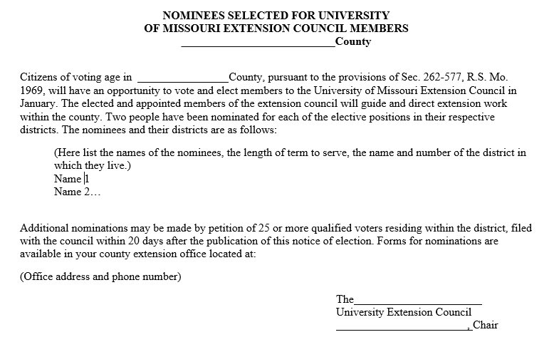
Notes:
This is a sample public notice of the nominees published by the Extension council. It includes:
A list of nominees and their districts
Instructions for petitioning additional nominees by at least 25 eligible voters of that district within 20 days of publication

Slide 8
State Statutes – Public Notice
Paid notice
At least once
Newspaper with general circulation
Notes:
State statutes require that public notice of the Extension council election be published at least once in a county newspaper with a general circulation.
This is to be a paid legal notice.

Slide 9
Preparing for the Election
Early Fall
Review election process
November
Select nominees
December
Publish public notice
Set date, deadlines
Publicize election
Notes:
Extension councils should begin preparing in the fall for the January elections.
Councils should review the election process and make any necessary revisions. A written procedure, adopted as part of the council bylaws, may be useful in ensuring a legal and inclusive process.
Next, the council must set the date for the election. The election date provides a starting point for establishing deadlines to comply with statutory requirements for providing public notice.
Nominees, at least two from each district, should be selected by December to meet the statutory requirement to publish a public notice of nominees in the 30-50 day time frame.
This is a paid notice, not a news story. It is recommended that the Extension council contact county newspapers in advance for advertising deadlines, rates and circulation areas. In some instances, the council may need to publish the notice in more than one newspaper to provide full coverage of the county.
Also within 30 days of the election, the council should notify the county commission, municipalities and farm organizations about appointees for the coming year.

Slide 10

Conducting the Election
Open to all citizens of voting age
Ballots
  On-line
  Walk-in
  Newspapers
  Mail
Info on election and other resources at https://muextensionway.missouri.edu/network-of-councils/county-councils/
Notes:
How county Extension councils carry out elections is not described in the statutes. The University has created an on-line voting system. Using the system helps ensure that your election is in compliance with state statutes.
Other options include:
Walk-in balloting. Ballot boxes are placed in the Extension center and at locations within each district. Ballot boxes also may be placed in county or municipal offices, banks and other places frequented by voters. Ballot boxes must be secured through such means as a locked box or the use of voting monitors.
Balloting via local newspapers. Ballots are published in local newspapers with eligible voters returning the ballots in person or by mail. Ballots may be published in any newspaper serving the county.
Balloting by mail. Ballots are mailed to eligible voters with instructions to return ballots to the Extension center by mail or in person. Provide a deadline by which returned ballots must be postmarked.
Because the statutes require an election process that is open to all citizens, it is recommended that councils use a combination of voting strategies to provide the greatest opportunity for participation among eligible voters in a cost-effective manner.

Slide 11
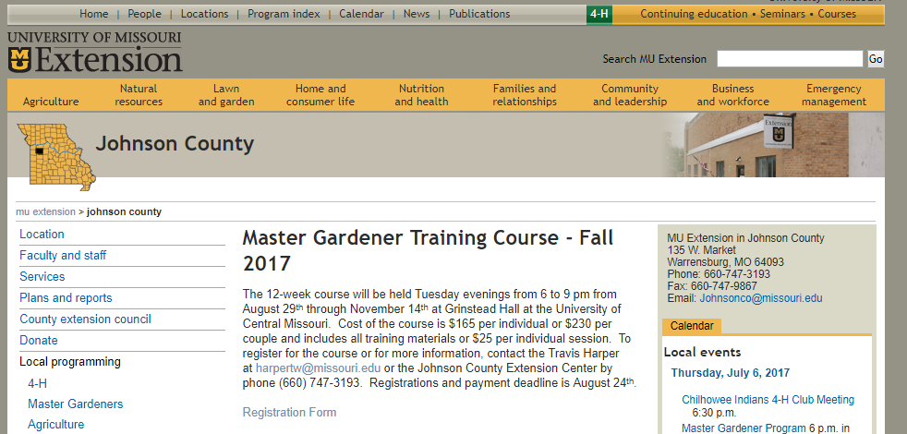


Conducting the Election
Ensure a good election turnout through
County web page and social media
News releases
Person-to-person contact
Email
Notes:
State statutes entitle each citizen of voting age to participate in council elections. To increase awareness and encourage participation, councils must educate citizens about the nominees and the election process. This can be accomplished through many means:
Promote the election on your county website, providing a link to the online ballot
Use the online election data system to provide background information on your candidates
Use social media to encourage voting
Distribute news releases to newspapers and to radio and TV stations. In addition to fulfilling the statutory requirement for a paid legal notice, councils may simultaneously distribute a news release containing the same information to all newspapers and to radio and TV stations serving the county. Many newspapers will publish brief profiles or interviews of council candidates. Additional news releases in the weeks leading up to the election can provide details on the election date and polling hours, and how and where to obtain a ballot.
Make person-to-person contacts within the communities. For example, council members can talk with neighbors and co-workers, and make announcements at meetings of civic groups to which they belong.
Send e-mail notices to extension users, public officials, stakeholders and community leaders seeking their participation and assistance in publicizing the election.

Slide 12
Conducting the Election - Maintain integrity of the election
Online system
Official ballot boxes
Clear instructions
Official observer during tally
Ensure one vote per person
Certify results
Notes:
Extension councils can take several steps to ensure the integrity of the election throughout the election process. Among those steps:
Use the council election online system
Use official ballot boxes obtained from the county clerk.
Write clear instructions to accompany ballots.
Ask the county clerk to be an official observer of the election tally. Have at least three people count the votes ― one to call the votes, one to tally results and one to serve as a spotter. (For ease of counting, use different paper colors for each district.)
Ensure one vote per person to the best of the council’s ability. Have a sign-in sheet (separate from ballot) for voters casting paper ballots
Have election results certified by county clerk.

Slide 13
After the Election
Notify candidates
Enter data
Elect officers
Take oath of office
Term begins March 1
Notes:
The newly organized council assumes its duties on March 1.
Several tasks must be completed to meet the requirements of state statutes:
Notify all of the candidates of the results of the election. For those newly elected, be sure they are aware of when they take office and include an invitation to the annual meeting.
County Extension councils must provide a list of members to both the county commission and the University. The list of members and officers is to be submitted by the council chair before the allocation of funds by the county commission. The online council data system provides an easy way to provide this information to the University, as well as helping you to maintain contact information.
At the first annual meeting after taking office, the council must elect a chair, vice chair, secretary and treasurer. Within five days of the election, officers must take and sign an oath of public office filed with the county clerk’s office.

Slide 14

After the Election
Welcome new members
Provide orientation
Notes:
Once new members have taken office, welcome them and provide them with an orientation to their roles and responsibilities, using the “New Member Orientation Manual.”
It is recommended that orientation be given within 30 days of taking office. Orientation for new council members also may take place before taking office on March 1.

