Slide 1
Recruiting Candidates
for Effective County Councils
Notes:
In accordance with the Revised Statutes of Missouri, county Extension councils are comprised of elected and appointed members, who represent the broad educational needs and backgrounds of people residing in the county.
Recruiting candidates for the council is one of the most important things you will do as a council member

Slide 2
Recruitment is first step in election process
Council responsibility by law
Open to any citizen of voting age
Overview
Notes:
Recruitment is the first step in the election process.
Nominating citizens for the council and conducting elections are council responsibilities set forth in the state statutes.
Any citizen of voting age may be nominated for the office of county Extension council member.

Slide 3
Membership
Elected
Appointed
Representative of people residing in county
Notes:
Membership on the Extension council is comprised of elected and appointed representatives.
Council members are representative of the people residing in the county.

Slide 4

State Statutes
Council membership composed of one member from:
Each district
County commission
General farm organization
Jurisdictions of 10,000+ or jurisdiction designated by council
Notes:
The state statutes describe the composition of the council and terms of office. These requirements include:
At least one elected member from each district in the county
A member of the county commission
One member from each general farm organization
One member from each incorporated town or city within the county having a population of 10,000 or more
In counties having no town or city with a population of 10,000 or more, one member is appointed by the mayor of the town or city designated by the elected council of the county.

Slide 5
State Statutes
Council members:
Two-year terms
Elected
Appointed
Men and women eligible
Notes:
Both elected and appointed council members serve two-year terms. State law dictates that members may serve two consecutive two year terms (for a total of four years) before their term limits expire, at which time they must go off the council for at least one year.
Men and women are eligible to serve on the Extension council. As you recruit candidates, make every attempt to include a balance of male and female candidates.
Note to presenter: Explain the election districts which have been established for your county council. Provide a map of districts if available.

Slide 6
State Statutes
Election Recruitment Process:
Determine number of positions
Nominate two per position
Set election date, places
Provide ballots, make arrangements
Notify commission, farm organizations, jurisdictions
Notes:
State statutes allow councils to determine the composition of elective and appointed members and outlines responsibilities for conducting elections.
Councils are to:
Determine the number of elective positions
Must nominate at least two citizens for each position that is up for election, based on established election districts.
Set the election date in January and polling places in the respective districts
Provide ballots and make necessary arrangements for the election
Give notice to farm organizations, cities, towns and the county commission at least 30 days before the election.

Slide 7
Recruiting Nominees
Appoint nominating committee
Create inclusive process
Notes:
Recruiting citizens for the ballot and proposing nominees are responsibilities of the Extension council. Recruitment is the precursor to the election process.
County Extension councils can ensure that their membership is representative of the people by establishing a recruitment process to reach all segments of the population.
A council may wish to appoint a nominating committee to coordinate the recruitment and nomination of candidates.

Slide 8
Recruiting Nominees
Diverse
Education
Gender
Occupation
Age
Race, Culture
Socio-economic Status
Notes:
To ensure that your council is truly representative of the citizens they serve, County Extension councils should broaden their search for nominees by seeking individuals with diverse:
Background
Gender
Occupation
Age
Race
Culture
Education and
Socioeconomic status
Begin by completing the “Council Candidate Worksheet” that accompanies this module to determine what groups your members and candidates represent

Slide 9
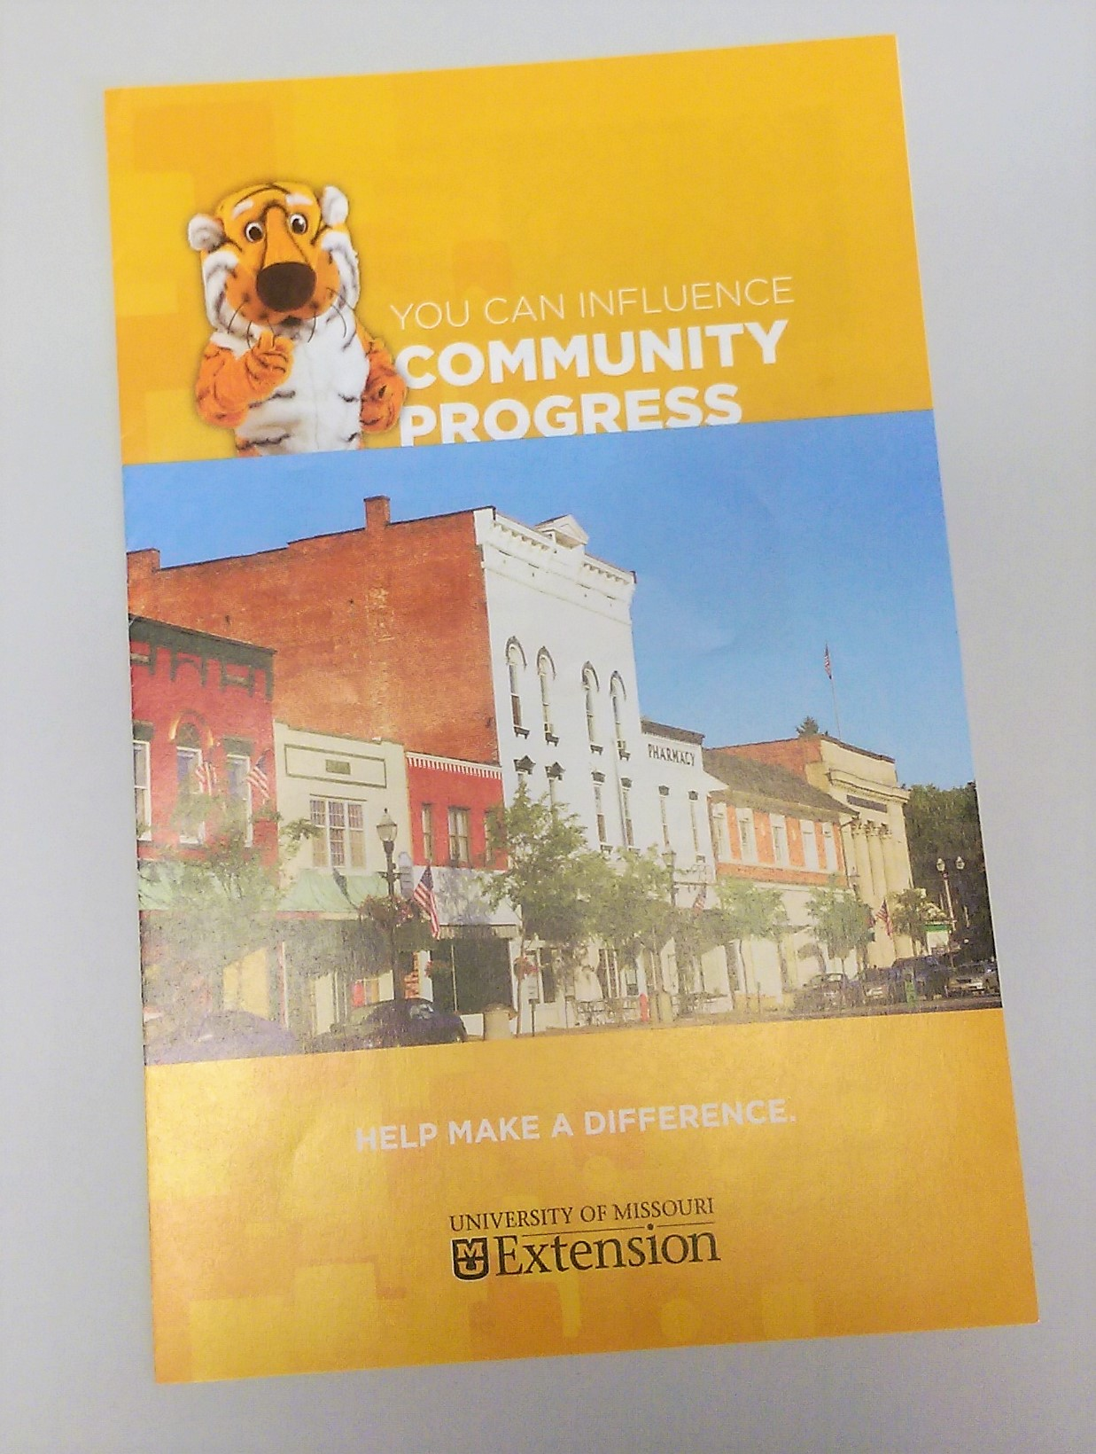
Recruiting Nominees
Develop a consistent message that is
Clear
Concise
Positive
Notes:
County Extension councils can broaden their search for nominees by developing specific messages to describe the responsibilities and activities of the council and the benefits of being a council member.
A new publication has been developed to help you communicate with potential council members. These can be ordered from Tracy Feller, Director of Partnership and Stakeholder Development
We’ll review some talking points later in this session.

Slide 10
Recruiting Nominees
Publicize through
Local media
Constituent groups such as 4-H and Master Gardeners
Partner organizations
Personal contacts
Notes:
County Extension councils also can broaden their search for nominees by publicizing the need for Extension council candidates through the local news media and personal contacts.
We will discuss how our council can do this later in this session.

Slide 11

Talking to candidates
Describe council responsibilities
Be honest about time, issues
Share the value of Extension programs
Notes:
After identifying potential nominees, approach them with an invitation to run for the council in a clear, concise and positive manner:
We can describe the council’s responsibilities and its importance in meeting the community’s highest priorities; share examples of programs that are making a difference to community members.
We must be honest about the time commitment as well as the issues.

Slide 12
Talking to candidates
Tell why you are asking
Discuss personal benefits
Explain election process
Notes:
We must tell potential nominees why we are asking them to run for the council, i.e., their skill, experience or expertise that will make them a valuable asset to the council and the well-being of the community.
We should discuss the personal benefits of being a council member, for example personal enrichment, involvement in issue or program area, opportunity to serve community, leadership development, friendship, etc. We can do this by sharing our own experience.
We should explain the election process.
Once a citizen has accepted the invitation to be nominated, be sure to collect important information you will need for the election, such as their mailing address, phone numbers, and email address. Throughout the election process stay in touch and keep him or her abreast of issues.
In another training module you can learn the details of conducting your council election

