Slide 1
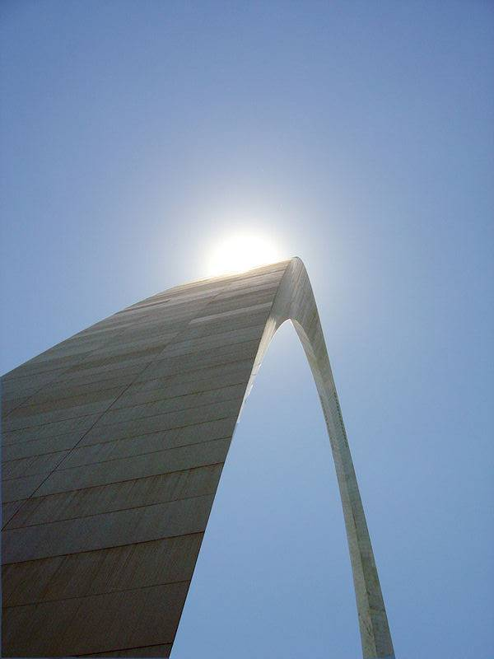
Extension Council Youth Leadership (ECYL) Topic #1
County Extension
Councils are a
Youth-Adult
Partnership
Produced by the Council Leadership Development Committee ― Missouri Council Leadership Development - a partnership of the Missouri Extension County Council Leadership Council and University of Missouri Extension
(c) 2007 University of Missouri Board of Curators. Updated October 2011. University of Missouri Extension does not discriminate on the basis of race, color, national origin, sex, sexual orientation, religion, age, disability, or status as a Vietnam-era veteran in employment or program. Funding for this project was made possible by a grant from the Surdna Foundation and the National 4-H Council.
Notes:
Introduce Topic #1.
A few quick facts about the ECYL program:
Funded by a Surdna Foundation/National 4-H Council grant to MU Extension in 2005
Based on survey of Missouri Extension Councils and focus groups with youth/young adults
Designed and led by a team of MU Extension leaders, staff, and youth
Endorsed by the MU Extension Council Leadership Development Committee in 2006
Missouri Extension councils have added youth in 18 counties (and counting), and on the Missouri State Extension Council

Slide 2
Extension Council Youth Leadership (ECYL) Topic #1
Learning Objectives:
Define youth-adult partnerships and relate the concept to the County Extension Council.
Be able to name some of the benefits of YAPs to youth, adults, and organizations.
Identify the County Extension Council’s goals for youth/young adult participation.
Name the stages of YAPs, including which stage the Council is in.
Understand how to do ongoing self-assessment related to youth/young adult participation.
Notes:
Read through learning objectives.
“Let’s check for understanding. Does anyone have any questions about the learning objectives? Is it clear what you will learn from this session?”
Facilitate “Open/Closed Circle” activity here, including the reflection questions at the end. Activity can be found at: http://extension.missouri.edu/extcouncil/documents/ecyl/energizer-activities.pdf
“This activity helps illustrate that the environment County Extension Councils create at meetings may come across to new members as welcoming (open) or unwelcoming (closed). The question we can ask is: ‘What kind of environment does our council want to create, and how will new members experience joining our group? Will new members find it difficult or easy to become a part of the team?”’

Slide 3
County Extension Councils are a Youth-Adult
Partnership
What Do You Think of When You Hear the
Term Youth-Adult Partnerships?
Notes:
“Here s a starter question to get us thinking about the idea of youth-adult partnerships. What do you think of when you hear the term ‘youth-adult partnerships?’”
Take several responses from participants, and possibly add a few phrases of your own to create a flip chart list.
Common responses might include:
Involves both youth and adults
Cooperation
Teamwork
Youth and adults working together
Shared leadership

Slide 4
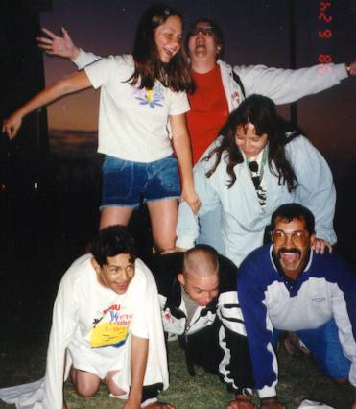
Youth-Adult Partnerships
Youth-Adult Partnerships (or YAPs) are based on the idea that young people and older people can work together in meaningful ways to get things done.
YAPs involve:
Youth and adults share responsibility and power.
Youth and adults share decision-making.
A new way of looking at things.
Excerpt from Building Community Toolkit. (2001). Innovation Center for Community & Youth Development: Tacoma Park, MD. http://www.theinnovationcenter.org.
Notes:
Read through the statements on the slide.
“For many people, youth-adult partnerships can be a new way of looking at things. As adults, we may have not considered youth as having the ability or interest to participate in council decision-making. Young people may not be used to adults asking them what they think, or if they want to be involved in meeting discussions. Youth-adult partnerships can be refreshing for adults and empowering for youth!”
Ask participants if anyone has had previous experience with youth and adults working together in decision-making, and in what capacity.
Ask if the County Extension Council will be the first experience participants have had with youth-adult partnerships.

Slide 5
Youth-Adult Partnerships
Some Guiding Principles
Develop equal partnerships between youth & adults
Focus on assets, not deficits
Identify and use the full diversity of local resources
Build on the work that groups and communities have already done
Excerpt from Building Community Toolkit. (2001). Innovation Center for Community & Youth Development: Tacoma Park, MD. http://www.theinnovationcenter.org.
Notes:
“True youth-adult partnerships aim to be ‘equal’ in every possible sense – youth and adults share the same roles, powers, and responsibilities. (In Missouri, County Extension Councils are an exception. The state statutes that pertain to County Extension Councils identify council members as being of legal voting age. But councils can welcome youth to be non-voting representatives and voice their ideas and opinions and influence decisions made by the council. Youth opinions do not count as votes of adult council members, but they can be recorded in meeting minutes alongside the roll call vote.)”
“Youth-adult partnerships focus on assets that youth bring to the table (such as energy, creativity, and new ideas) vs. the perceived deficits of young people (such as limited knowledge or experience). Like all MU Extension programs, this approach is built upon research-based information that shows giving young people voice in community decision-making supports positive youth development. Communities viewing and engaging young people as resources also supports an asset-based approach to community development.”
“Having youth on County Extension Councils helps counties make fuller use of the diversity of local resources available to them. Youth members provide councils with insights and connections to younger audiences which may make up 25% or more of the county’s total population. Young people are active participants through 4-H, but also may be involved through ag & natural resource programs, gardening & horticulture, business development, and many other MU Extension programs.”
“Youth-adult partnerships can be a ‘recession-friendly’ way for councils to enhance Extension’s presence in the county. It does not necessarily require additional funding to implement, but may help Extension retain or even attract additional funding as stakeholders see councils investing in the development of youth as future leaders for the area. Some research also suggests that organizations that have young people on board are more compelling and successful in their fundraising overall.”

Slide 6
St. Louis Gateway Arch Construction
1963
http://www.nps.gov/jeff/architecture.html
Notes:
“The St. Louis Gateway Arch is one of the most recognizable and remarkable architectural feats in the world, welcoming visitors to St. Louis as the Gateway to the West.”
Share a few facts about the history of the St. Louis Gateway Arch:
Designed by architect Eero Saarinen, who won a competition for the best design for the Jefferson National Expansion Memorial Association
He died in 1961 and would never see his dream come true.
Construction started in downtown St. Louis in 1963, and finished in 1965.
Despite the dangers of cranes, pulleys, high elevation, and strong winds, there were no worker deaths or injuries.
In winds of up to 150 mph, the Arch will sway up to 18 inches.
For more information, see http://www.nps.gov/jeff/
Ask a participant or two to relate a story about visiting the Arch. What impression did it leave on them?

Slide 7
Partnership
Youth
Adults
http://www.nps.gov/jeff/architecture.html
Notes:
“The Gateway Arch, and how it was constructed, offers a great illustration of how councils can create a sturdy partnership between youth and adults.”

Slide 8
Your Extension Council as a Youth-Adult Partnership
http://www.nps.gov/jeff/architecture.html
Notes:
“As we watch the Arch being constructed here, how can you relate it to the steps your extension council can take to become a youth-adult partnership?”

Slide 9
How a Youth-Adult Partnership is like the Arch Construction Process:
County Extension Councils are a Youth-Adult Partnership
Pouring of foundation
Building readiness with youth and adults separately (setting sections in place)
Dropping last section in (starting to work together)
Give and take (adults and youth)
Notes:
“Just like the tons of concrete poured to form a solid foundation for the Arch, County Extension Councils will need to dig deep to ensure that youth and adults are committed to partnering with each other, and to creating and implementing a plan to make it happen.”
“Youth and adults preparing to work together (starting with this training) is like the various sections of the Arch being set in place. There are seven sections or topics that make up the ECYL training module).”
“When the final section is set in place, the Arch (partnership) is working. That is like the point when youth have been added to the council, are being supported by adults, and are actively contributing to meetings.”
“The ‘give and take’ (between youth and adults) is illustrated by the Arch being a free standing structure, with each side (youth on one side, adults on the other) leaning and relying on the other to fulfill certain expectations. Flexibility has been built in to withstand winds of change. The end result is a stronger structure.”
Ask participants for comments and feedback on the comparison between the Gateway Arch and County Extension Council youth-adult partnerships.

Slide 10
County Extension Councils are YAPs
What benefits do YAPs have for…
Youth?
Adults?
Councils?
MU Extension?
Notes:
“Based on our discussion so far, what are some of the benefits for youth, adults, councils and MU Extension? “
Create a flip chart list of benefits participants name: first for youth, then for adults, then for councils, and finally for MU Extension overall.

Slide 11
County Extension Councils are YAPs
Stages of YAPs
Building Readiness | Planning & Visioning
Change & Sustainability | Implementation
Excerpt from Building Community Toolkit. (2001). Innovation Center for Community & Youth Development: Tacoma Park, MD. http://www.theinnovationcenter.org.
Notes:
“Let’s take the Arch construction process a step further in exploring the stages of building youth-adult partnerships.“
Ask participants to locate the handout called “A Picture of the Building Community Model.” http://extension.missouri.edu/extcouncil/documents/ecyl/A-picture-of-the-building-community-model.pdf
Review the diagram in clockwise direction. Start with Building Readiness as the first stage of youth-adult partnerships, then Planning & Visioning, next Implementation, and finally Change & Sustainability.
Check-in with participants to see if they follow the four stages of youth-adult partnerships in the diagram.

Slide 12
County Extension Councils are YAPs
Building Readiness
Gaining an accurate understanding of how your council views itself, its role, its future.
Recognizing how your council contributes to youth development and how youth can contribute to the council.
Preparing youth and adults for working together on councils.
Excerpt from Building Community Toolkit. (2001). Innovation Center for Community & Youth Development: Tacoma Park, MD. http://www.theinnovationcenter.org.
Notes:
Briefly review the points on the slide. “County Extension Councils already are supporting youth development in the county by making decisions and being good stewards of the 4-H program. Through ECYL, councils can further support local youth development by having young people on the council, gaining leadership skills and exercising citizenship in the local community.”
“The ECYL training is a first step for councils to build readiness for youth and adults working together!”

Slide 13
County Extension Councils are YAPs
Visioning & Planning
Discussing youth/young adult participation and deciding which path your council will take.
Creating a shared vision for youth/young adult participation among council members and youth advisors alike.
Excerpt from Building Community Toolkit. (2001). Innovation Center for Community & Youth Development: Tacoma Park, MD. http://www.theinnovationcenter.org.
Notes:
Briefly review these points.
“By completing the ECYL training, County Extension Councils are also moving through the second stage of YAPs –Visioning & Planning!”
“It is important that the vision the group comes up with be the collective vision of both adult council members and youth. Both youth and adults need buy-in and a sense of ownership in what it looks like in order to stay engaged.”

Slide 14
County Extension Councils are YAPs
Implementation
Using successful techniques for facilitating meetings and involving youth.
Setting the context for how the council will work together.
Working for early wins and visible successes to gain trust and recognition from youth and adult members.
Excerpt from Building Community Toolkit. (2001). Innovation Center for Community & Youth Development: Tacoma Park, MD. http://www.theinnovationcenter.org.
Notes:
Briefly review these points.
“Implementation comes after the council has completed the ECYL training module, has created a plan to add youth/young adults, and carries out that plan.”
“Council leaders have an especially important role in setting the tone for how youth/adults can work together on the council, leading meetings in ways that ensure youth can participate along with adults, and pointing out the benefits and successes of the partnership to council members along the way.”

Slide 15
County Extension Councils are YAPs
Change & Sustainability
Taking stock of changes in the council’s attitudes, styles, and structures.
Identifying strengths in how the council engages people of different ages in decision-making.
Locating opportunities for increased sharing of leadership.
Excerpt from Building Community Toolkit. (2001). Innovation Center for Community & Youth Development: Tacoma Park, MD. http://www.theinnovationcenter.org.
Notes:
Briefly review these points.
“Change & Sustainability is the stage when the youth-adult partnership has been in place for a while (one year or more). The Stages of YAPs are a cycle, rather than going in a straight line. County Extension Councils do not pass through the YAP stages just once, but may move through the stages again and again as things change. Later, we will talk about ways councils can assess where they are in the process, and to evaluate how it is working.”

Slide 16
What Stage is Your Council In?
Notes:
“We are approaching the end of the first topic. We want to give you a chance to consider what stage of YAPs your County Extension Council is in.”
“Take a few moments to reflect on what you’ve learned about the stages of YAPs. Discuss your thoughts with a neighbor or in a small group, then let’s hear back from you.”
Ask several participants which stage of YAPs they see their council in right now and why. Note any common answers that suggest broad agreement. Allow room for differing opinions too, pointing out that people may have various perspectives.

Slide 17
Please Complete the Self-Assessment (see “Explore Your Ideas: Discussing Youth Involvement”)
Notes:
“To help clarify your own thoughts and perspectives, please take a few minutes to complete the handout called “Explore Your Ideas: Discussing Youth Involvement” and then we will discuss.” http://extension.missouri.edu/extcouncil/ecyl/Topic-1/Explore-your-ideas-discussing-youth-involvment.pdf
Give participants about 5-10 minutes to complete the handout. For each of the handout questions, ask one participant to share their answer.
Point out the “Developing a Clear Vision, Goals, and Objectives” and “Organizational Assessment” handouts with this module topic as additional tools councils can use to build their readiness.
http://extension.missouri.edu/extcouncil/documents/ecyl/Developing-a-clear-vision-goals-and-objectives.pdf
http://extension.missouri.edu/extcouncil/documents/ecyl/Organizational-assessment.pdf

Slide 18
County Extension Councils are YAPs
Action Step…
Record what benefits the council sees YAPs will have for youth, adults, and councils, and MU Extension.
Discuss the results of the self-assessment.
When will the group share these results with the council, and preferably repeat the self-assessment or use the organizational assessment with the whole council?
When would be the best time annually for the council to revisit/retake the assessment to track progress?
Notes:
“At the end of each module topic, the group representing your County Extension Council (preferably a team of youth and adult participants) will be given the opportunity to work as a group to identify the actions your council will take. All together, your action steps will become a draft action plan for your County Extension Council to add youth and young adults. Now is the time to identify action steps from the first topic!”
Ask each group representing a County Extension Council to break into a small group, and to identify: a) group facilitator (to facilitate the group’s discussion); b) recorder (to write down the group’s decisions); and c) reporter (to share the group’s decisions back with the crowd). Encourage groups to invite a mixture of youth and adult participants to assume these roles!
Pass out the “Summary of Module Topics” handout for participants to begin writing down notes as they go through the module topics. http://extension.missouri.edu/extcouncil/documents/ecyl/summary-of-module-topics.doc
Read through the action steps slide and ask for questions. Then, give groups about 10-15 minutes to discuss and record their action steps.
After the time is up, briefly ask each group to report out their work.
Wrap-up the topic by congratulating groups on starting a plan and encouraging participants that they are on the right track to laying a foundation for youth-adult partnerships!

Slide 19
Extension Council Youth Leadership (ECYL)
County Extension Council Training Module
Produced by the Council Leadership Development Committee ⎯ a partnership of the Missouri Extension County Council Leadership Council and University of Missouri Extension http://extension.missouri.edu/extcouncil/training/
Funding for this project was made possible by a grant from the Surdna Foundation and the National 4-H Council.
Notes:
Conclude the session.

