Slide 1
Orientation
County Council
Notes:
Note: The presentation contains many places where information about your county should be included. These places are noted within the speaker notes.
Welcome to the <Name> County Extension council. This training session is designed to give you an overview of your role as a council member and the workings of Extension.
As a county Extension council member, you play a vital role in meeting the educational needs of people in <Name> County.
County Extension councils were created by state statutes to work with the University of Missouri in carrying out local educational programs.

Slide 2
Land-Grant Mission
Morrill Act of 1862 - established the University of Missouri as a land-grant university
Morrill Act of 1890 - established the Lincoln University
Hatch Act 1887 established agricultural experiment stations – Delta Fisher Research Center in SE / Wurdack Research Center (Cook Station)
Smith-Lever Act of 1914 established the Cooperative Agricultural Extension Service - Distinct mission of service fulfilled through Extension
Notes:
Extension is grounded in the land-grant mission established by the federal Morrill Acts of 1862 and 1890.
The land-grant mission mandates resident instruction, research and service, and it is this mission that distinguishes the University of Missouri and Lincoln University from other colleges and universities in the state.
Through Extension, the Universities fulfill their service mission by delivering science-based information and education to the people of Missouri through county Extension centers.
Wurdack Research Center - Nestled along the Meramec River near Cook Station in the northeast Ozarks, this Center conducts demonstrations and research in integrated livestock, forages, forestry, agroforestry and wildlife management practices that are economically viable, environmentally sound and sociologically acceptable for the Ozark Region of Missouri. Timber covers most of the acreage, while 260 acres provide the base for forage production, rotational grazing and cattle production. Current research includes programs to improve forage, beef, agroforestry and timber.

Slide 3
Extension Mission
County Extension councils
University of Missouri System
Lincoln University
US Dept. of Agriculture
Other stakeholders and partners
Notes:
(Mission Continued)
As an integral part of the land-grant mission, University of Missouri Extension is a joint venture of the:
University of Missouri campuses (including Columbia, Kansas City, Rolla and St. Louis)
Lincoln University Cooperative Extension
The people of Missouri through county Extension councils
Cooperative State Research, Education and Extension Service of the U.S. Department of Agriculture
And other stakeholders and partners.

Slide 4
Extension Mission: Our distinct land-grant mission is to improve lives, communities and economies by producing relevant, reliable and responsive educational strategies that enhance access to the resources and research of the University of Missouri.
Highest priorities in the county
Applying research-based knowledge - unbiased
Notes:
The Extension mission is to:
“Improve Missourians’ lives by addressing their highest priorities through the application of research-based knowledge and resources.”

Slide 5
Engagement
Added in 2016
Goal – engage entire MU system with communities across the state
Statewide Engagement Council created to provide focus
Notes:
(Mission Continued)
In 2016 the director of Extension’s title was changed to “Vice Chancellor for Extension and Engagement.” This change elevated the position to the Chancellor level and added “engagement” to the title.
Engagement efforts aim to connect the residents of our state with all of the resources of the University system, not just those who have traditionally been a part of our Extension program efforts.
The MU Engagement Council has been created to bring together university leaders to focus on the engagement initiatives of the university. By strengthening public engagement and connecting the people of the state to the University, we hope to increase our public understanding and support.

Slide 6
County Council Responsibilities
Notes:
Lets discuss the responsibilities of your Extension council.

Slide 7

Councils created by statutes 262:550 to 262:620 work with the University
Responsibilities
Programs
Governance
Membership
Notes:
State statutes give Extension council members specific legal responsibilities. These responsibilities can be categorized into three general areas:
Educational program development and implementation
Governance
and Membership.
In this session, we will take a brief look at each of these areas. More specific information about these areas of responsibilities is explored in depth in other council training modules.

Slide 8
Council Responsibilities
Identify concerns 262.587
Make recommendations 262.587
Work with regional faculty 262.593
Ensure access 262.587
Secure local funding to support programs and administer local budget 262.597
Annual elections 262.573
Manager Office Operations 262.583
Notes:
Council members’ responsibilities for Educational Program Development and Implementation include assisting regional faculty in planning and carrying out Extension programs in their county. As council members, we:
Identify concerns in our communities
Make recommendations to the University and work with local faculty
And ensure access to local residents, groups and organizations.

Slide 9
Council Responsibilities
Membership
Recruit candidates
Ensure diverse voices, representing all citizens
Orient new members
Provide ongoing member training
Notes:
Membership on the Extension council is comprised of elected and appointed representatives.
The council holds responsibility for recruiting candidates and conducting the election.
The key to a council’s effectiveness is recruiting individuals who represent the broad educational needs and backgrounds of people who live in the county.
Membership responsibilities also include orienting new members to the council and providing ongoing training to enhance the ability of members to serve their constituents.

Slide 10
Governance
Important Considerations
Legally obligated to operate within State Statutes
Comply with Sunshine Law
Avoid conflict of interest
Divulge conflict
Remove yourself from conflict
Notes:
County Extension councils and their operations are set forth in state statutes. Choosing to ignore state law opens you up to liability.
Councils are required to comply with Missouri’s Sunshine Law. Notice of meetings must be posted, and requests for records fulfilled.
The University makes recommendations to help you be aware of “best practices” but the council is free to make their own decisions – but they also are responsible for repercussions from those decisions.
All nonprofits and government agencies are required to refrain from conflict of interest. Defined as putting personal benefit before the welfare of the organization. If potential conflicts arise, disclose it to the group. Remove yourself from the decision making process (discussion as well as vote.)

Slide 11
Local Faculty and Staff
Notes:
Let us introduce you to the people who provide Extension programs to your county.

Slide 12
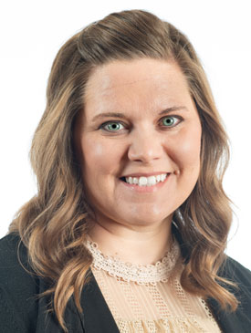
County Office Staff
Extension Engagement Specialist
Liaison among council, staff and University
Engaged with community to identify needs
Organizes programs to address needs
Liaison with County Commission
Notes:
Note: Add name and photograph of your county’s CES.
(Name) is our County Engagement Specialist.
The County Engagement Specialist, often referred to as the CES, is a off-campus specialist assigned by the University to serve as a liaison among the county Extension council, and other faculty who serve our county and the University. (Name) ensures that the educational programs in our county meet the high-priority needs of our constituents.

Slide 13
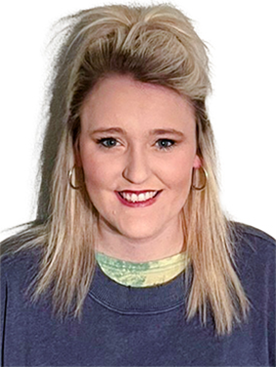
Clerical Staff
Council funded employees
Support
Office operations
Programming
Thoma McCoy
Office Support
Notes:
Clerical staff in the Extension center are employed by the Extension council or MU Extension through a MOU with University of Missouri. Through the MOU, the council pays all the payroll costs for the staff person. In either arrangement, these individuals provide support for both office operations and programs.

Slide 14
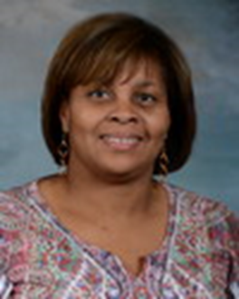
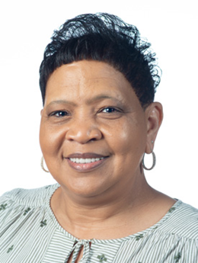
Paraprofessionals
University employees – concentrated program effort
Program specific focus
Dorothy Blissett NPA
Teresa Green NPA
Council may support full salary or partial salary
Family Nutrition Education Program (NPA)
4-H Youth Development Program (YPA)
Notes:
Counties also are served by paraprofessionals who work with the:
Family Nutrition Education Program
Small Farm Family Program
And 4-H Youth Development.
These staff members are University employees. (Note: If council shares salary responsibility, include that information here.) Paraprofessionals are supervised by regional specialists.

Slide 15
Regional Field Specialists
University faculty appointments
Multi-county assignments – multiple specialties
Provide education in their specialty
Notes:
As a council member, you will interact regularly with the faculty and staff who work in the county. Regional Extension specialists, as the title implies, specialize in a particular field. They are faculty members of the University of Missouri. While regional specialists are headquartered in a specific county, most have multicounty assignments. This structure allows each county access to expertise in a number of specialty areas that might not otherwise be available.
Councils play an important role in hiring those specialists, serving on personnel teams during the hiring process and approving candidates for positions in their county. Councils also participate in annual performance reviews of regional specialists.

Slide 16
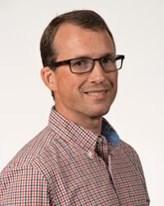
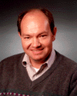
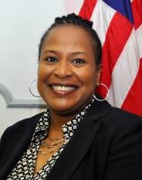
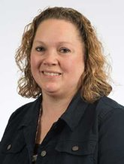
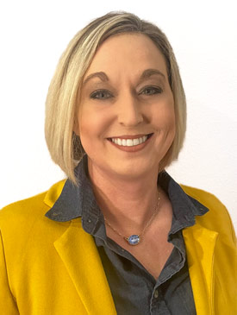
Field Specialists Serving
Anthony Ohmes
FIELD SPECIALIST IN AGRONOMY
David Reinbott
FIELD SPECIALIST IN AGRICULTURAL BUSINESS
Maude Harris
FIELD SPECIALIST IN NUTRITION
Donna Aufdenberg
FIELD SPECIALIST IN HORTICULTURE
Tabatha Shankle
FIELD SPECIALIST IN HUMAN DEVELOPMENT
https://extension.missouri.edu/counties/southeast-region
Notes:
Note: Use this slide and make additional slides as necessary to list regional specialists 1) assigned to the county and 2) serving the county. Photos from the Extension staff directory may be added to the slide.
In our county, we have (number) of specialists headquartered here. They are:
(list name and title)
These specialists also serve our county:
(list name, title, headquarter county – use additional slides as necessary)

Slide 17
MU Extension
Organizational
Structure
Notes:
Let’s discuss how Extension is organized in our state

Slide 18
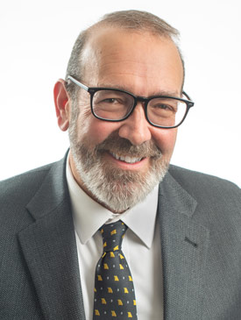
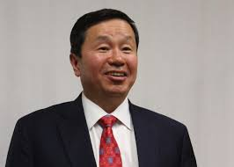
Leadership
Extension Led by
Interim Vice Chancellor for MU Extension and Engagement Chad Higgins
Reports to
MU Chancellor and President of University System Dr. Mun Choi
Notes:
The University of Missouri Extension program is administered by the Columbia campus, MU. Dr. Marshall is Vice Chancellor for MU Extension and Engagement.
He reports to MU Chancellor, the campus’s chief academic officer. Garnett Stokes currently serves as Interim Chancellor
While administrative responsibility is assigned to Columbia, Extension collaborates with the University of Missouri campuses in Kansas City, Rolla and St. Louis to fulfill the land-grant mission.

Slide 19
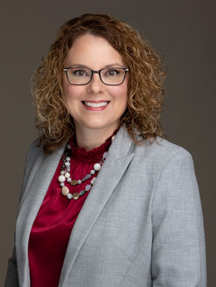
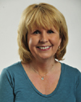
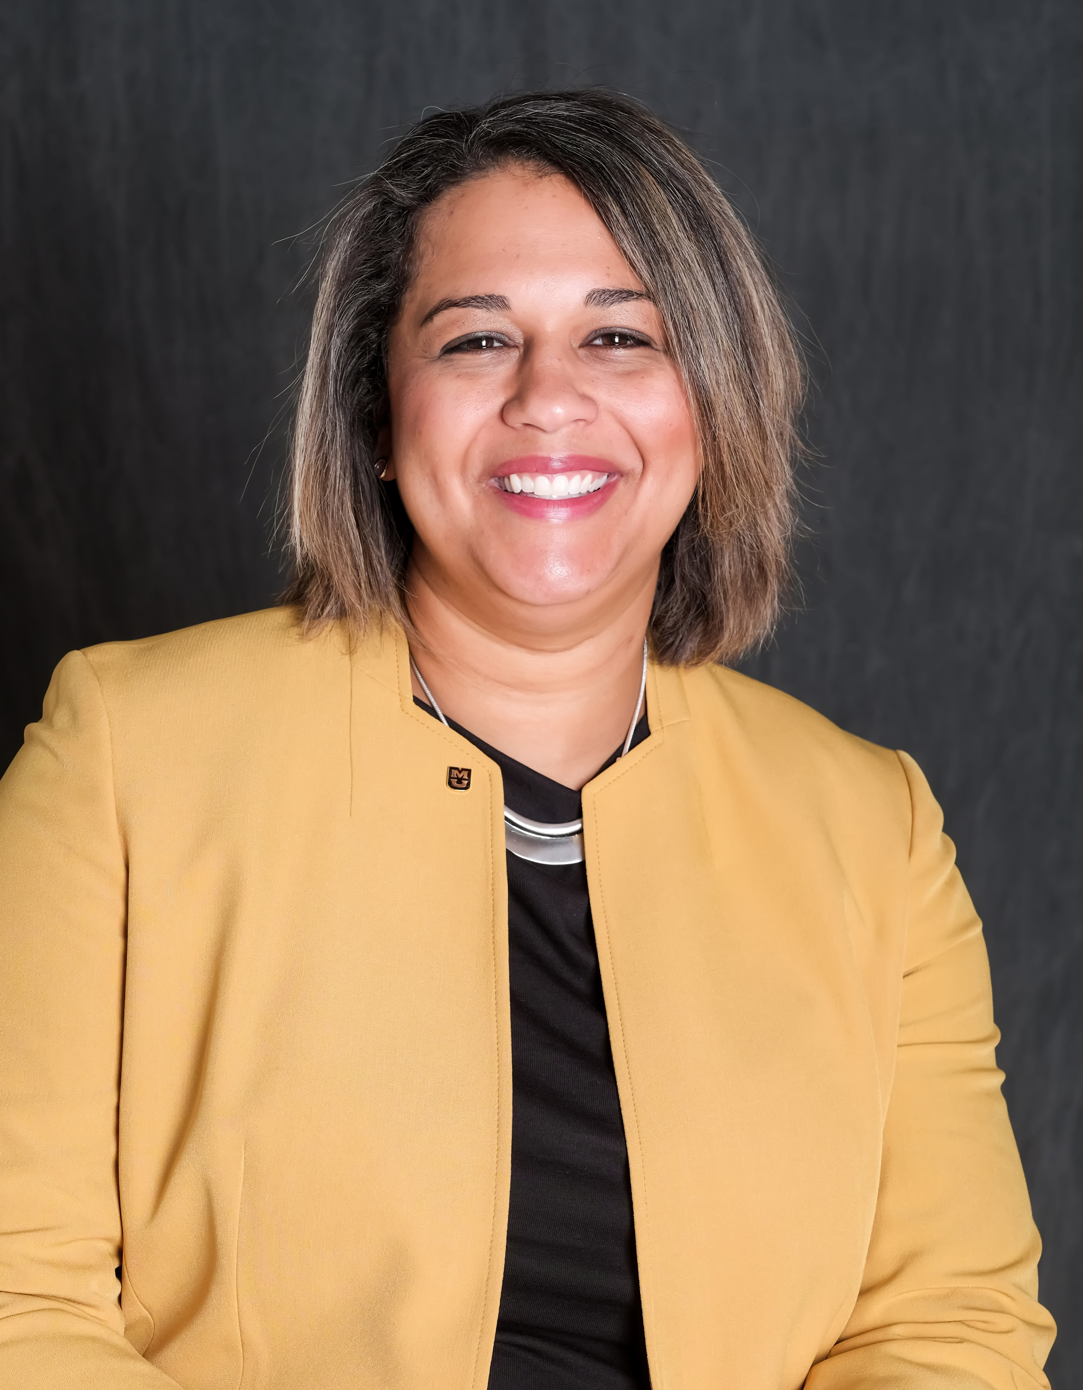
Leadership
Alison Copeland
Deputy Chief
Engagement Officer
for UM System
Engagement​
Sarah Traub
Interim Associate Vice Chancellor for Extension and Engagement
Susan Renoe
Assistant Vice Chancellor for Research, Extension and Engagement
Notes:
The Extension Leadership Team also includes:
Blake Naughton, Associate Vice Chancellor for Extension and Engagement
Susan Reno, Assistant Vice Chancellor for Research, Extension and Engagement

Slide 20



Interim Vice Chancellor for Extension & Engagement
Chad Higgins
Organizational Leadership
Updated January 2023
Interim Associate Vice Chancellor for Extension & Engagement
Sarah Traub
Senior Executive Assistant
Kim Foley
Interim Director of Off-Campus Operations
Jody Squires
Associate Vice Chancellor
for Research, Extension & Engagement
Susan Renoe
Deputy Chief Engagement Officer for UM System Engagement
Alison Copeland
EXTENSION PROGRAM LEADERSHIP
REGIONAL DIRECTORS
ADMINISTRATIVE DIRECTORS
Chief Development Officer
James Preston
Director, Integrated Marketing Communications
Robert Jones
Business & Finance
The Connector
Director
Sara Vassmer
UM ENGAGEMENT
Engagement & Outreach Associate
Ashley Rhode
Statewide Extension & Engagement Specialist
Noah Washburn
East Central Region
Matthew Herring
Northeast Region
Michael Krauch
Northwest Region
Stacey Steffens
Southeast Region
Sarah Denkler
Southwest Region
Sarah Havens
Urban East Region
Jody Squires
Urban West Region
Shatomi Luster-Edward
West Central Region
Wayne Prewitt
Agriculture & Environment Senior Program Director & Associate Dean: Rob Kallenbach
Faculty Leadership
Animal Health & Production Plant Production & Technology Agriculture Business & Policy Natural Resources
Nutrition, Health & Family Senior Program Director: Lisa Washburn
Faculty Leadership
Nutrition, Health & Family
EXTENSION & EDUCATION CENTERS
Graves-Chapple
James Crawford
4-H Youth Development Senior Program Director: Lupita Fabregas
Director
Callie Glascock
Human Resources Associate Director Kim LeCompte
Risk & Volunteer Management Director
Eric Jackson
Equity, Diversity & Inclusion Director
Dwayne James
Director of Partnerships & Council Development
Lorin Fahrmeier
Hundley-Whaley
Jennifer Miller
Wurdack
Gatlin Bunton
Jefferson Farm
Charles Holland
Business & Community Senior Program Director: Rob Russell
Faculty Leadership Business Development Community Development Workforce Development MU Executive Education
Regional Economic Development Local Government & Public Policy
Community & Professional Health Education
Senior Program Director & Associate Dean: Kathleen Quinn
Faculty Leadership
Community Health Engagement & Outreach
Continuing Education for Health Professions
EDUCATION & IMPACT
Director
Sarah Traub
Conferences & Institutes
MU Conference
First Responder Education
Director: John Worden
Community Emergency Mgmt.
Fire & Rescue Training Institute
Law Enforcement Training Institute
Missouri Training Institute
Dewey Thompson
Learning & Teaching Services
Jessica Gordon
Missouri Training Institute
Office
Osher Lifelong
Learning Institute

Slide 21
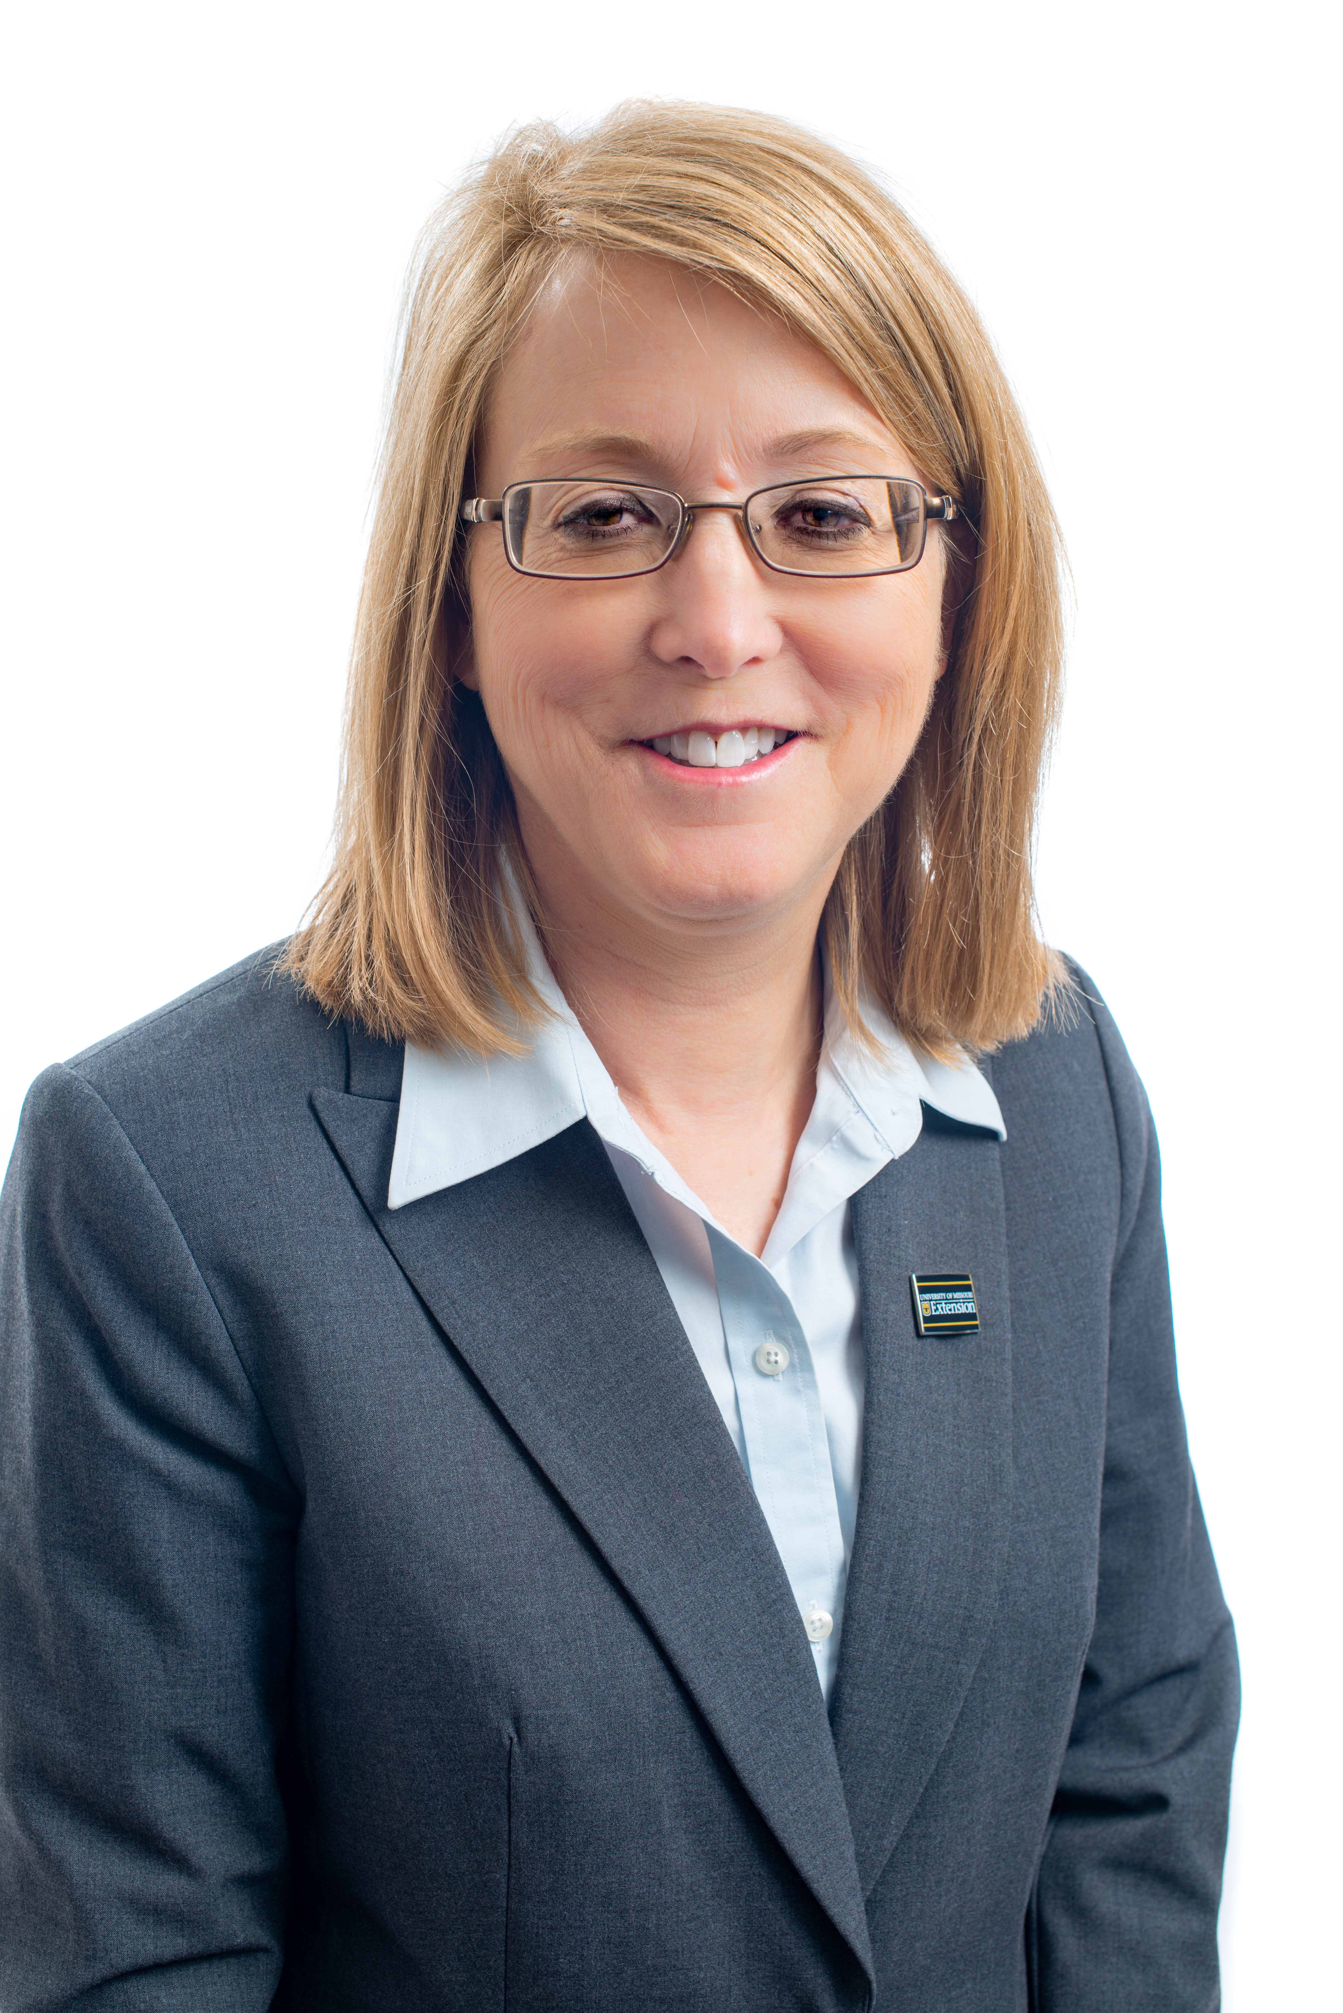
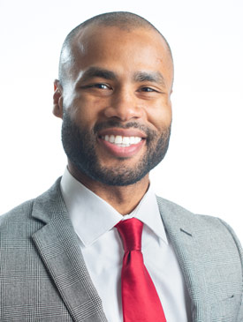
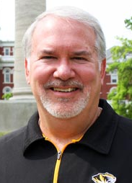
Leadership
Callie Glasscock
Director of Finance and Human Resources
Robert Jones
Director Communication and Marketing
James Preston
Chief Development Officer
Notes:
The Extension Leadership Team also includes:
Blake Naughton, Associate Vice Chancellor for Extension and Engagement
Susan Reno, Assistant Vice Chancellor for Research, Extension and Engagement

Slide 22
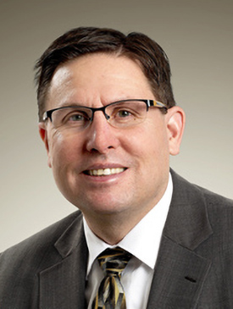
Rob Kallenbach
Interim, Senior Program Director
Agriculture and Environment
Animal Health Production
Plant Health Production
Agriculture and Business Policy
Natural Resources & Environment
Notes:
Business and Communities is led by Steve Devlin, Program Director and Associate Dean. Programming in this area focuses on:
Business Development
Community Development
Workforce Development

Slide 23
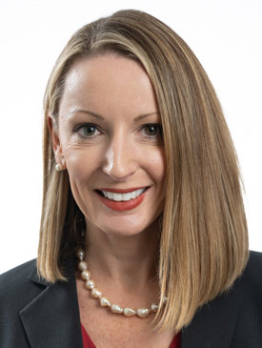
Lisa Washburn
Senior Program Director
Nutrition, Home and Families
Nutrition and Wellness Education
Family and Home Education
Notes:
Business and Communities is led by Steve Devlin, Program Director and Associate Dean. Programming in this area focuses on:
Business Development
Community Development
Workforce Development

Slide 24
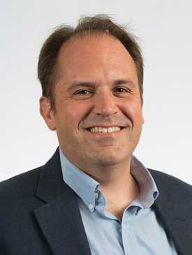
Rob Russell
Interim, Senior Program Director
Businesses and Communities
Business Development
Community Development
Workforce Development
Notes:
Business and Communities is led by Steve Devlin, Program Director and Associate Dean. Programming in this area focuses on:
Business Development
Community Development
Workforce Development

Slide 25
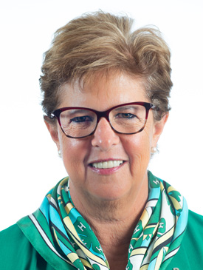
Lupita Febregas Janeiro
Senior Program Director
4-H Center for Youth Development
Youth Development
Volunteer Development
Notes:
Business and Communities is led by Steve Devlin, Program Director and Associate Dean. Programming in this area focuses on:
Business Development
Community Development
Workforce Development

Slide 26
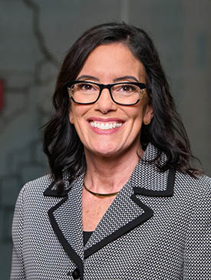
Kathleen Quinn
Senior Program Director, Associate Dean
Health and Safety
Community Health
Continuing Medical Education
Nursing Outreach
Law Enforcement Training
Fire and Rescue Training
EMS Education
Community Emergency Mgmt.
Notes:
Business and Communities is led by Steve Devlin, Program Director and Associate Dean. Programming in this area focuses on:
Business Development
Community Development
Workforce Development

Slide 27
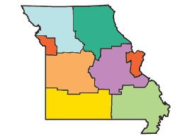
Extension Regions:
Northwest
Northeast
West Central
East Central
Southwest
Southeast
Urban (West and East)
Notes:
Across the state, Extension is divided into seven administrative regions, supervised by Regional Directors.

Slide 28
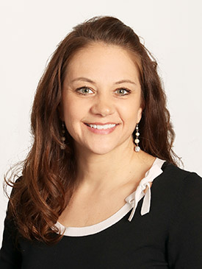
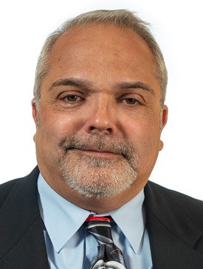
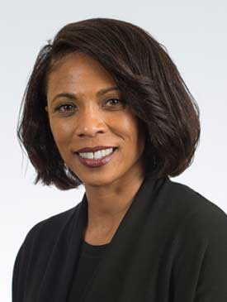
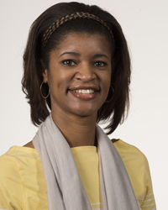
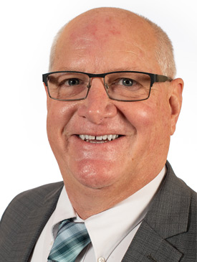
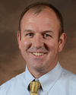
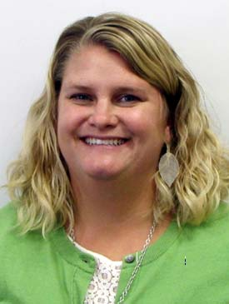
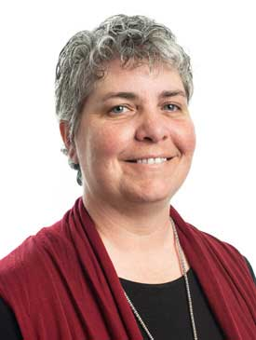
Stacey Steffens
Northwest
Mike Krauch
Northeast
Shatomi Luster-Edward
Urban West
Jody Squires
Urban East
Regional
Directors
Wayne Prewitt
West Central
Matt Herring
East Central
Sarah Havens
Southwest
Sarah Denkler
Southeast
Notes:
Business and Communities is led by Steve Devlin, Program Director and Associate Dean. Programming in this area focuses on:
Business Development
Community Development
Workforce Development

Slide 29
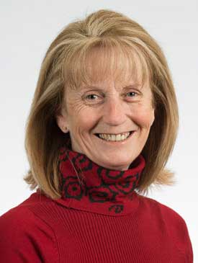
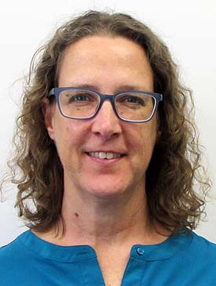
Associate Directors
Food Nutrition and Education Programs (EFNEP)
Teresa Fossett Nancy Keim
Michelle Chapman
Notes:
Note: Choose only the Regional Director slide for your region.
We are in the Southeast Region, and our Regional Director is Sarah Denkler, whose office is at the Delta Center in Portageville.
Regional Directors provide leadership for programming, coordination and evaluation at the county level. Each Regional Director supervises the work of regional Extension specialists.

Slide 30
County Extension Council Members
Identify needs
Secure funds
Ensure access
Notes:
At the core of this structure are County Extension Council members who ensure the system works by:
Identifying local educational needs
Securing funds
And ensuring that the research-based information of the state’s land-grant universities is available to people in their communities.

