Slide 1
Monthly County Invoice Training
October 20, 2021

Slide 2
Today’s Discussion
What is the Net Invoice
How is it generated
Where does it come from and where does it go
How should it be used
Other Resources

Slide 3
Net Invoice
Considers most everything owed to the University
Considers everything owed to the County
Difference is considered net owed to or due from county

Slide 4
Invoice Generation
Settleup will gather PeopleSoft transactions from prior month after month end closing
Settleup will gather 4-H transactions from prior month
Settleup will gather Cvent program transactions, CC info, program fees, etc.
Settleup will gather Nexus transactions
At this time, mileage rates and soil lab fees are not included

Slide 5
Invoice location
The invoice detail will come from MU Extension Portfolio 4
The invoice for the month will show up in your county email box
Questions can be redirected back to MU Extension Portfolio 4 and someone on the team will get it answered for you

Slide 6
Invoice Use
The emailed invoice detail is the back up data that supports either the monies you will receive in the form of a check or electronic deposit or it will support the check that you issue back to the University.
Emailed invoice should be printed off and stapled to the check stub and the mailed monthly bill for bookkeeping records.
Please pay invoice in its’ entirety. Discrepancies can be fixed in next month’s net invoicing.
Can be copied and pasted into Excel for ease of printing

Slide 7
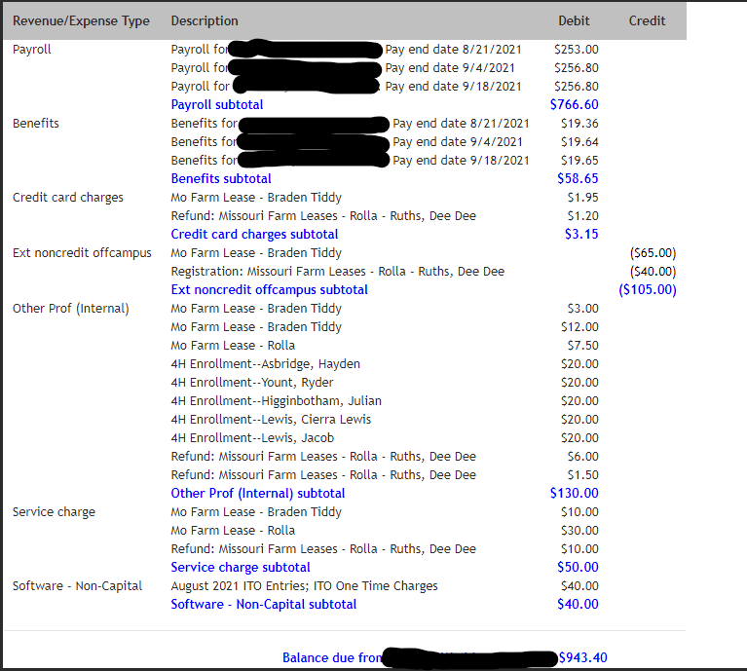

Slide 8
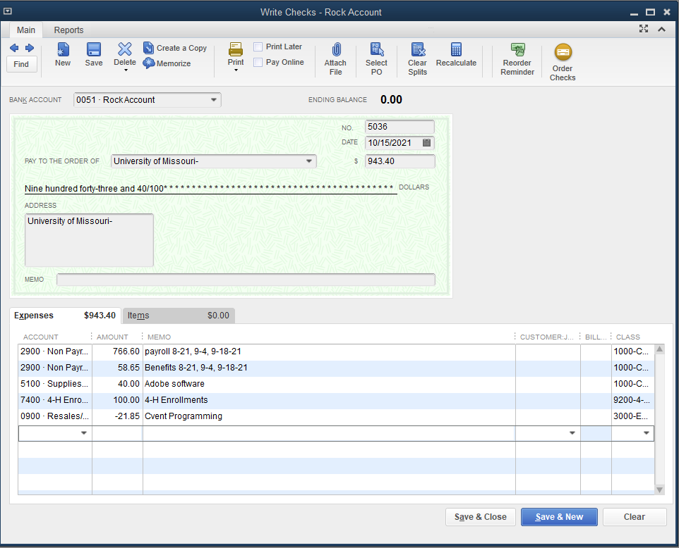

Slide 9
Other Resources
Resources regarding the event submission process, fees and other FAQ’s can be found within the event management pages of the MU Extension Way. Or reference and print the Event Lifecycle and Submission Process for a summary and visual of the process.
Once the organizer has completed the Offline Roster (if applicable) for an event, a summary fiscal report regarding registration, along with a roster of attendees will be posted to the Event Final Roster & Fiscal Reports File.

