Slide 1
Making the Census Count for Missouri
Pam Duitsman
County Engagement/Community Economic Development
Christian County
Notes:
Introduction
Outline:
-Background/facts on Census
-What I have done as CED CES

Slide 2
2020 Census: Getting a complete count
Why should it matter to you?
Distribution of federal resources: ~$800B/year
How congressional seats are decided
Accurate data for strategic decision-making
To apportion to states as directed by Article 1, Section 2 of the US Constitution:
Notes:
The goal for Census 2020 is to have an accurate/comple count – there are multiple reasons which are all compelling for us as CED faculty.
Census data determines how many seats each state has in Congress & guides the distribution of approximately $800B in federal funds each yr for vital programs that impact housing, education, transportation, health care, public safety and more.
Local governments use the data to plan new roads, hospitals & schools, as well as for public safety and emergency management. States use the information to redraw boundaries for legislative districts. Businesses use census data to decide where to build factories, offices & stores – which create jobs. (ED Summit statement)
MO lost a congressional seat and ~$75M for every 1% of the population undercounted

Slide 3
2020 Census: Who is counted?
The census counts all persons who live in the United States on April 1, 2020, regardless of citizenship or immigration status
People are counted at their “usual place of residence” every ten years
College students living away from home: counted at college residence
Incarcerated: at prison/jail facility
Homeless: Service-based Enumeration; Enumeration of Transitory Locations; or where they are staying, however temporary, if there is no other “usual residence”
Notes:
Census is required by the US Constitution every 10 yrs, & counts every resident,
whether adult or child, citizen or noncitizen. At their “usual place of residence” (where they live & sleep most of the time)
College students living away from home will be counted at their college residence
Incarcerated persons at the prison/jail facility
Homeless (1) Service-based Enumeration; (2) Enumeration of Transitory Locations; or (3) at the home where they are staying, however temporary, if there is no other “usual residence”

Slide 4
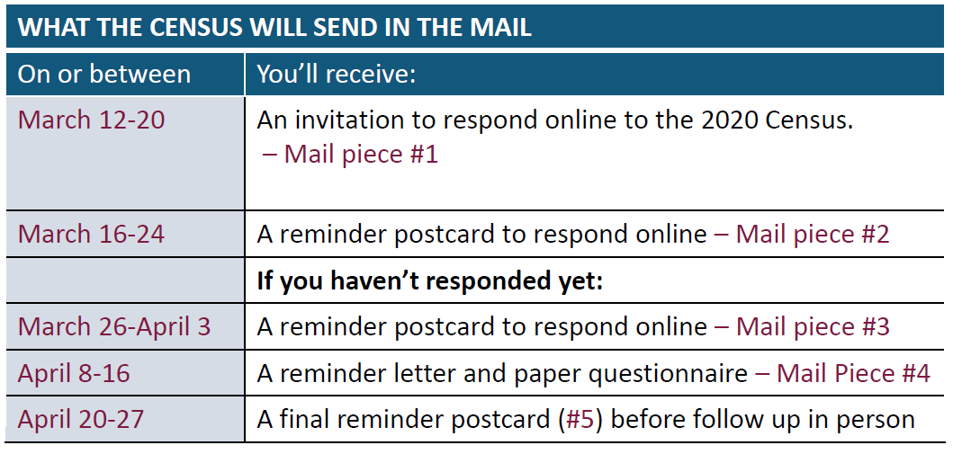
New Challenges
First high-tech census: primarily driving to internet
Notes:
Everyone will be driven to complete the census on-line. While welcomed by many – this presents challenges to getting a complete count. (Discuss reasons/timeline/mailings)
Roughly 20% of MO households lack access to broadband and may face multiple other issues with submitting an online census form.

Slide 5
Challenges to a getting a complete count
Broadband issues
No mailers to PO Boxes
Increase in “under-served” populations
Particular concern re: seniors due to on-line push
Call-in option
Automated
Opportunity for translators
Fewer canvassers and limited outreach
Decreased and delayed funding
Notes:
Challenges also include: fewer canvassers, broadband issues, more underserved populations. There is particular concern about the senior population (which has ↑).
There will be no mailing of any kind to PO Boxes.
Impact of decreased & delayed funding… ex: as of last week, continue work on the design, process & wording for postcard & educational materials.

Slide 6
2020 Census: Impact on Missouri --Lessons from 2010--
Received $16.5B in federal funds in FY2016 from 55 federal programs.
Forfeited $1,272 for every person undercounted in 2010
Lost ~$75M for every 1% undercounted.
Lost a congressional seat as a result of 2010 Census
Notes:
MO received $16.5B in 2016 from the 55 largest federal funds that are based on census data. This funding supports several programs such as Medicaid, SNAP, Medicare Part B, National School Lunch Program, Head Start, Special Education Grants, Section 8 Housing Choice Vouchers, and highway planning and construction.
MO was in the top 7 for states w/biggest impact from undercounting in 2010. For 1% of the population (~60,000) ~$75M federal dollars left on the table
The 2010 Census illustrated that our state’s population was not keeping pace with that of other states. As a result, MO dropped from 9 to 8 congressional seats, and lost a vote in the electoral college that formally elects the president.

Slide 7
Missourians Rely on Federal Dollars
Notes:
This HO breaks down specific funding for Missouri in 2016.
~$6.5B in Medicaid dollars;
$967M for highway planning & construction program – helps state depts of transportation plan, construction, & preserve the Ntl highway system & is used for transportation improvements to federal-aid highways & to bridges on all public roads.
Section 8 housing Choice voucher program ~$240M. Voucher program to assist low-income families, elderly, & disabled to afford decent, safe, sanitary housing in the private market.
$210M for National School Lunch Program
$173M for CHIP – State children’s health insurance program
Programs such as head start, health centers funding, Special Education Grants, WIC, TANF, and many more.
An undercount impacts all of us. Undercounts will impact how communities access education, financial services, housing, and health care they deserve. When services fall short, it puts increased pressure on every community to fill the gaps.

Slide 8
Missouri’s Hard to Count
Low income
Rural
Renters
Multifamily housing
Communities of color
Limited English proficiency
Children under five
Homeless
Older Adults
PO Box Holders
Notes:
~9% of MO population lived in hard-to-count areas for 2010. They will continue to be a challenge. However, an even bigger challenge is that in 2016, 20.7% of households had either no internet subscriptions or dial up only access according to American community survey data; and while Older adults weren’t considered hard to count in 2010; however older adults are at risk for being undercounted this time around with the push to submit forms online.
Children are actually the hardest population to count. In 2010 ~1M children <5y didn’t show up in the survey.
PO Box Holders

Slide 9
2020 Census Timeline
2019 Highlights
Spring 2019: Hiring of in-field address canvassers
Fall 2019: Hiring of enumerators
2020 Highlights
January: Launch national advertising campaign
March 16 – April 30: Self-response phase (internet, phone)
April 1: CENSUS DAY!
May 13 – July: Nonresponse Follow-up (canvassing)
By December 31st: Census Bureau transmits state information to President
Notes:
The national advertising campaign will launch in January, but will be abbreviated due to high cost of ads (direct competition with a presidential election, whose primary season will overlap with much of the count, as well as local and state elections). Paid media will be more expensive than usual.
Census day is April 1, but self-response will begin in mid-March.

Slide 10
My Census Work
County Commission expressed concern
I attended a training
September 16, 2019: Held County-wide Forum
Formed a Complete Count Committee
US Census bureau provides free training, resources, materials, and support.
Updates by e-mail and in-person meetings
October 10: Held CCC Training
Broad participation across county
Subcommittees meeting bi-weekly to monthly
Visible
Funding
Notes:
County Commission shared concerns (May 2019)
Attended presentation July ‘19 & also became concerned. Coordinating Christian County involvement seemed like a good role for a CES.
Planned county-wide forum to educate on the importance:
40 min educational presentation; 20 min Panel of Commissioners/Mayors/ leaders from every municipality: signed a resolution; 1 hour Breakouts w/?’s:
Who are the hard to reach populations in Christian County?
Who can reach them? Who do they trust? Who do they listen to?
What common methods can we use to reach them?
What are the hurdles (why wouldn’t someone fill it out?)
Formation of a Complete Count Committee/CCC Training/Committee work

Slide 11
Resources
Missouri Foundation for Health 2020 Fact Sheet- https://mffh.org/wp-content/uploads/2019/01/2020-Census-Fact-sheet.pdf
censuscounts.org
Southwest Missouri Council of Governments – Complete Count Committee - https://www.smcog.org/census
Census Bureau – 2020 Census - census.gov
Counting for Dollars – GW Institute of Public Policy- https://gwipp.gwu.edu/sites/g/files/zaxdzs2181/f/downloads/IPP-1819-3%20CountingforDollars_MO.pdf
Hard To Count Maps - https://www.censushardtocountmaps2020.us/

