Slide 1
On-Farm Response Tests for P & K
Peter Scharf
University of Missouri Plant Sciences

Slide 2
Q: What is the main tool we use to make P & K decisions?
A: Soil testing

Slide 3
Q: What does a soil test tell you?
A: Probability of yield response to P or K

Slide 4
Q: Why not just measure yield response to P and K, and skip the soil test?
A: Great idea! We have the tools.

Slide 5
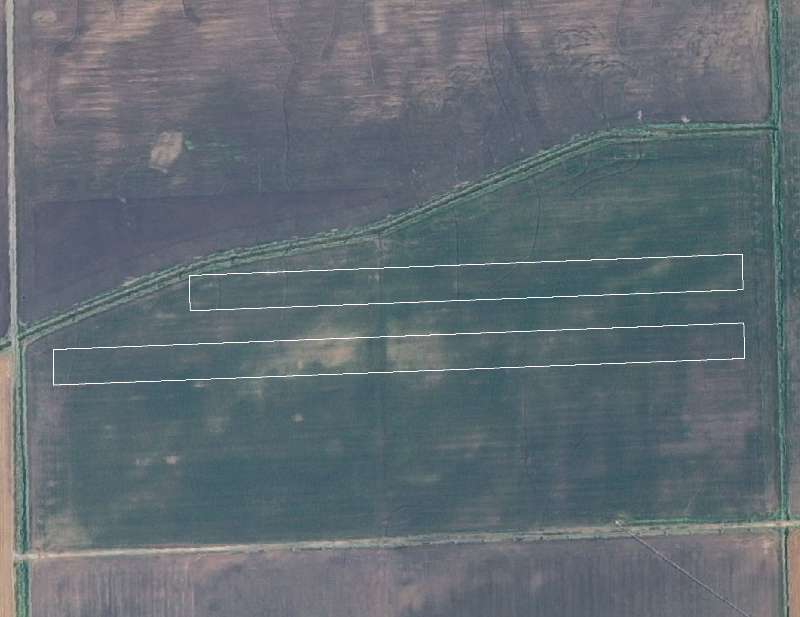
The concept: 0 PK strips…
2 strips with no P or K applied
The rest of the field got variable-rate P & K based on grid soil samples

Slide 6
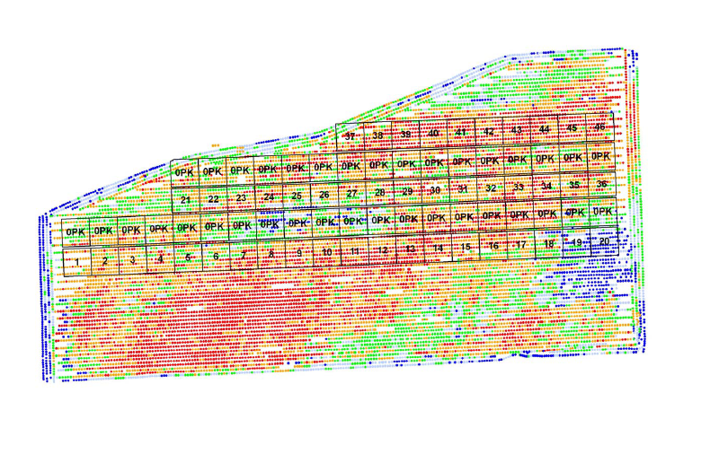
…plus yield maps
Minus yield without P & K
Yield response = yield with P & K

Slide 7
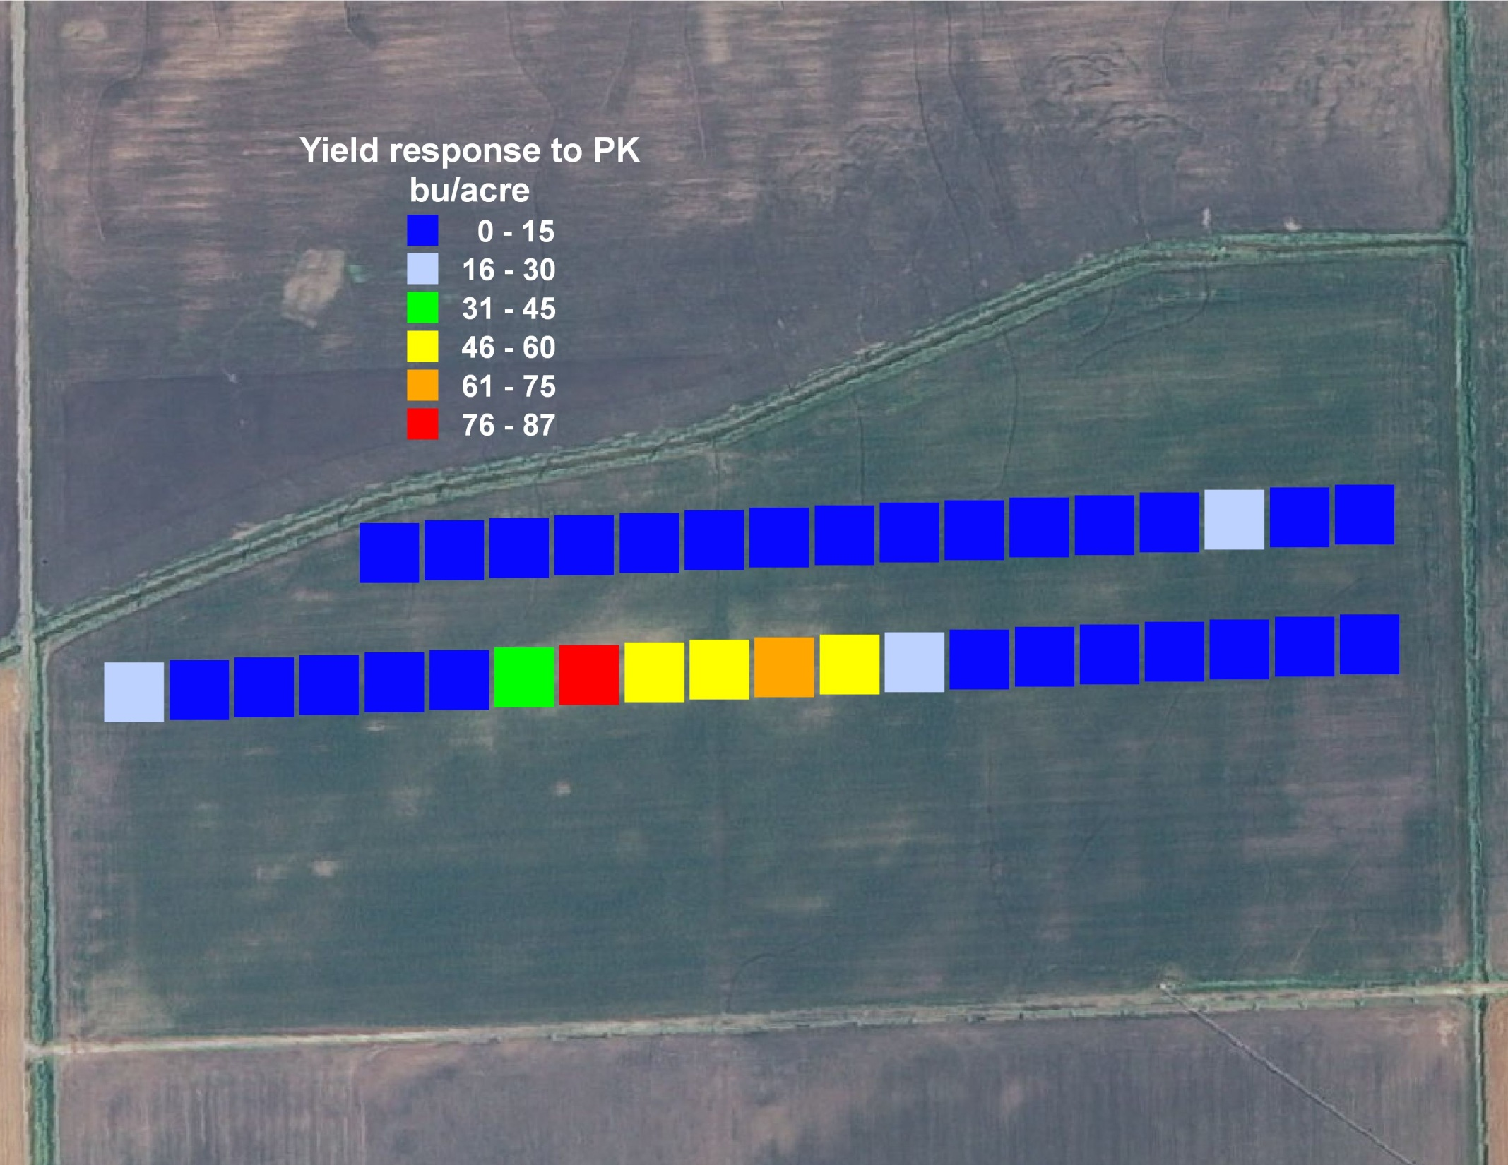
Outcome: low yield response, spatially clustered
3.4 bu/acre average yield response to P & K
$20/acre benefit
$63/acre spent on P & K + $8/acre app cost
-$50/acre return to P & K

Slide 8
Is yield response predicted by soil test?
Not by soil test P!
Not by soil test K either

Slide 9
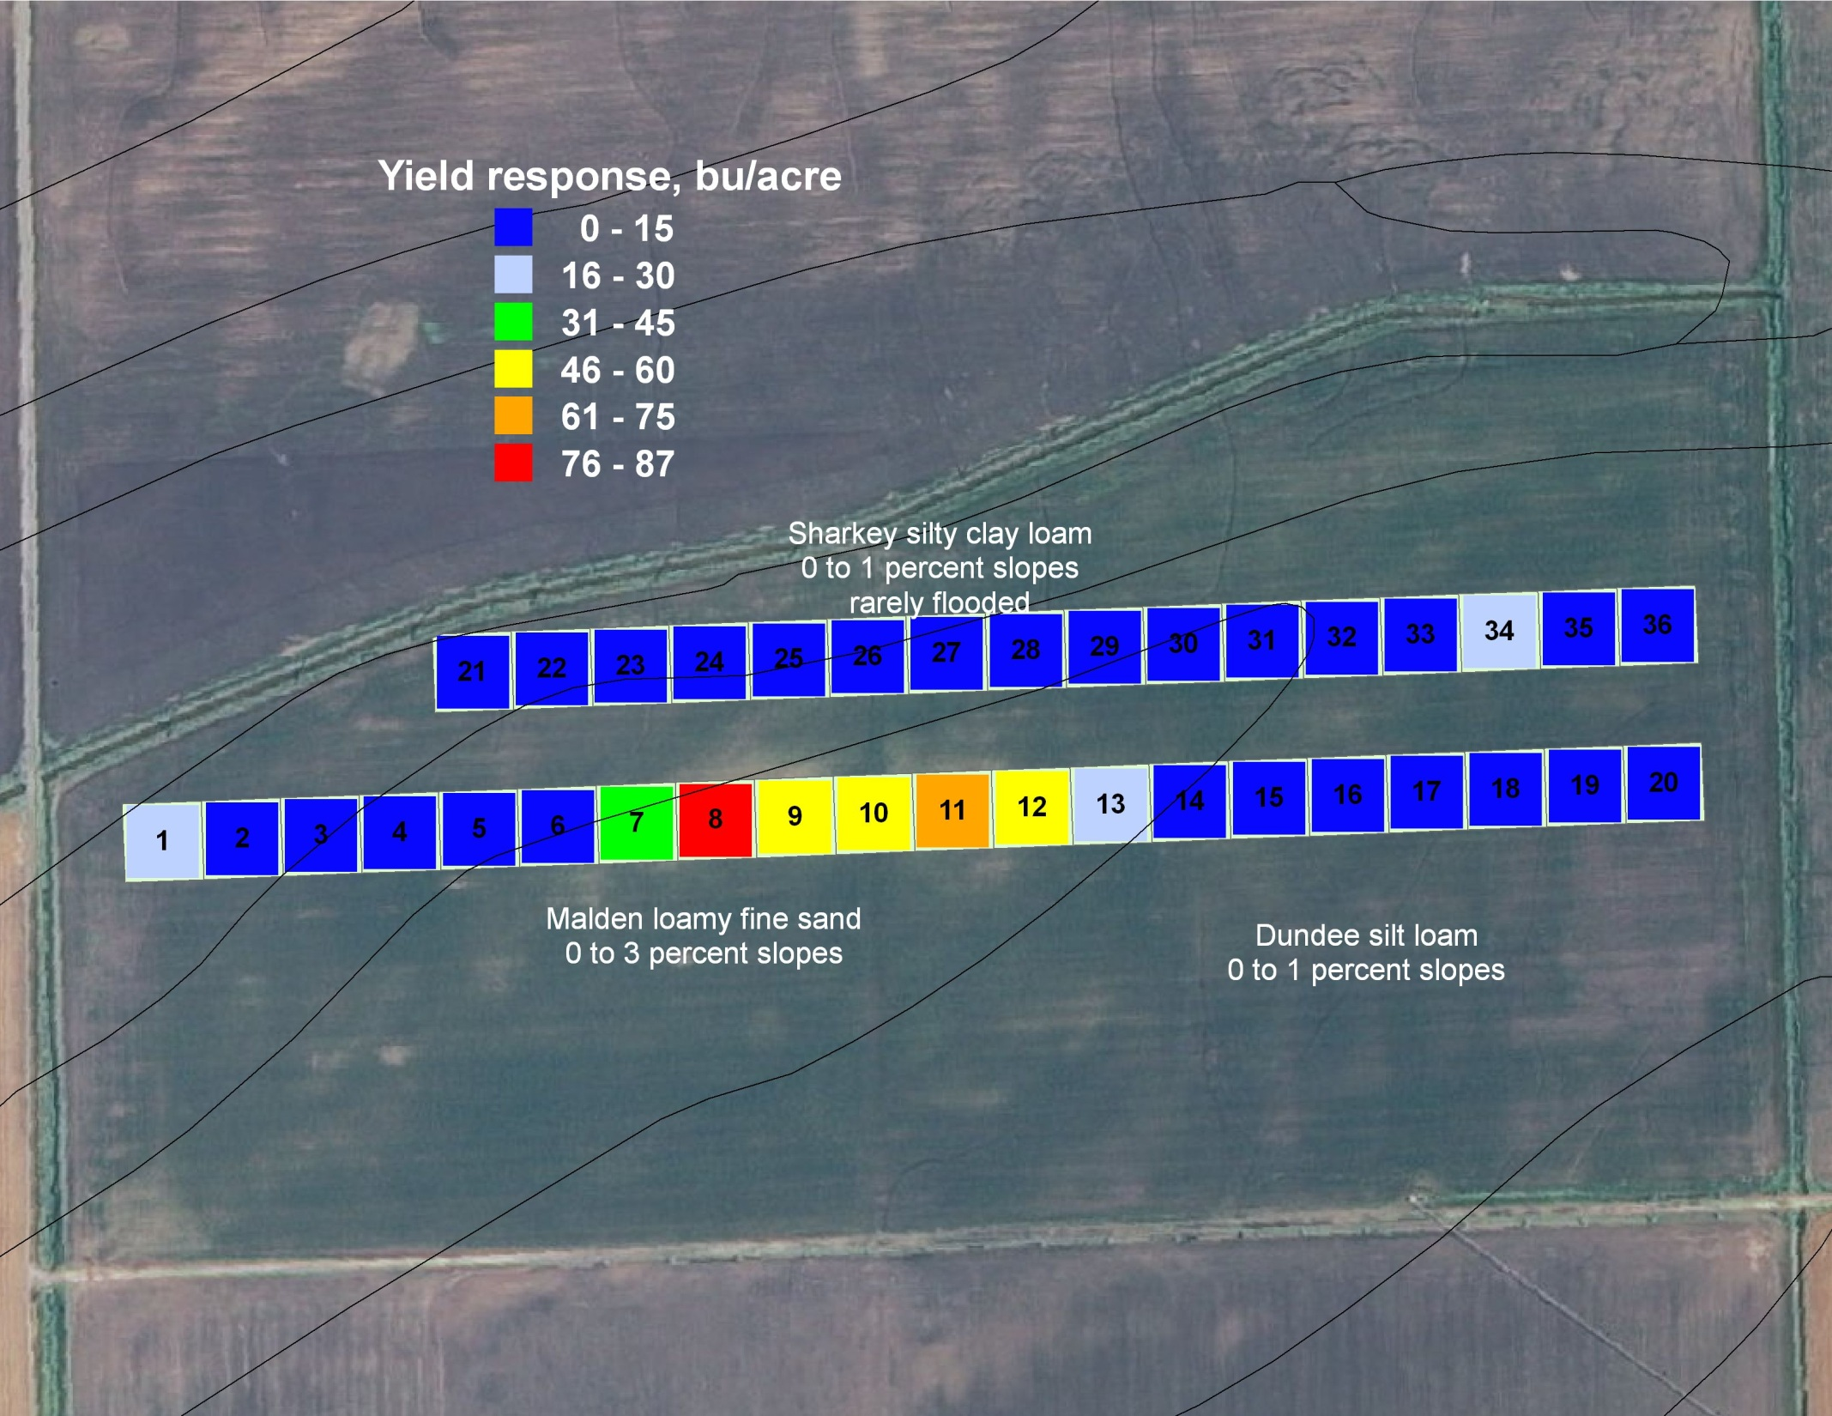
Yield response appears to be strongly related to soil map unit!

Slide 10
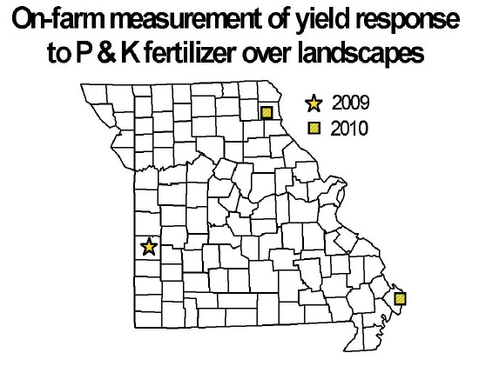

Slide 11
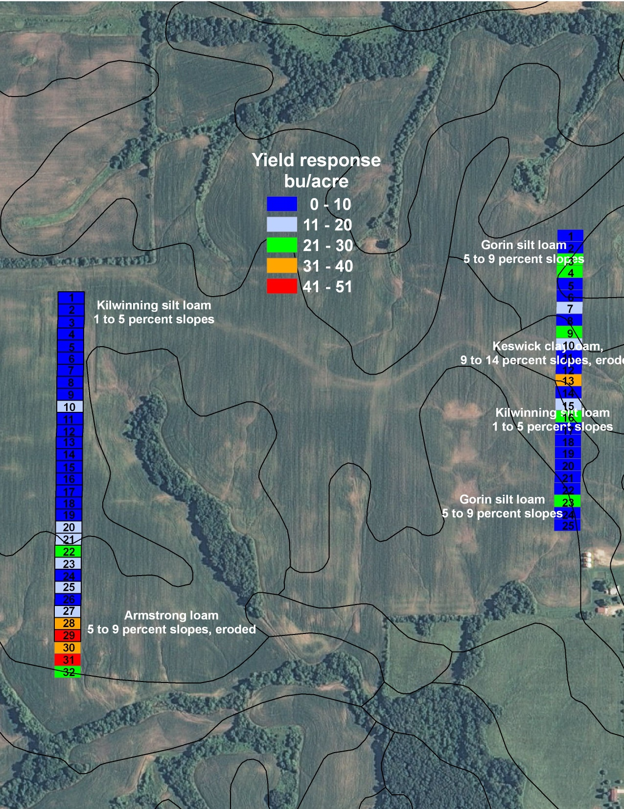
7.5 bu/ac average yield response
But average soil test P was only 6 ppm!
Applied 25-120-100, spent $134/ac, made $45 back
Net return = -$89 per acre
Soil map unit again appeared to be related to yield response

Slide 12
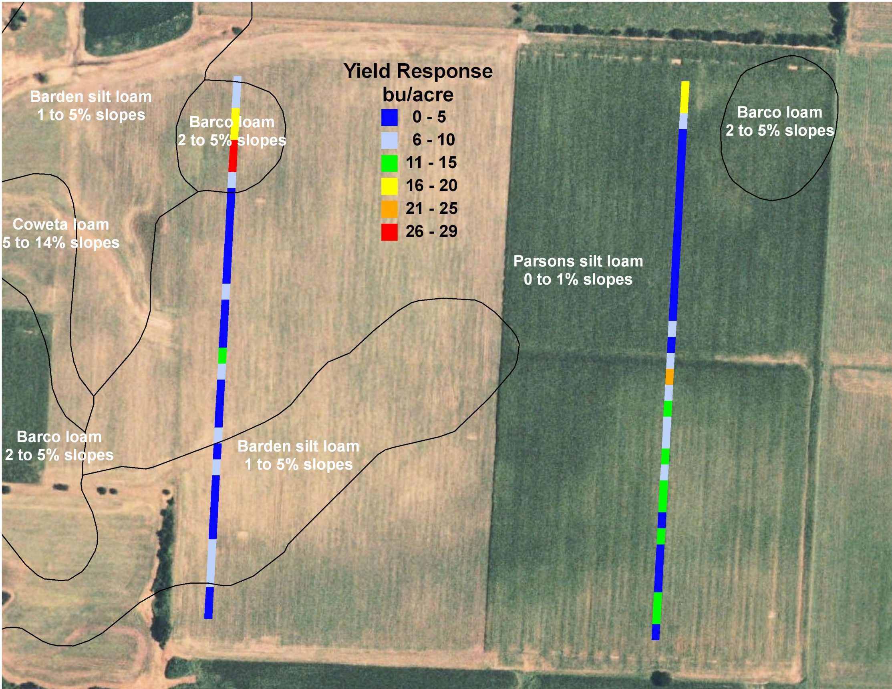
Spent $90/ac on P & K (23-60-79 average rate + variable-rate application)
6 bushel/acre average yield response
-$53/acre net
Soil map unit again related to yield response!

Slide 13
P & K strip trials: Summary
Return to P & K was strongly negative in all 3 fields
Soil test values
No predictive ability in 2 fields
Weak predictive ability in 3rd field (lowest testing)
Made $ on PK only in certain map units: all 3 fields

Slide 14
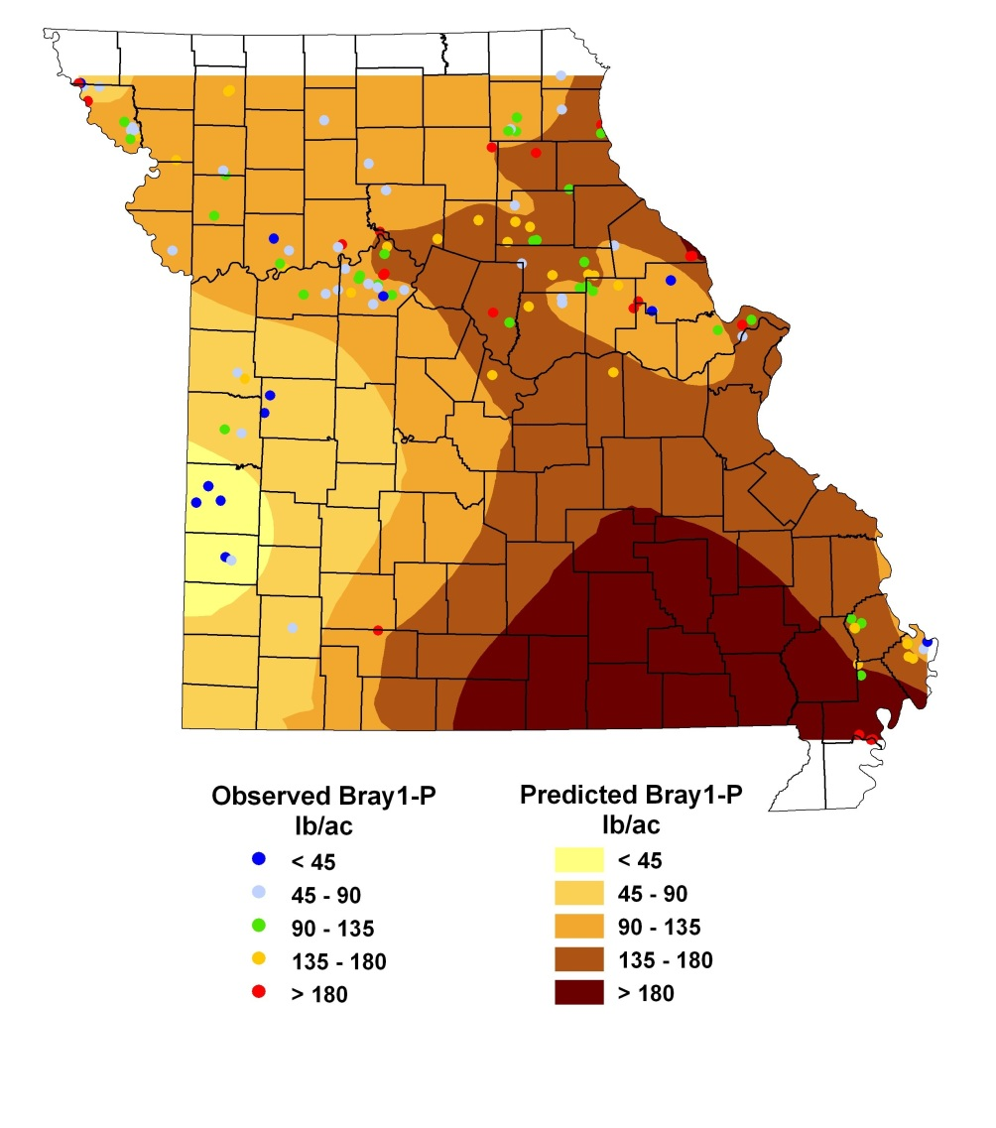
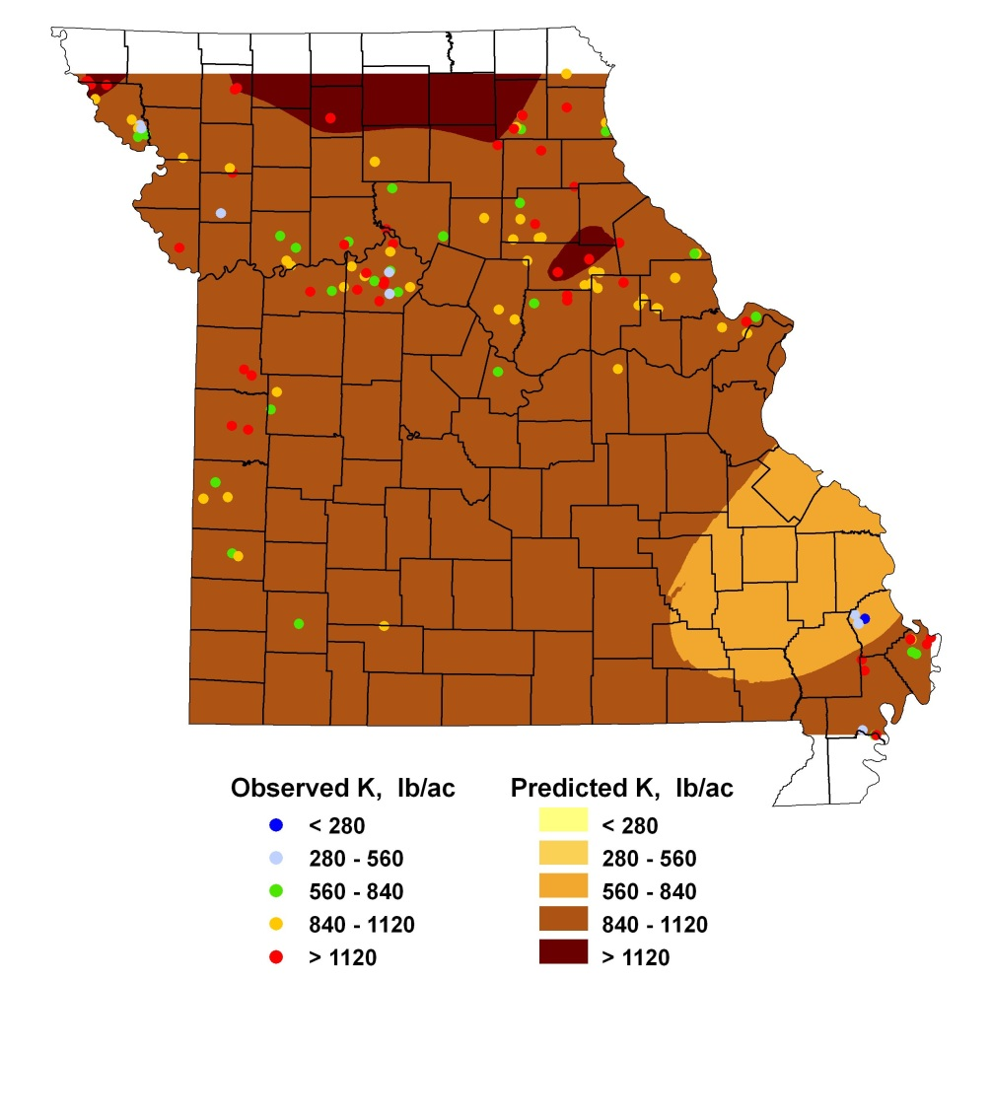
Why low yield response to P & K?
Maybe subsoil P & K?
Subsoil Bray-1 P 6-36”
Subsoil K 6-36”
>4x
2-3x
3-4x
3-4x
1-2x
<1x
2-3x
>4x

Slide 15
How to make $ with this approach
Try strips with 0 P & K
If yield loss is small or zero, switch to only applying P & K on one or two strips
Apply same strips every year
Carefully monitor yield response to P & K
When an economical yield response is seen, go back to replacement applications
Maybe double application the first year
Start replacement applications on responsive soil map units first
Savings are temporary—withdrawing from the soil ‘bank’
But if economical yield response is not seen for 5-10 years, the saved capital can be put into something more profitable
Example: 1000 acres, 7 years, $80/ac/yr = $560,000

Slide 16
Thanks for your attention!
Questions?

Slide 17
Sources of uncertainty
Soil test
In-field response test
Availability of nutrients below sample depth
Calibration on different soil than yours
Vagueness of translation from research to recommendation
Effect of weather on yield response

